Slide 1


ANALYSIS OF THE ELECTRICITY SPOT MARKET IN ITALY
17th December 2024
Nonparametric Statistics
MSc. Mathematical Engineering
Mattia Gastoldi, 10794648

Slide 2


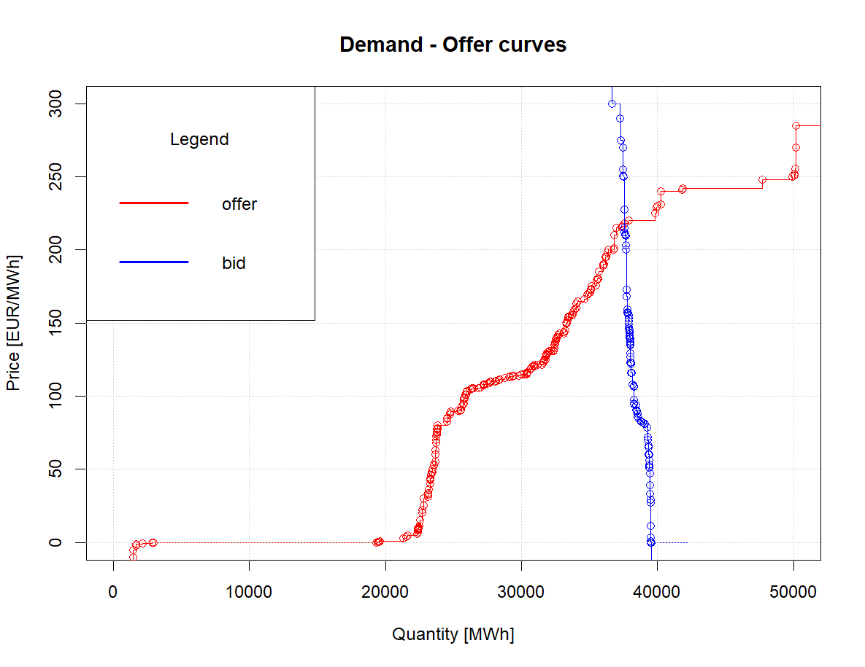





ABOUT THE DATA
Dataset:
Offer – Demand Dataset provided by Dr. Guillaume Koechlin* The data have been collected by Gestore dei Mercati Energetici (GME)
Time Period: 2007 - 2024
Data Features:
Day
Quantity [MWh]
Hour
we obtain a subdataset
Price [€/MWh]
Fixing
Zone
Type ∈ {OFF, BID}
* PhD candidate in Data Analytics and Decision Science, Dept. of Mathematics - MOX Lab, Politecnico di Milano

Slide 3
THE GOALS
ANALYSIS OF THE ENVIROMENT: - Identify trends and tendency in the Electricity Market - Identify which factors can be significant in determining the final price.
PREDICTION: - Predict both curves of Suppy and Demand for the next day, given the observed curves in the previous time instants.

Slide 4
EXPECTED WORKFLOW
DATA PREPARATION
Data Processing
Quick Data Exploration
Time-Series Regression
Suppy-Demand Curves Smoothing
Functional Data Exploration
NONPARAMETRIC REGRESSION
FUNCTIONAL INFERENCE
Functional Inference on Time-Series Functions
Functional Inference on Supply-Demand functional representative curves
FUNCTIONAL
PREDICTION
Auto Regressive Functional Model

Slide 5
EXPECTED WORKFLOW
DATA PREPARATION
NONPARAMETRIC REGRESSION
Data Processing
Period of interest: 2023-2024
Zones of interest: All together
Data Exploration
Exploration using summary variables
Detect missing observations
Set a specific time slot
Kernel density estimation on a subset of curves
FUNCTIONAL INFERENCE
FUNCTIONAL
PREDICTION

Slide 6
EXPECTED WORKFLOW
DATA PREPARATION
Time-Series Regression
Fourier Basis smoothing with roughtness penalty and equispaced knots
Suppy-Demand Curves Smoothing
Smoothing with Basis Expansion
Local Avereges
Local Polynomials
Functional Data Exploration
Exploration on the functional representative of the supply- demend curves
NONPARAMETRIC REGRESSION
FUNCTIONAL INFERENCE
FUNCTIONAL
PREDICTION

Slide 7
EXPECTED WORKFLOW
DATA PREPARATION
NONPARAMETRIC REGRESSION
Functional Inference on Time-Series Functions
Local inference on the time-series smoothed functional representative in different embedded spaces
The aim is to detect trends on a yearly scale
Functional Inference on Supply-Demand functional representative curves
Local inferece on the the supply-demand smoothed functional representative
The aim is to detect trends on a daily scale
FUNCTIONAL INFERENCE
FUNCTIONAL
PREDICTION

Slide 8
EXPECTED WORKFLOW
DATA PREPARATION
NONPARAMETRIC REGRESSION
Auto Regressive Functional Model
Implement an autoregressive functional model to predict the unobserved supply and demand curve for the next day, hence predict the new equilibrium price at which the energy is exchanges
This part might require to consider proper methods to treat missing functional observation.
IDEA: AR(1) and Adjustment (?)
FUNCTIONAL INFERENCE
FUNCTIONAL
PREDICTION

