Slide 1



WeatherWise – by WeatherWise team
A simple, but effective microservice weather web app.
course
author
academic year
Cloud Computing
The WeatherWise team
2023/24

Slide 2


Introduciton
Introduction
WeatherWise is …
simplicity! all in one app! by users, for users! your weather app!
WeatherWise – by the WeatherWise team
on report: 3 to 3

Slide 3
Introduciton
Functionality & implementation details
WeatherWise – by the WeatherWise team
on report: 3 to 3

Slide 4
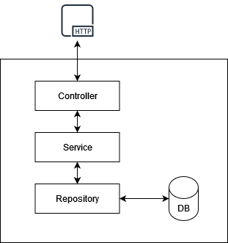
Technologies, languages and tools
Microservices
The idea, compared to monolithic applications, is to divide the application into a series of smaller and interconnected services, autonomous and independently distributed software components (independent units of deploy).
At runtime, each instance of a microservice is associated with a container or a cloud VM
Note.
Microservices architecture addresses the problem of complexity;
It allows each service to be developed independently by a team focused on it.
Some principles:
Low coupling and high cohesion;
Asynchronous is better than synchronous;
Choreography is better than orchestration;
Single Responsibility Principle.
WeatherWise – by the WeatherWise team
on report: 3 to 3

Slide 5













Technologies, languages and tools
Programming Languages, Frameworks and API
BACK-END
Spring;
Spring-cloud;
Java;
JPA;
Hibernate;
Spring Data JPA;
Javax Validation;
Lombok.
FRONT-END
HTML;
CSS;
Javascript;
Bootstrap;
React;
Axios.
DATABASES
SQL;
MySQL;
PostgreSQL.
WeatherWise – by the WeatherWise team
on report: 3 to 3

Slide 6
Technologies, languages and tools
API and API Rest interface
APIs (Application Programming Interface) are a set of definitions and protocols by which application software is built and integrated. A REST API, on the other hand, is a programming interface that uses HTTP to handle remote data.
In particular:
REST stands for Representational State Transfer and it's an architectural style for distributed systems. It's, therefore, an abstraction, a design pattern, a way of discussing architecture without worrying about its implementation.
HTTP, acronym for "Hypertext Transfer Protocol," is a communication protocol used for data transmission over the Internet. It's one of the fundamental protocols that enables clients (like web browsers) to request web resources from servers and receive them reliably.
WeatherWise – by the WeatherWise team
on report: 3 to 3

Slide 7
Technologies, languages and tools
API and API Rest interface
Microservices 1 – Weather Consulting
Base path: /meteo
Path | Method | Description
/{cityName}/{number} | GET | Ritorna il meteo della città a {number} giorni dall’odierno, fornendo, inoltre, indicazioni relative ad umidità e temperatura.
Microservices 2 – City consultation
Base path: /cities
Path | Method | Description
/{prefixCityName} | GET | Ritorna 5 città che iniziano con un dato prefisso.
WeatherWise – by the WeatherWise team
on report: 3 to 3

Slide 8
Technologies, languages and tools
API and API Rest interface
Microservices 3 – Feebacks
Base path: /feedbacks
Path | Method | Description
/{cityName} | GET | Ritorna una probabilità riguardo alla correttezza del meteo sulla base dei feedbacks forniti negli ultimi 7 giorni.
/ | POST | Aggiunge un feedback sull’effettività della previsione meteo della città fornendo la città ed il valore binario.
/{cityName}/{progressiveID} | PUT | Modifica uno specifico feedback, invertendone il {binaryValue}. Questa funzionalità è applicabile entro un’ora dalla POST.
/{cityName} | DELETE | Elmina uno specifico feedback. Questa funzionalità è applicabile entro un’ora dalla POST.
WeatherWise – by the WeatherWise team
on report: 3 to 3

Slide 9
Technologies, languages and tools
API and API Rest interface
Microservices 4 – Places
Base path: /places
Path | Method | Description
/getAll/{cityName} | GET | Ritorna tutti i luoghi di interesse di una data città
/ | POST | Aggiunge un “luogo di interesse” per una città fornendo il nome della città, il nome del luogo, il nome dell’utente che lo consiglia, una valutazione ed una breve descrizione.
WeatherWise – by the WeatherWise team
on report: 3 to 3

Slide 10
Some microservices patterns
Microservices pattern
API-Gateway – A microservice Pattern
Service Registry – A microservice Pattern
The API Gateway pattern is a common pattern in the realm of microservices, often used to manage client requests to a distributed architecture of microservices. In this pattern, an API Gateway serves as a unified entry point for all client requests. But what are the key points?
Request aggregation;
Request routing;
Load balancing and failover.
The "Service Registry Pattern" is an pattern widely used in the realm of microservices. This pattern is employed to enable distributed services to dynamically discover and communicate with each other in a scalable and highly distributed environment.
A service registry is a central component that keeps track of available services in the network;
Other services wishing to communicate with a registered service can query the Service Registry to obtain the contact information of the target service.
WeatherWise – by the WeatherWise team
on report: 3 to 3

Slide 11
Some microservices patterns
Microservices patterns
Circuit breaker – A microservice Pattern
Config server – A microservice Pattern
The "circuit breaker pattern" is a pattern that aims to improve the resilience and stability of the system. It is applied to manage calls between services, especially when there are external dependencies such as third-party APIs, databases, or other microservices. The pattern is implemented through three main states:
Open;
Closed;
Half-open
The "config server pattern" is a pattern that allows for efficient and scalable management of configuration for distributed applications. In general, this pattern involves the use of a dedicated service called the "config server" that manages and provides configuration for different instances of microservices within the architecture.A service registry is a central component that keeps track of available services in the network;
Other services wishing to communicate with a registered service can query the Service Registry to obtain the contact information of the target service.
WeatherWise – by the WeatherWise team
on report: 3 to 3

Slide 12
Some external APIs
External APIs
Circuit breaker – A microservice Pattern
?????????????????????????
WeatherWise – by the WeatherWise team
on report: 3 to 3

Slide 13
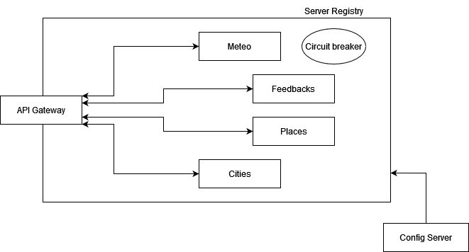
Organization of the application
The architecture of PlaDat
WeatherWise – by the WeatherWise team
on report: 3 to 3

Slide 14
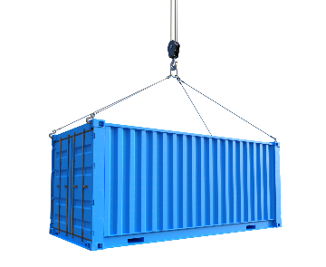
A Cloud-Native Application
Containers
Containers provide an additional layer of abstraction and automation of operating system-level virtualization on Linux. The goal is to provide a consistent packaging and execution of software.
Containers and virtual machines have similar advantages in resource isolation and allocation, but they operate differently because containers virtualize the operating system rather than the hardware. Containers are more portable and efficient.
Within a container, all necessary executables, binary code, libraries, and configuration files should be present to run the application. However, multiple containers can run on the same machine, sharing the operating system kernel with other containers, each of them running as isolated processes in user space.
Benefits for WeatherWise
Each microservice is associated with a container in WeatherWise. This allows:
Portability;
Scalability;
Resource Management;
Agility in Development and Deployment;
Security;
Version Management.
WeatherWise – by the WeatherWise team
on report: 3 to 3

Slide 15

A Cloud-Native Application
Kubernates
Kubernetes (K8s) is an open-source system, managed by the Cloud Native Computing Foundation, for automating the deployment, scaling, and management of containerized applications across multiple machines (called nodes).
Kubernetes makes global decisions about the cluster and detects and responds to cluster and application events. The control plane constantly monitors the cluster's state and reconciles differences between the current state and the desired state in response to events. K8s performs a number of tasks automatically, such as starting or restarting containers (or pods).
Benefits for WeatherWise
Why do we use Kubernates?
Container Orchestration;
Scalability;
High Availability;
Resource Efficiency;
Extensibility.
WeatherWise – by the WeatherWise team
on report: 3 to 3

Slide 16
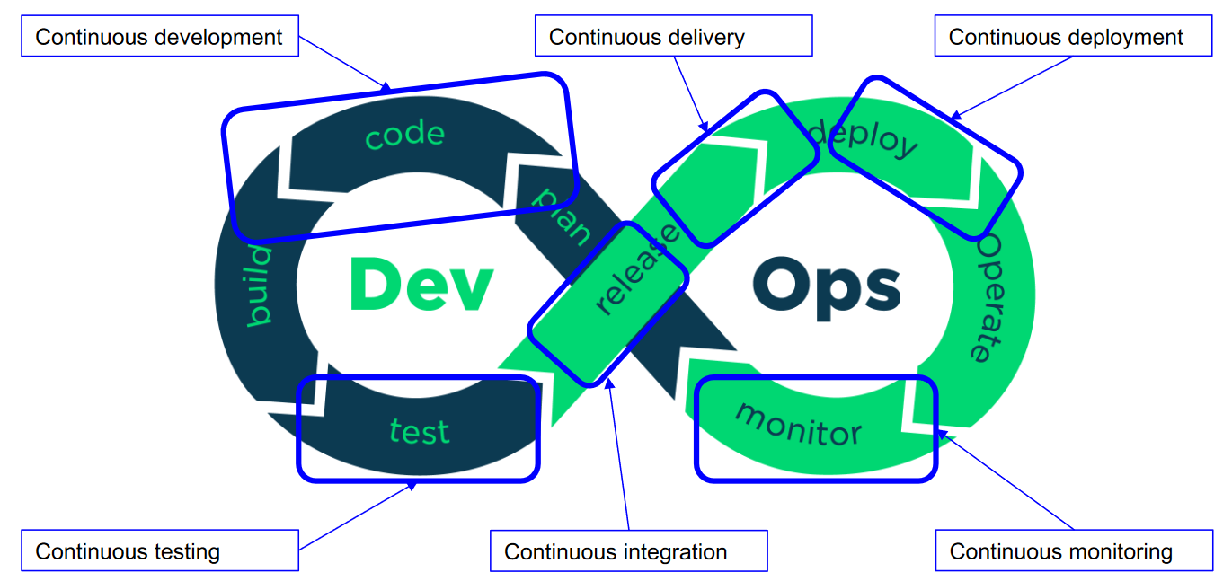
A Cloud-Native Application
The DevOps Culture
The term "DevOps" doesn't have a truly concrete definition. It's a philosophy, a way of working, and means different things to different people. It's a software development method, a technology management approach that emphasizes communication, collaboration, integration, automation, and measurement of cooperation between software developers (dev) and operational staff (ops) in order to create and deliver software applications to their users.
Principles:
Customer-centric action.
End-to-end responsibility.
Continuous improvement.
Automate everything.
Work as one team.
Monitor and test everything.
DevOps has its lifecycle:
WeatherWise – by the WeatherWise team
on report: 3 to 3

Slide 17

A Cloud-Native Application
Our pipeline
???????????
WeatherWise – by the WeatherWise team
on report: 3 to 3

Slide 18
Other information
Other information
README, License, Authors e .gitignore
Released version
To conclude with the analysis present in this report, we would like to highlight the task of four files present in the project folder and which have, despite often being underestimated, great importance: README, License, Authors, and .gitignore.
README is a file that contains information about the files contained in an archive or directory and is commonly included in software packages;
License is a file that contains the full text of the license chosen for the project without any modifications;
Authors is a file that identifies who worked on a particular project which critical for copyright management;
.gitignore is a file in the git system that contains a set of items to be ignored by the version control system.
In software development, version corresponds to a certain state in the development of a software. Conventions for numbering a software version normally involve a triplet of numbers in the form X.Y.Z, where X, Y, and Z:
X is the major version: which should increase only as a result of radical changes in the product, such as those that make it in some way incompatible with its earlier versions;
Y is the minor version: which increases with the introduction of small features to complement existing ones, but maintaining substantial compatibility;
Z is the patch version: which augments usually only by correcting errors with the same functionality.
We release the first version of WeatherWise (v1.0.0).
WeatherWise – by the WeatherWise team
on report: 3 to 3

Slide 19

Other information
LICENSE
GPL-3.0 license
Benefits for WeatherWise
The GNU General Public License version 3.0 (GPL-3.0) is a software license developed by the Free Software Foundation (FSF). It is designed to ensure the freedom of users to run, modify and share software.
We summarize the key features of GPL licenses:
Each program with its own source
Each program must be accompanied by a copy of the licensed
No constraints until you distribute
If you make it publicly available, you also need the source
As long as the source is there, it can also be sold
No linking from closed applications
Why did we choose it?
To preserve freedom. We want our software to remain open and free; GPL-3.0 is an excellent choice. It protects users' freedom and helps preserve the sharing and collaboration approach.
Open development community. GPL-3.0 is often associated with open source development projects and communities that promote collaboration. By using this license, you can take advantage of the support and contributions of a large community of developers.
WeatherWise – by the WeatherWise team
on report: 3 to 3

Slide 20
Thanks
The WeatherWise team
Mattia Piazzalunga, Nicolò Urbani, Matteo Severgnini e Davide Soldati
author
course
academic year
WeatherWise team
Cloud Computing
2023/24

