Slide 1
QuERA challenge

Slide 2
Syntesis
The 1-qubit paradox

Slide 3
Synthesis of rotations
The need for non-Clifford gates
Gottesman-Knill Theorem
T gates allows to generate a dense subgroup of SU(2)
We NEED magic states

Slide 4
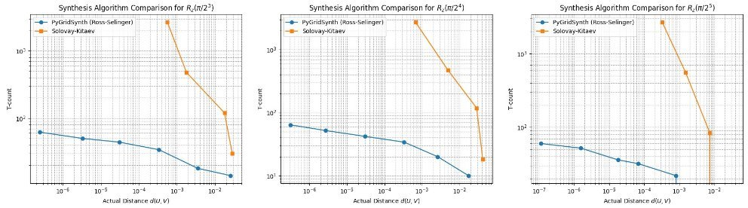
Synthesis of rotations

Slide 5
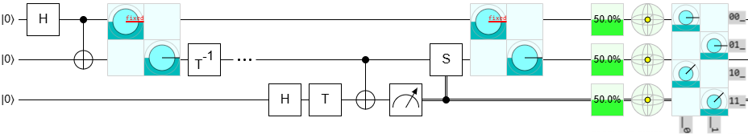
The need for fault-tolerance
Not each possible gate can be transversal in a quantum code
Quantum Gate Teleportation
Increasing overhead requires ancillary qubits

Slide 6
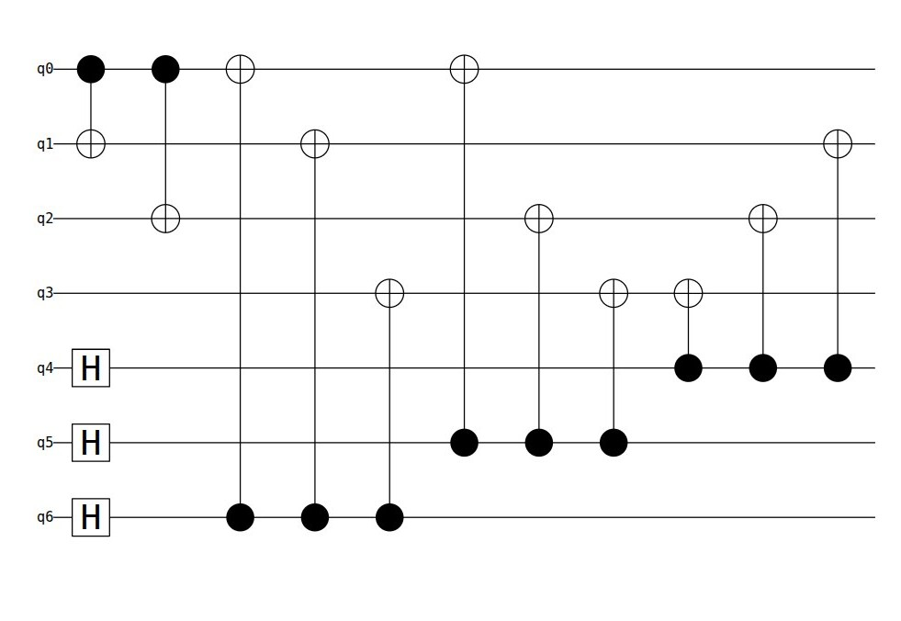
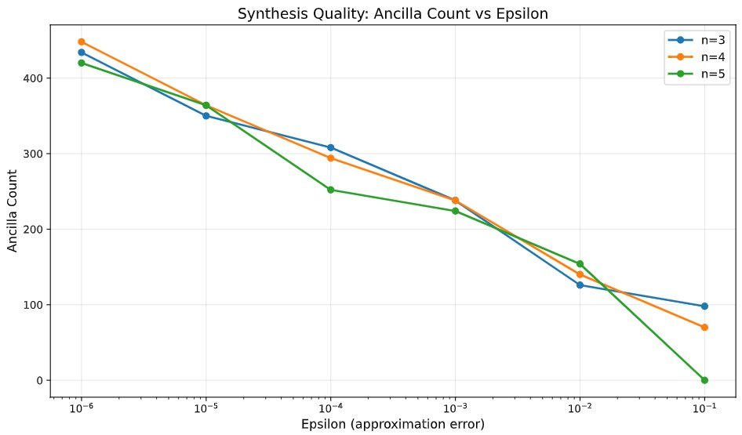
The need for fault-tolerance
The Steane [[7,1,3]] Code doesn't support transversal T gate
We must make our implementation fault tolerant
9 CNOT gates for the encoding + 16 CNOT gates for each T gate

Slide 7
Future work
What more?
Noisy simulations
Magic state distillation

Slide 8
Conclusion
From the synthesis part, we can confidently say that T gates are not that easy as you could expect

Slide 9
STAR
MegaQoup

Slide 10
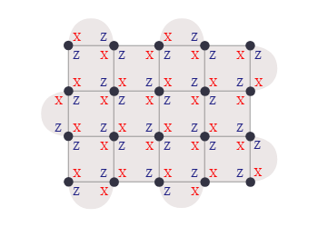
Surface Code: What and How
Encoding one qubit with different distance
X_L and Z_L are nontrivial loops
Errors as well
Syndrome cycle to do with detectors
Build 3D graph to see syndrome evolution

Slide 11
TSIM generator
Allows us to simulate mostly Clifford circuits with stabilizers formalism
Detection events on ancilla to get syndromes
Create 3d timespace graph
One error two syndromes
MWPM for decoding using Pymatching library
For distance 3 first Post select on first 24 detectors and then decoding

Slide 12
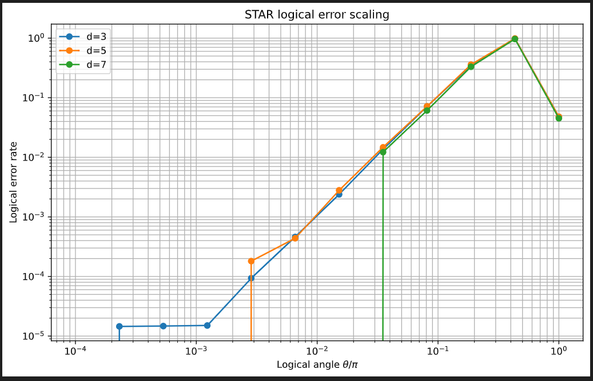
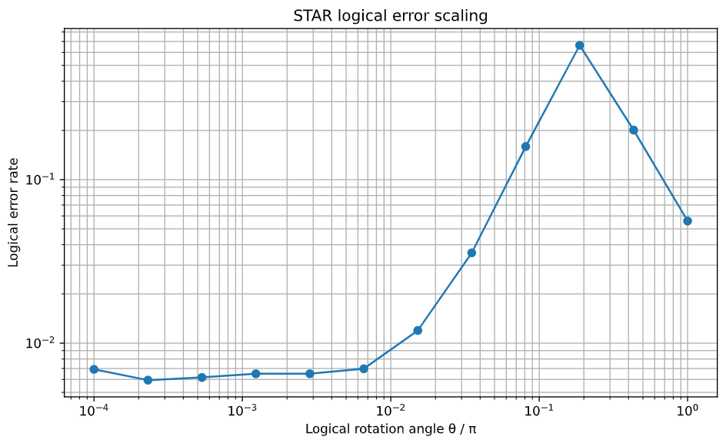
TSIM generator

Slide 13
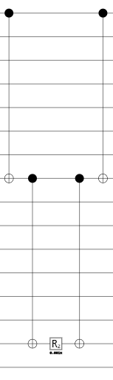
What is STAR
Magic angle state
In the challenge we used to inject rotations:
Space-time efficient analog rotation:
Early Fault tolerant
Clifford operations fault tolerant
Nonclifford operation as rotation are not
MegaQUOPs

Slide 14
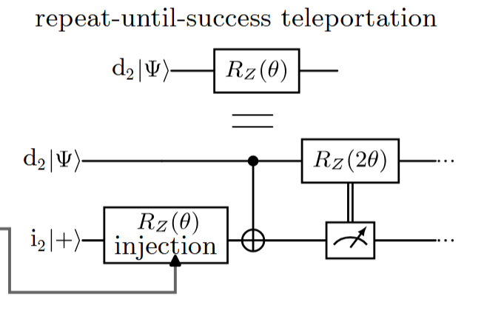
What is STAR
But in generale the generations of magic is the following.

Slide 15
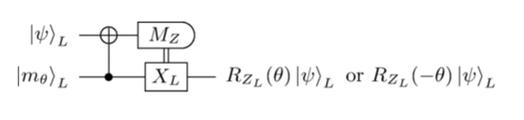
Teleport a non-Clifford rotation into a L Qubit
This seems easy in the paper but…..

Slide 16
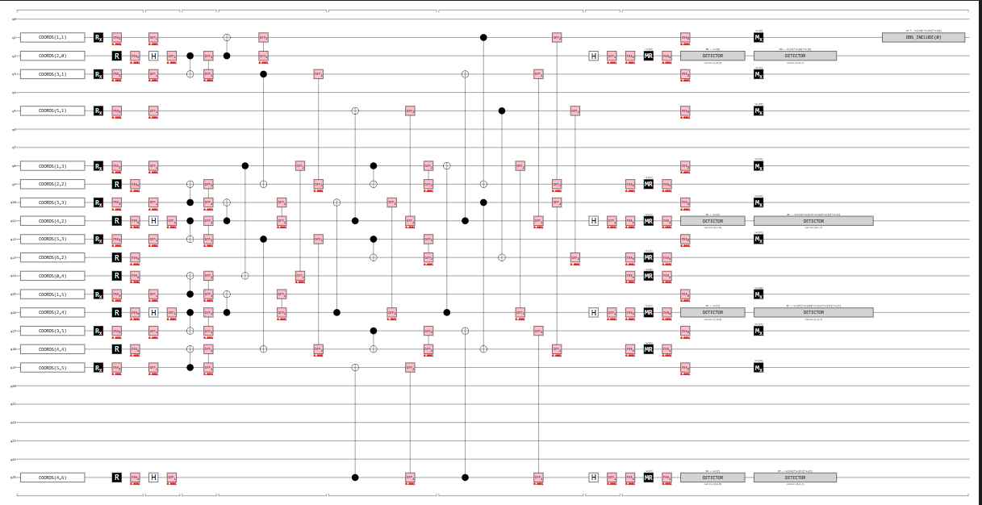

Teleport a non-Clifford rotation into a L Qubit

Slide 17
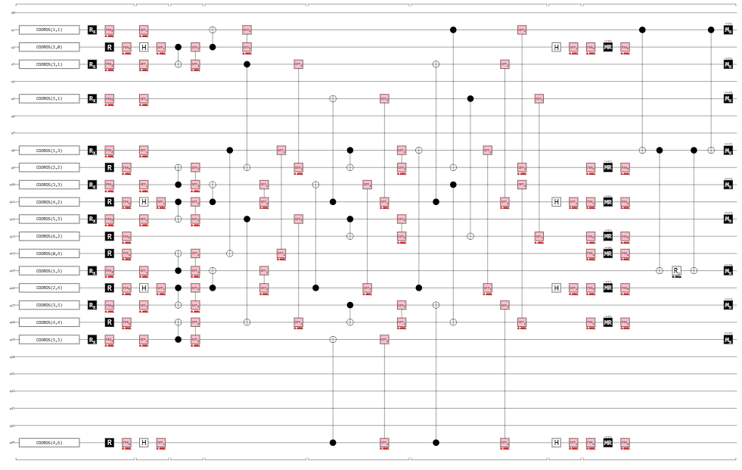

Teleport a non-Clifford rotation into a L Qubit

Slide 18
Could we use this method to do other things?
What about H?
Used in QFT
Trasversal gate but requires physical rotation of qubits in space
In principle could work transpiling H as different rotations applied

Slide 19
What is STAR good at?
When we need many small rotations:
QPE
Many qubits QFT
Trotterization
Is there a transform from bigger to small rotations?

Slide 20
So is it worse a single or two qubits gate?
Answer:
It depends of course
Is it a Pauli 1q gate?
How do you syntetize T gates or small rotations
What is the underliyng architecture
Is there a control

