Slide 1

12345: TA Assignment Problem
Prof Muise (cm290)

Slide 2
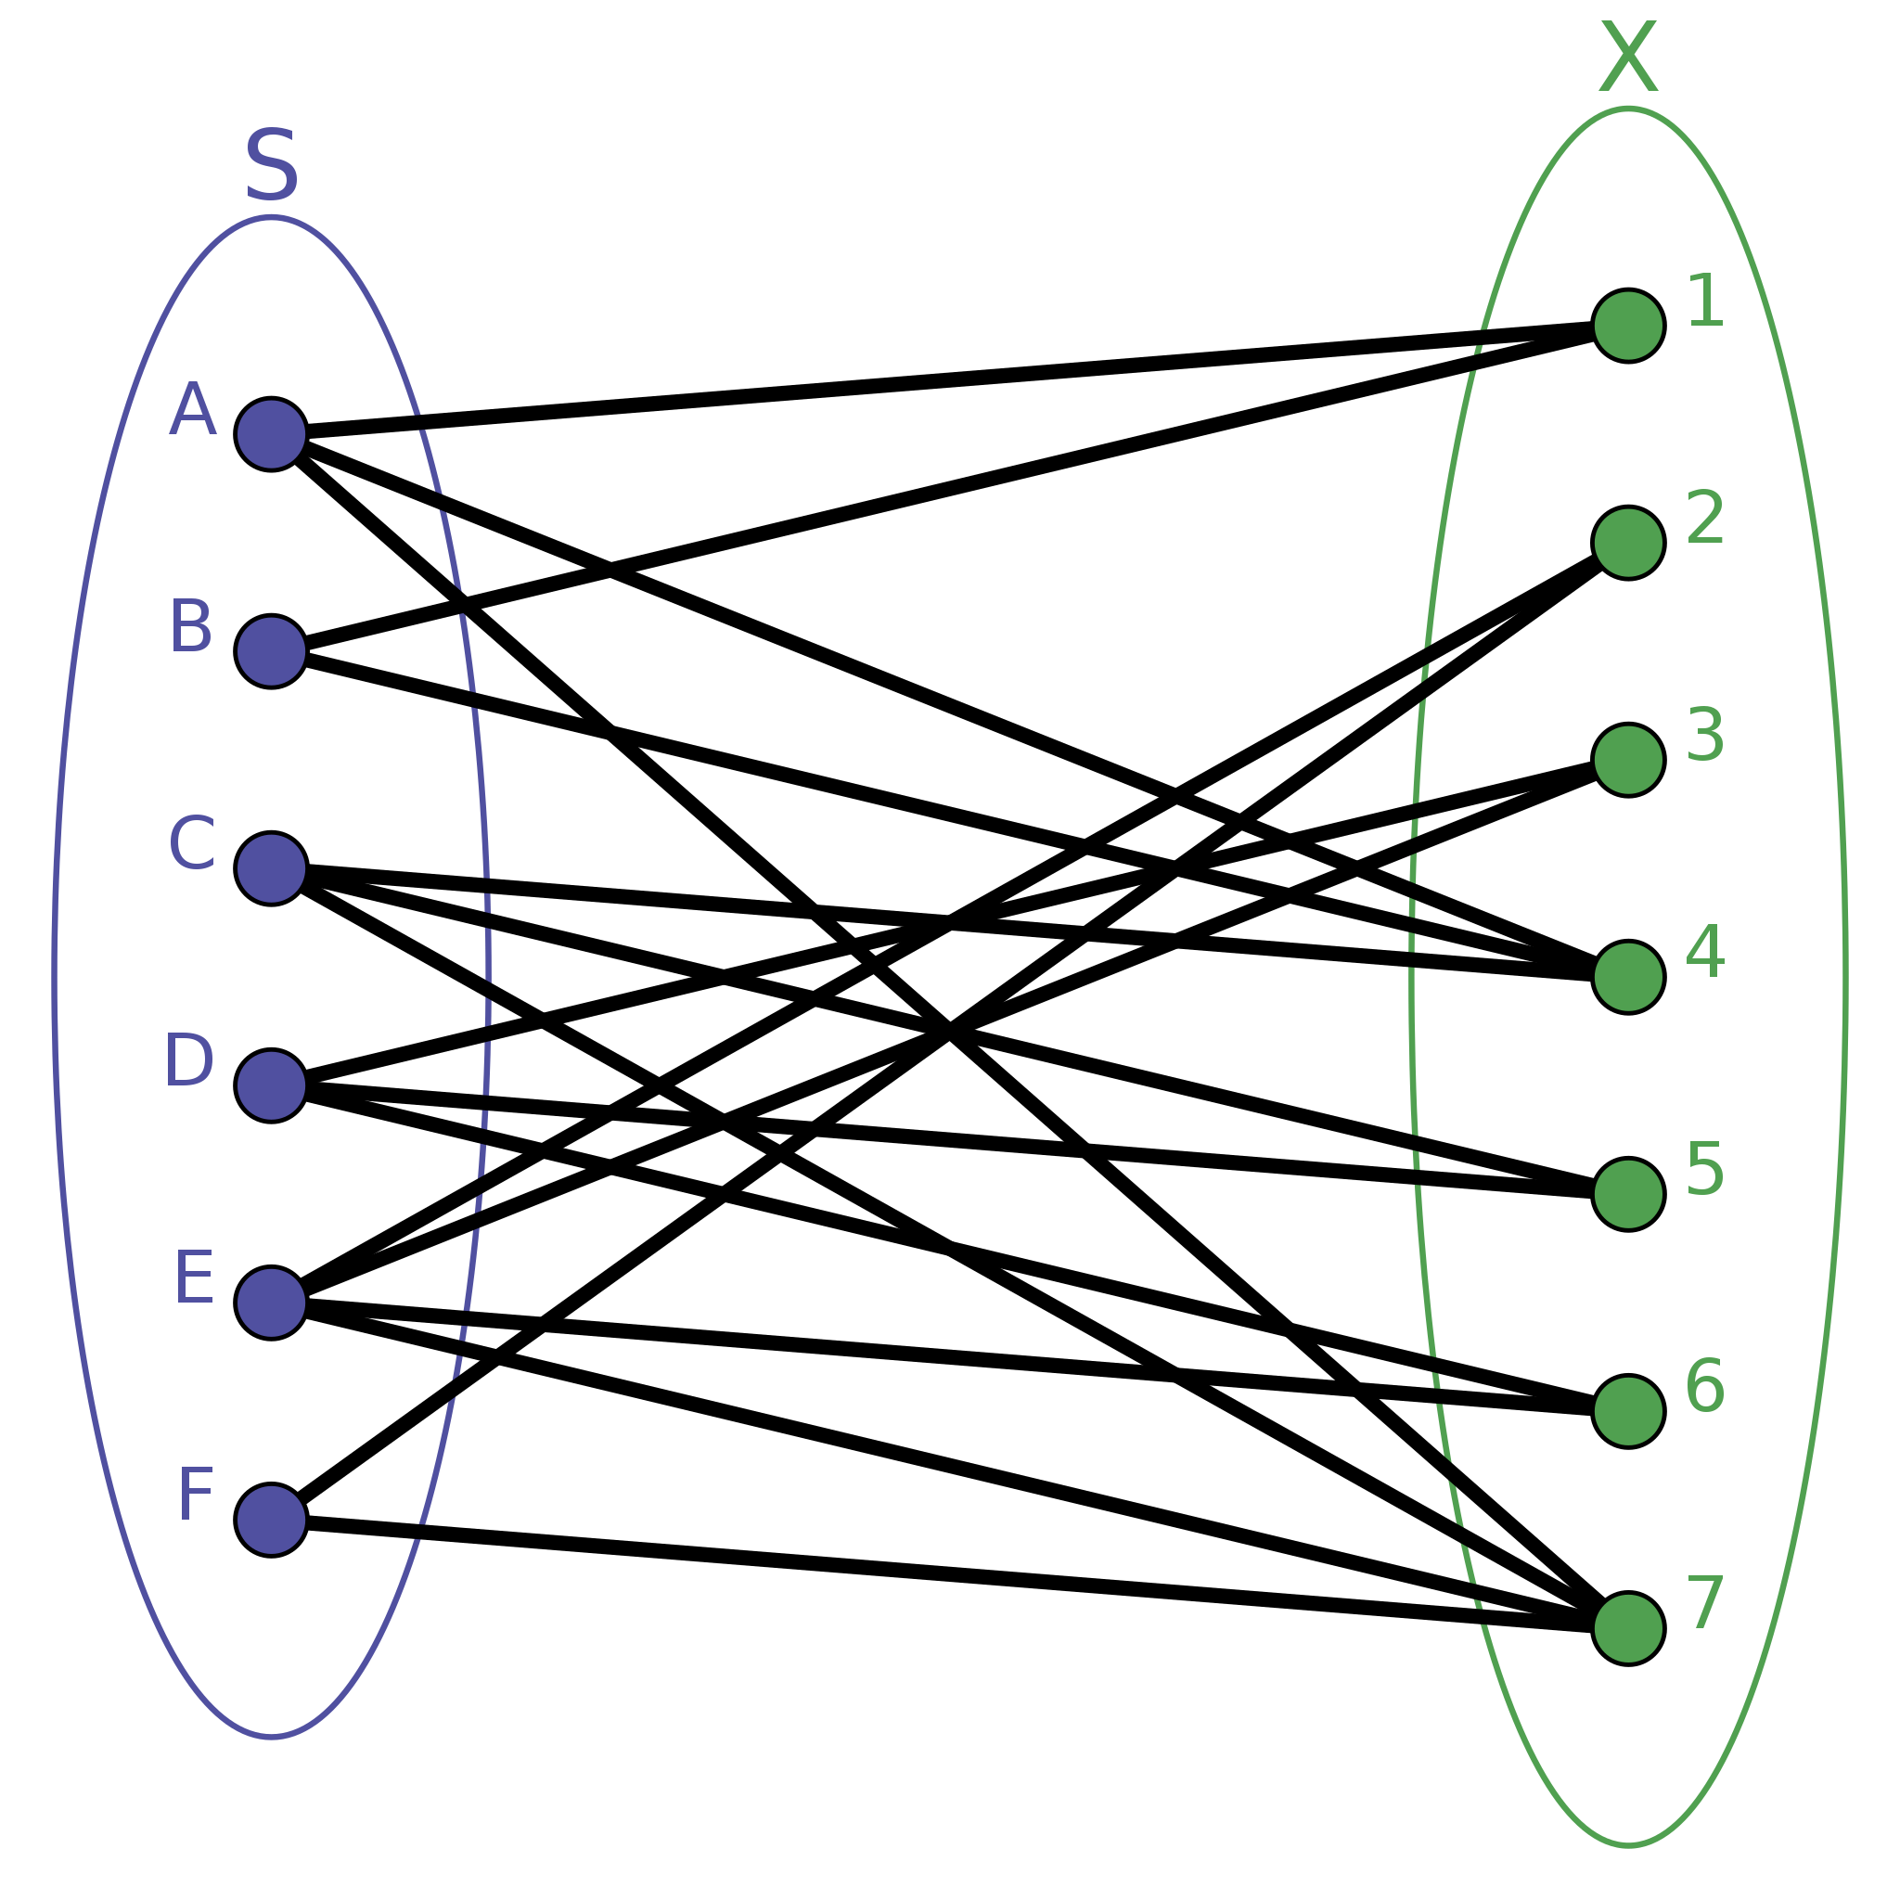
Summary
The aim of this project is to take some initial configuration of student preferences for the courses they would like to TA, as well as the Prof preferences of the TA’s they would like to have, and then find a workable assignment of TA’s to the courses. Constraints will be needed for specific elements like dedicated TA’s, sufficient grades in the course, distribution of graduate TA’s, etc.

Slide 3
Propositions
Assigned_X_Y: Student X is assigned to course Y for a TA’ship
Preference_X_Y_Z: Student X has a preference level of Z (1->5) for course Y
ProfPref_W_X_Y_Z: Prof W has a preference for TA X at level Z (1->5) for course Y
MaxGrad_X_Y: The maximum number of graduate students TA’ing course X is Y
…

Slide 4
Constraints
A TA can be assigned to only one course
For every student X and pair of courses Y1 and Y2 (that are unique), we have ~(Assigned_X_Y1 /\ Assigned_X_Y2)
No course gets a TA ranked 2 or lower by the instructor
For every course Y, TA X, and prof W, (ProfPref_W_X_Y_1 \/ ProfPref_W_X_Y_2) → ~Assigned_X_Y
Some profs can veto certain TAs
Nash equilibrium: no swap of TAs/Courses should lead to a better outcome (i.e., more preferences satisfied)

Slide 5
End

