Slide 1

Text-to-image model for Pokemon images
Mattia Tritto
Master Degree in Computer Engineering

Slide 2
Model architecture
A visual explanation of the model architecture

Slide 3
A high-level overview
Input Tokens
Text encoder
Attention
Image Decoder
Attention mask
Encoder output representation
Context vector

Slide 4
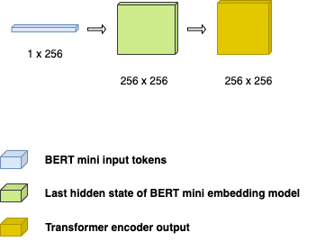
Text encoder architecture

Slide 5
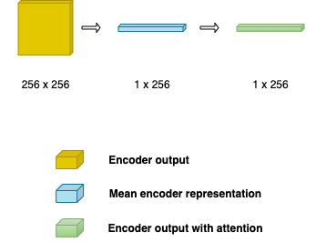
Attention module

Slide 6
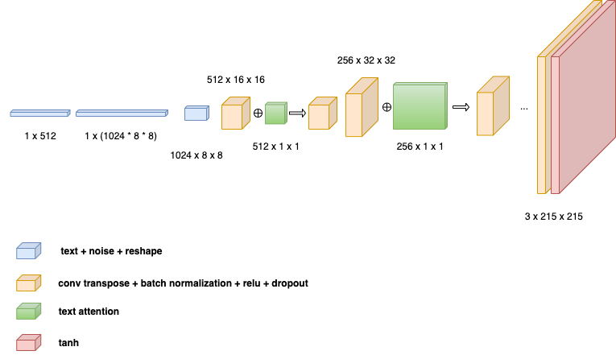
Decoder module

Slide 7
Preprocessing
Data preparation for the model

Slide 8
Images preprocessing
For preprocessing, I first extracted the alpha channel to identify transparent regions in the image. These regions are then filled with white to convert the image into a standard RGB format.
Next, I apply min-max normalization to scale the pixel values from [0,255] to [−1,1], which aligns with the output range of the decoder’s final Tanh activation function.

Slide 9

Image augmentation
To increase the size of the dataset, I applied image augmentation techniques, specifically, by rotating the images. This should help improve model generalization by introducing variability in the training data.

Slide 10
Text preprocessing
For text preprocessing, I create an enriched textual description by combining multiple fields from the dataset: description, primary type, secondary type, and classification. These additional fields are included because they often carry visual attributes that can enhance the model's ability to generate images aligned with the textual input.
«There is a plant seed on its back right from the day this Pokèmon is born. The seed slowly grows larger. This Pokémon is classified as a Seed Pokèmon. It is of grass type and poison type»

Slide 11
Training process
Some details about the training

Slide 12
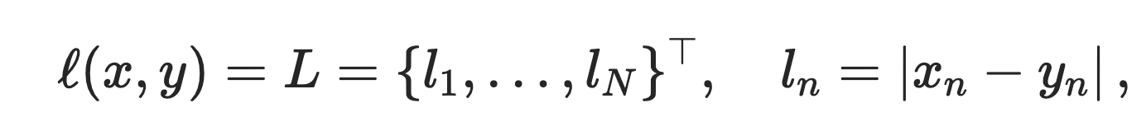
L1 Loss
As the primary loss function for evaluating the model, L1 loss was used. This pixel-wise loss measures the absolute difference between the predicted and ground truth images. L1 loss is particularly effective in preserving fine accurate reconstruction at each pixel details and sharpness in generated images, making it suitable for tasks that require high-fidelity outputs.

Slide 13
CLIP score
The CLIP score is a metric that evaluates how well a generated image aligns with a given text description. It is based on the CLIP model (Contrastive Language-Image Pretraining) developed by OpenAI, which learns joint embeddings for images and text in a shared semantic space.
To compute the CLIP score:
The generated image and its corresponding text description are both passed through the pretrained CLIP model.
The model extracts feature embeddings for both modalities.
The cosine similarity between these embeddings is calculated.

Slide 14
Results
All the experiments conducted

Slide 15
First trial configuration
Data augmentation used
False
Epochs
100
Loss
L1
Bath size
10
Dropout
False
Learning rate
1e-4

Slide 16
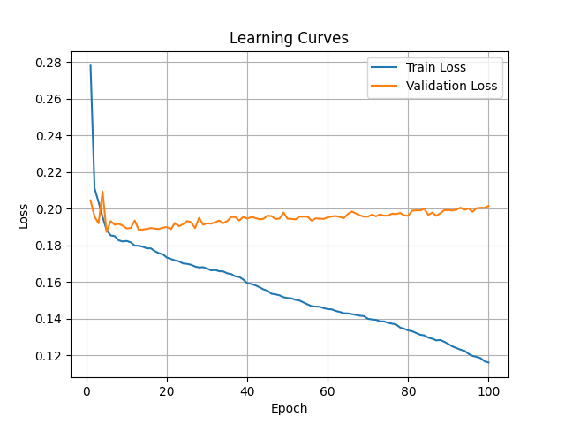
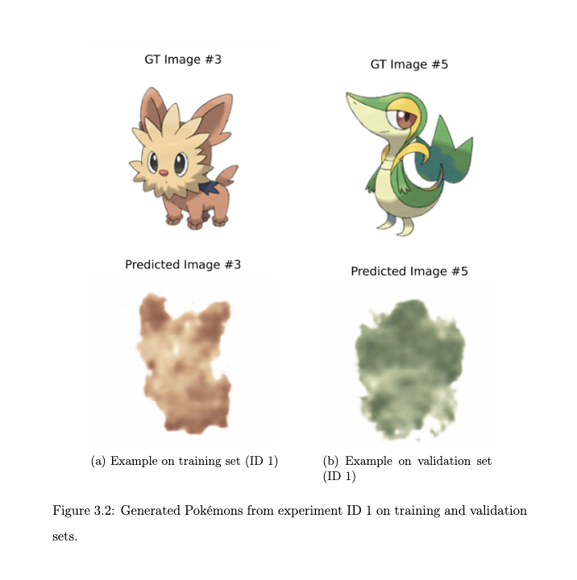
First trial

Slide 17
First trial
As observed from the learning curves, the model is able to learn effectively during training; however, it quickly overfits the data. This is evident as the training loss decreases steadily, while the validation and test losses remain higher, indicating poor generalization to unseen data.
Qualitatively, the model performs well on the training images, successfully learning their specific visual patterns. However, it fails to replicate similar quality on the validation images, suggesting that it has memorized the training set rather than learning generalizable features.

Slide 18
Second trial configuration (dropout added)
Data augmentation used
False
Epochs
100
Loss
L1
Bath size
10
Dropout
0.3
Learning rate
1e-4

Slide 19
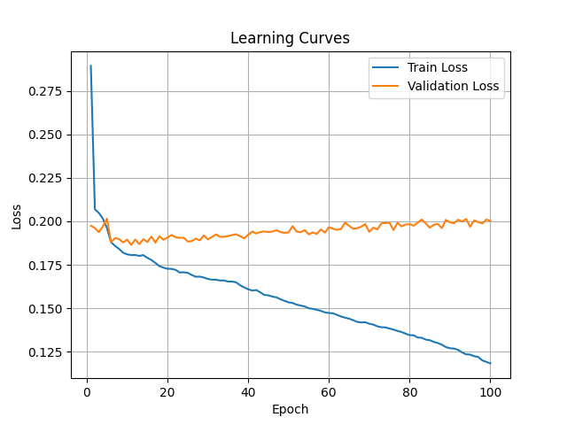
Comparison between learning curves
First trial learning curve
Second trial learning curve

Slide 20
Second trial (dropout added)
According to the results, dropout did not improve the model's ability to generalize to unseen images on the validation and test sets. One possible explanation is that the model may already have sufficient regularization or capacity, and introducing dropout might not have helped prevent overfitting.

Slide 21
Third trial configuration (CLIP loss)
Data augmentation used
False
Epochs
100
Loss
CLIP loss
Bath size
10
Dropout
False
Learning rate
1e-4

Slide 22
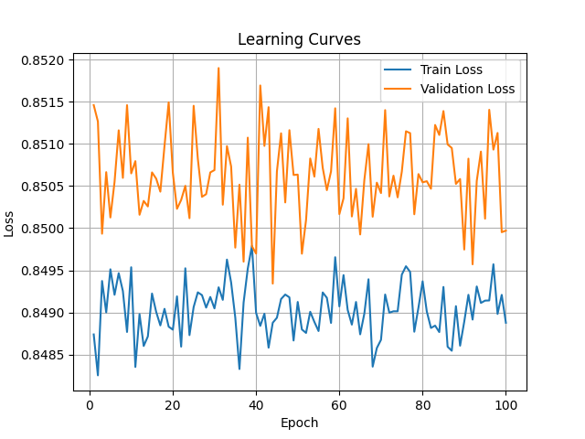
Comparison between learning curves
First trial learning curve
Third trial learning curve

Slide 23
Third trial (CLIP loss)
According to the results, the CLIP loss leads to unstable training, as the model fails to learn, evidenced by the fact that the training loss does not decrease. One possible reason for this behavior is the initialization strategy: instead of using BERT-mini vectors, the model should be initialized with embeddings from the CLIP model itself. This would ensure better compatibility with the CLIP loss and facilitate more effective learning throughout the pipeline.

Slide 24
Fourth trial configuration (Data augmentation)
Data augmentation used
True
Epochs
100
Loss
L1 loss
Bath size
10
Dropout
False
Learning rate
1e-4

Slide 25
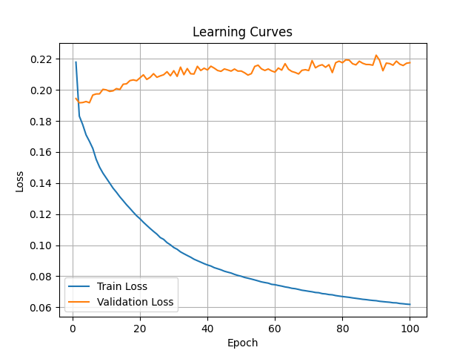
Comparison between learning curves
First trial learning curve
Fourth trial learning curve

Slide 26
Fourth trial configuration (data augmentation)
According to the results, augmenting the dataset did not help the model generalize better. The performance on the validation set, both visually and based on evaluation metrics, remained almost the same as without augmentation. Moreover, the learning curves suggest that the model may have overfitted the training data, as the training loss decreased significantly while the validation performance did not improve.

Slide 27
Fifth trial configuration (enriched description)
Data augmentation used
False
Epochs
100
Loss
L1 loss
Bath size
10
Dropout
False
Learning rate
1e-4

Slide 28
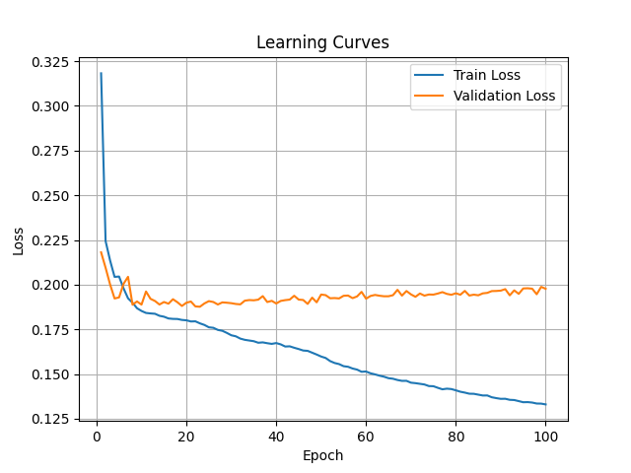
Comparison between learning curves
First trial learning curve
Fifth trial learning curve

Slide 29
Fifth trial configuration (enriched description)
According to the results, using an enriched description did not improve the model’s ability to generalize, as the validation loss remained unchanged.

Slide 30
Hyperparameter optimization (1/4)
As a final experiment, I conducted a grid-search-style exploration of several hyperparameters to identify the best configuration. The hyperparameters evaluated include:
Learning rate (1e-4, 1e-5);
Weight Decay (1e-5, 1e-6);
Number of attention head in the encoder (2, 4);
Dimension of the feedforward encoder (512, 1024);
Number of transformer encoder layers (2, 3).

Slide 31
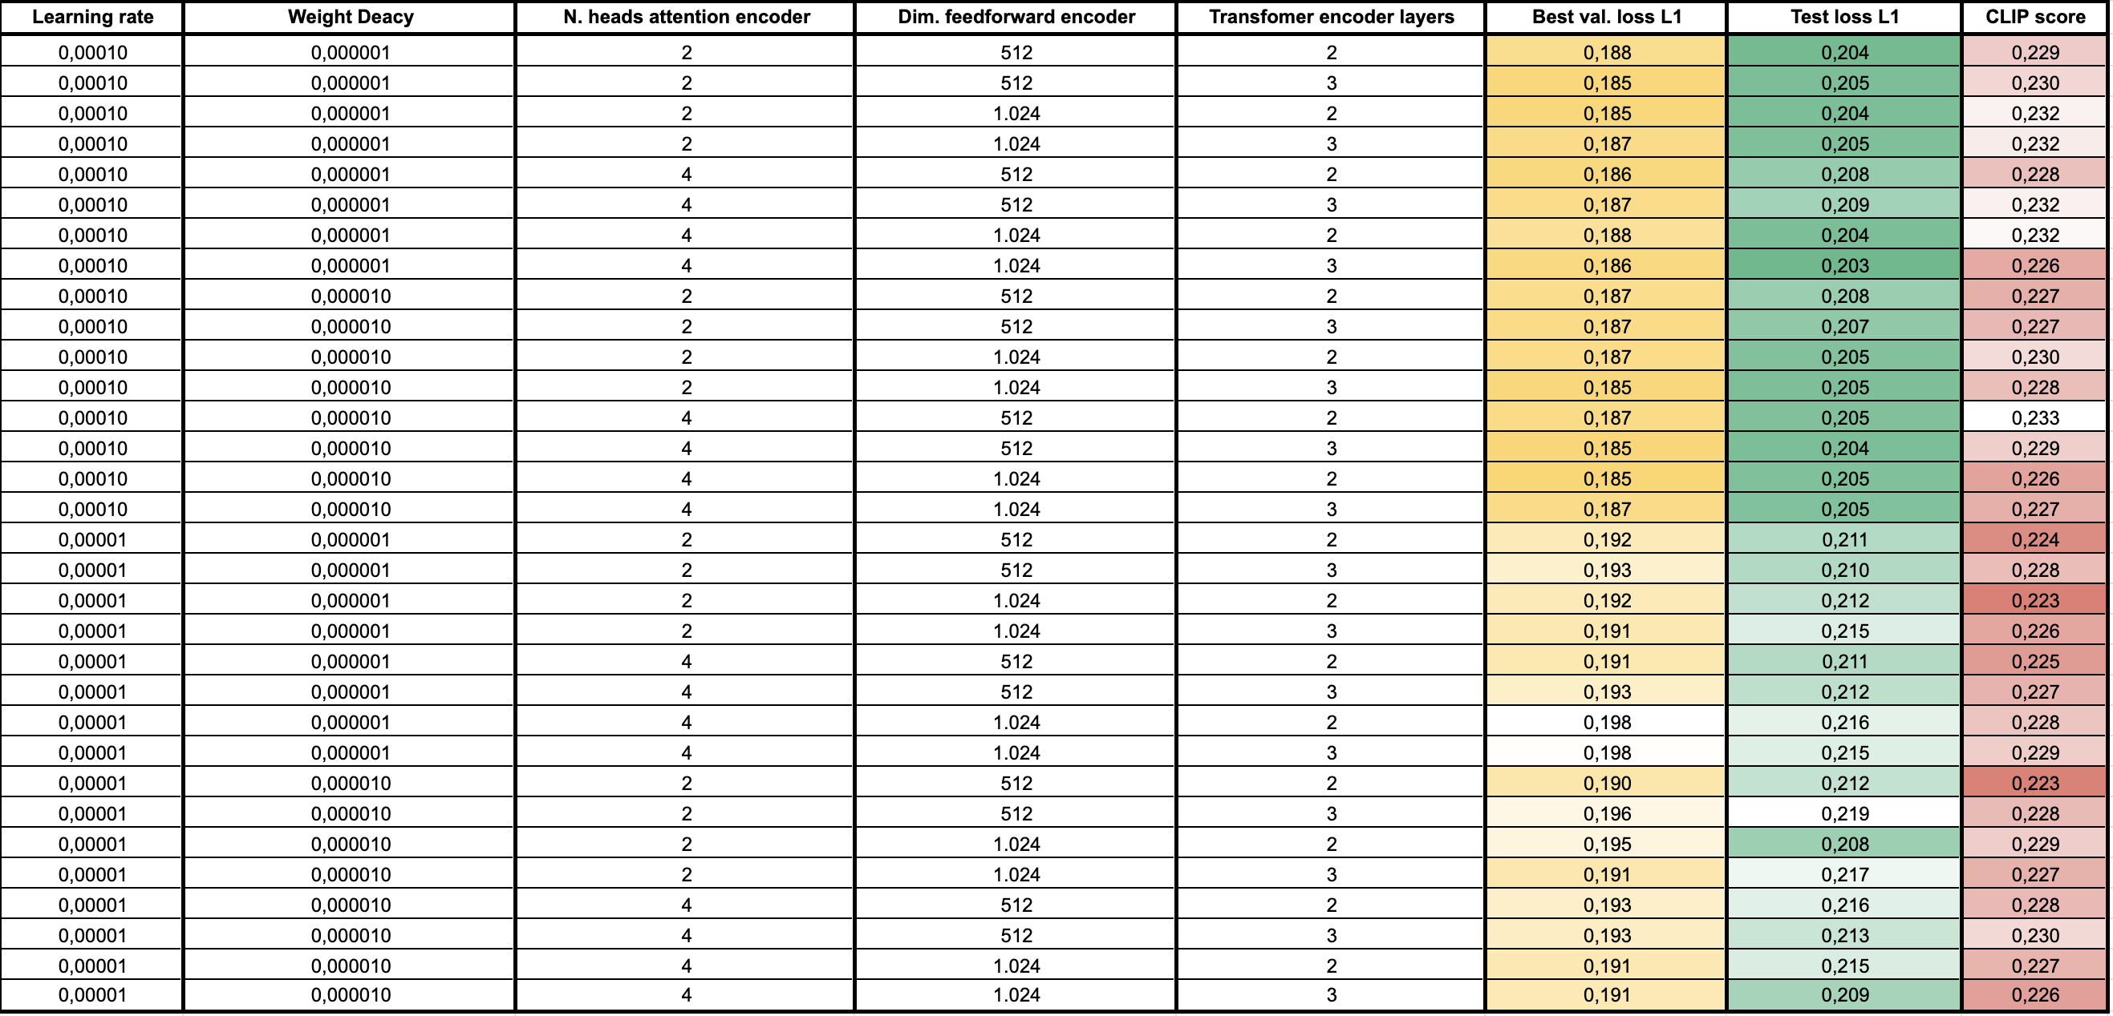
Hyperparameter optimization (2/4)

Slide 32
Hyperparameter optimization (3/4)
As shown in the previous table, the performance across different configurations remains relatively consistent. Specifically, the validation loss ranges between 0.18-0.19, the test loss between 0.20-0.21, and the CLIP score between 0.20-0.22. This suggests that the overall performance is not highly sensitive to hyperparameter variations within the explored ranges.

Slide 33
Hyperparameter optimization (4/4)
Learning Rate: 1 × 10⁻⁴
Weight Decay: 1 × 10⁻⁵
Loss Function: L1 Loss
Epochs: 100
Batch Size: 10
Augmentation: Enabled (N=8)
Enriched Description: Yes
Transformer Encoder Layers: 2
Attention Heads: 4
Feedforward Dim: 1024
Dropout encoder: 0.3
Dropout attention: 0.3
Dropout decoder: 0.3
Nevertheless, if a single configuration must be selected, I recommend the one that achieved the lowest validation and test loss:

Slide 34
Conclusions
Following a series of trials, the key takeaways are…

Slide 35
Conclusions (1/4)
In conclusion, the current architecture does not appear to be particularly effective for generating Pokémon sprites. Across all configurations, the model consistently exhibits a tendency to overfit, failing to generalize well on both the validation and test sets: this represents a significant limitation.
I strongly believe that the core issue lies in the architecture itself. To achieve meaningful improvements, it would be necessary to redesign it entirely. The most promising direction would be to adopt a Stable Diffusion-based model, which has been extensively studied and proven effective for generating images from textual prompts.

Slide 36
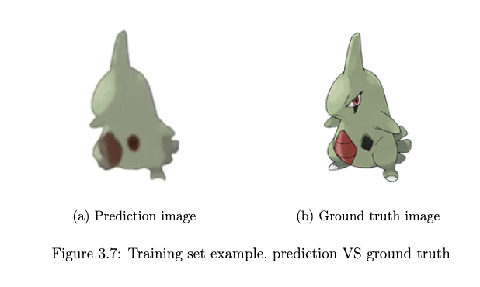
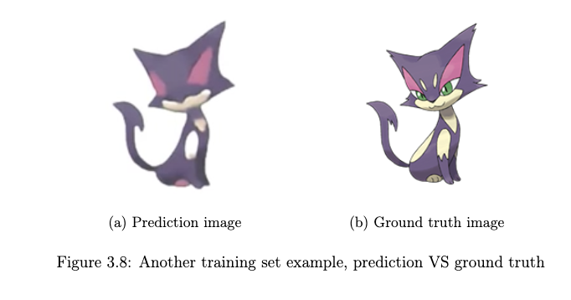
Conclusions (2/4)

Slide 37
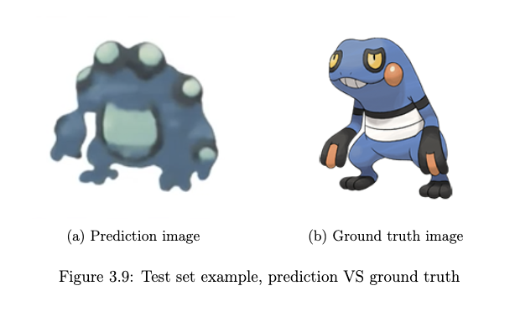
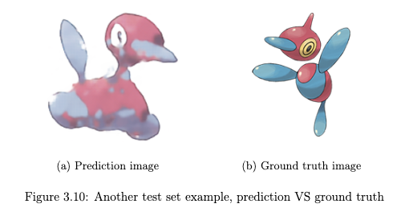
Conclusions (3/4)

Slide 38
Conclusions (4/4)
However, before proceeding with a complete architectural overhaul, there are still a few avenues worth exploring to attempt incremental improvements. I report here 3 ones:
Paraphrasing textual descriptions
A combined loss function that involves L1 and CLIP
Staged training

Slide 39
Thank You

