Slide 1
Gegründet im Jahr 1669, ist die Universität Innsbruck heute mit mehr als 28.000 Studierenden und über 5.000 Mitarbeitenden die größte und wichtigste Forschungs- und Bildungseinrichtung in Westösterreich.

Slide 2
Improving Recommendations through User-baser Constraints Dataset: Osu! 10k-users Top/random dataset

Slide 4

Gegründet im Jahr 1669, ist die Universität Innsbruck heute mit mehr als 28.000 Studierenden und über 5.000 Mitarbeitenden die größte und wichtigste Forschungs- und Bildungseinrichtung in Westösterreich.

Slide 5
Osu! Game basics.

Slide 6
Why is our dataset appropriate for the RQ?
Improving Recommendations through User-baser Constraints
How fast tapping and
how sustained?
How hard are elements
to hit (distance and angles)
How fast do elements appear
Reaction/read time
difficulty estimation

Slide 7
Dataset Preprocessing
Obtained through dump by Lead-Developer
High_scores for 10k random and top users
Sanitized, filtered for full attributes available, min interactions, etc…
Feature engineeering

Slide 8
Dataset Preprocessing
Obtained through dump by Lead-Developer
High_scores for 10k random and top users
Sanitized, filtered for full attributes available, min interactions, etc…
Feature engineeering
Domain Challenges and Solutions
Beatmap + Mod Combinations Item explosion
Collapse into 4 Combinations: NM, DT, HD, DTHR. beatmap_{MOD} as items
User Improvement over time
Estimation of Skill Stabilization date for each user
No Explicit feedback, what rating metrics?
Calculation of enjoyment_factor, from mostly implicit feedback, fallback: playcount.

Slide 9
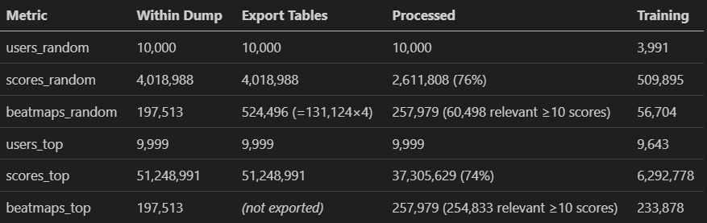
Dataset Preprocessing

Slide 10




Enoyment factor construction
Enjoyment of each score
0.2 * playcount_c
0.3 * favourite_c
0.2 * accuracy_c
0.3 * pp_contrib_c

Slide 11

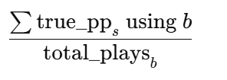
Enoyment factor construction
Enjoyment of each score
0.2 * playcount_c
0.3 * favourite_c
0.2 * accuracy_c
0.3 * pp_contrib_c
balanced by
farm_factor

Slide 12
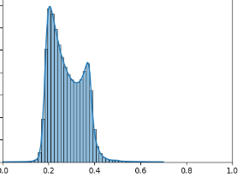
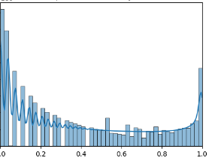
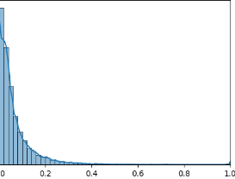
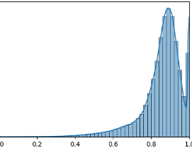
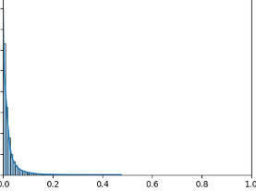
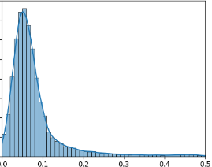
Enoyment factor construction
Enjoyment of each score
balanced by
Blue zenith 7*
Freedom dive DT 10*
No title HR 6 and 7*
Epitaph NM and HR 7/9*
PADORU DT 8*
Santa-san 5*
Crab Rave 5*

Slide 13
Enoyment factor construction
Enjoyment of each score
balanced by
Blue zenith 7*
Freedom dive DT 10*
No title HR 6 and 7*
Epitaph NM and HR 7/9*
PADORU DT 8*
Santa-san 5*
Crab Rave 5*
KARMANATIONS 6*
AaAaAaAAaAaAAa DT 7*

Slide 14
Enoyment factor construction
Enjoyment of each score
balanced by

Slide 15
Methodology
For random and top trained: baseline, knn(user), svd
Implement user-specific constraints, on limiting attributes mentioned before
99% percentile ceilings on speed, aim, approach rate and difficulty.
Flag scores where any ceiling was violated
3-fold cross validation, evaluate Metrics on k=100 top recommendations, and again after filtering flagged scores.
MSE
AVG, TOP and MIN ground truth rating in k recommendations
Compute deltas for metrics above.
5. Averaged on Users and Manifolds.
6. Repeat but with Playcount metric instead of enjoyment

Slide 16
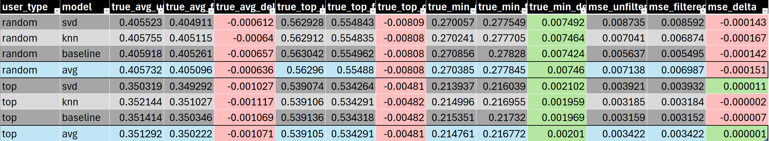
Results
Enjoyment rating
small deltas expected, when filtering with 99 percentile.
Postive deltas for min_rating => slight „precision“ improvement,
In all other columns negative deltas

Slide 17
Results
Enjoyment rating
For playcount rating basically the same
- A bit more delta difference between random and top
- „coloring“ the same

Slide 18
RQ transfered

Slide 19
Takeaways
Implementing user-constraints as a filter is easy
Might improve precision slightly, our results not clear enough to tell for sure.
Somewhat clean Osu! dataset with many interesting features in a RecSys unexplored domain created.

Slide 20
Dataset Analysis

