Slide 1
Working full-time on Open Source Software PyData / ITC Dec 19, 2018 Matti Picus

Slide 2
OSS
I began a two-year contract to work on NumPy in April. In this talk I will share
How it happened
What it is like to work full-time on open-source software
Why you should get involved
NumPy’s Roadmap
PyPy - a python interpreter with a JIT

Slide 3
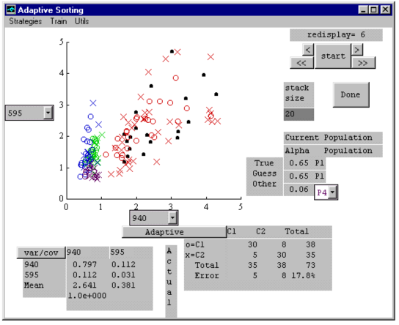
About Me – Early Days
Moved to Israel 1982, started Kibbutz Lotan.
PhD 1993 – 1997 as an opportunity to get into high-tech (nascent internet; Linux; Matlab; VIM; Latex)
Slackware 1.0 in 1994
Adaptive Sorting Toolbox for MATLAB 4.0, 1996

Slide 4
About Me – Bubble 1
Python? Naa, C++!!!!!!!!
Visual Studio is the one true tool of developers
Image Processing (Virtual Dressing Room)
Testing - BOOST-Test
CGI scripts on the server

Slide 5
About Me – Enlightenment
Then I discovered Python
Test framework to drive integration testing
Leverage the power of other’s work to handle 2D matrices (NumPy, OpenCV)
Joined GitHub in June 2011, first contribution: Arduino Ethernet shield
Searched for a hard problem, found PyPy
Image processing in Python via PyPy
Call to action – come help Numpy on Pypy
By Nov. 2011, I was hooked

Slide 6
About Me – Last 5 years
One thing led to another
Courses on scientific Python (mainly for MATLAB users)
Tracking open-source software in large organizations
License policy
How can management know what the developers are injecting into the software stack?
Giving talks
Pycon Israel 2016 - PyPy
Pycon Israel 2017 – Cffi, ctypes, cython

Slide 7
About Me – Last Year
And then came an offer I couldn’t refuse
The Berkeley Institute for Data Science received a grant to hire 2-3 people to work full-time on NumPy
Since April, I am working on NumPy. The money flows through BIDS, but the community decides my priorities

Slide 8
How is it?
Is it different from a “real job”?
Does the code get reviewed?
Are the standards high?
Who commits / decides / sets priorities?

Slide 9
How is it?
What will I gain after 2 years?
What can you gain by contributing?
Reputation
Connections
Grow and improve as a programmer
Warm fuzzies

Slide 10
NumPy
Roadmap, Scope statement
4 new NEPs
Triaging bugs and merging pull requests
SciPy in Austin TX
Euro SciPy
Start rewriting the dtype NumPy type system

Slide 11
PyPy
It is a different python implementation
Written in Python
Uses an incremental mark and sweep GC (no refcounts)
Has a tracing JIT (different from a method JIT or AOT compilation)
Typically 2-5 times, but can be 100 times faster than Cpython
Small, flexible team of really smart people (I am the exception – I deal with packaging, documentation, compatibility)
Could use help and funding
Useful today, download, set up in a virtualenv, and run your code!

