Slide 1
Open Source Software
ITC Tech Fellow
Dec 10, 2018
Matti Picus

Slide 2
OSS
What will we cover
What is it?
How can you use it?
  Where, what, is it good, what do I have to look out for
  Excercize
How can you help?
Who am I and why do I care?

Slide 3
As a Consumer
What is it?
Open source software is software with source code that anyone can inspect, modify, and enhance.
"Source code" is the part of software that most computer users don't ever see; it's the code computer programmers can manipulate to change how a piece of software—a "program" or "application"—works. Programmers who have access to a computer program's source code can improve that program by adding features to it or fixing parts that don't always work correctly.
From https://opensource.com/resources/what-open-source

Slide 4
As a Consumer
Why should I use that?
Control
Training (avoid making the same mistakes)
Security (many eyes make bugs shallow)
Stability
From https://opensource.com/resources/what-open-source

Slide 5
As a Consumer
Where can I find it?
Sourceforge.com
“Older” home for code, with email forums and archives of code
Github.com
The New Shiny and default site for managing code development
Bitbucket.org
Like github, supports mercurial as well as git

Slide 6
As a Consumer
How to find a good package?
Google, friends
Is it any good?
Stars, downloads, openhub.com
Is it secure?
CVE, issues, commits

Slide 7
As a Consumer
Licenses - What are they?
Copyright, trademark patent: what is the difference
Do common licenses cover patents?
Permissive: BSD, MIT, Apache
Reciprical: GPL, LGPL, AGPL
https://choosealicense.com/licenses/

Slide 8
As a Consumer
Managing OSS within a project
Internal build tools (code repository, build system)
How to include third party asset? (as a repo? as a binary?)
When and how to update?
What do managers want to know?
https://jfrog.com/artifactory/

Slide 9
Assignment
Choose a software package you know about
Where is it hosted?
When was the last release?
What did the last release fix?
How many people work on it? How do they govern the project? Is there a code of conduct?
What does the project depend on?
What is its license?

Slide 10
As a Contributor
The golden path to being sucked in
Find a bug, submit a fix, find more, rinse, repeat
Decide to add a feature
Become a maintainer
Become a core contributor

Slide 11
As a Contributor
Reporting and fixing a problem
Open an issue on the project issue tracker
Formulate a pull request
  Do you need your employer’s approval?
  Do you agree to the license/code of conduct?
  How do you want to be known in the project?
  Now you can write the code
    Fork
    Fix
    Push

Slide 12
As a Contributor
Adding a feature
Discuss it with the community
Formulate a pull request
  Tests
  Code formatting
  Maybe a separate repo?

Slide 13
As A Contributor
Start your own project
Discuss it with the community
  Reddit
Put it all together
  Community
  License
  Code of Conduct
  Set up CI, …
Become BDFL (governance)

Slide 14
How I Became Addicted to Open Source
From kibbutznik to NumPy developer
Matti Picus, PyData Tel Aviv, Aug 23, 2018

Slide 15
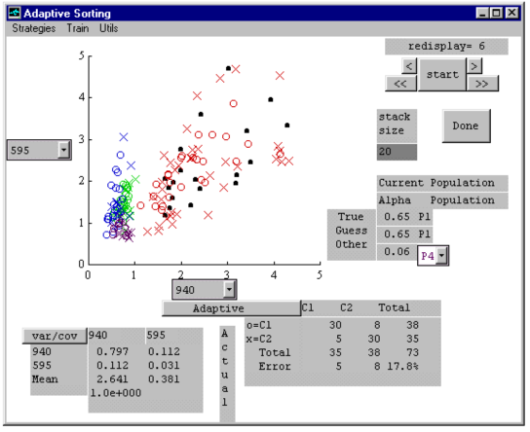
First steps with Open Source
Moved to Israel 1982, started Kibbutz Lotan.
PhD 1993 - 1997
Slackware 1.0 in 1994
Adaptive Sorting Toolbox
for MATLAB 4.0, 1996

Slide 16
Python? Naa, C++ is where it is at!
Visual Studio is the one true tool of developers
Image Processing
Testing
CGI scripts on the server

Slide 17
But then I discovered Python and PyPy
Test framework to drive integration testing
Leverage the power of other’s work to handle 2D matrices (NumPy, OpenCV)
Joined GitHub in June 2011, first contribution: Arduino Ethernet shield
Searched for a hard problem, found PyPy
  Image processing in Python via PyPy
  Call to action – come help Numpy on Pypy
  By Nov. 2011 I was hooked

Slide 18
One thing led to another
Courses on scientific Python (mainly for MATLAB users)
Tracking open-source software in large organizations
  License policy
  How can management know what the developers are injecting into the software stack?
Giving talks
  Pycon Israel 2016 - PyPy
  Pycon Israel 2017 – Cffi, ctypes, cython

Slide 19
And then came an offer I couldn’t refuse
The Berkeley Institute for Data Science received a grant to hire 2-3 people to work full-time on NumPy
Since April, I am working on NumPy at BIDS

Slide 20
What have you done so far?
Roadmap, Scope statement
4 new NEPs
Triaging bugs and merging pull requests
SciPy in Austin TX
Euro SciPy
Start rewriting the dtype NumPy type system

Slide 21
How is it?
Thick skin
Don’t be ashamed to make very public mistakes (bug in 1.14.4 lead to release 1.14.5)
Patience

