Slide 1
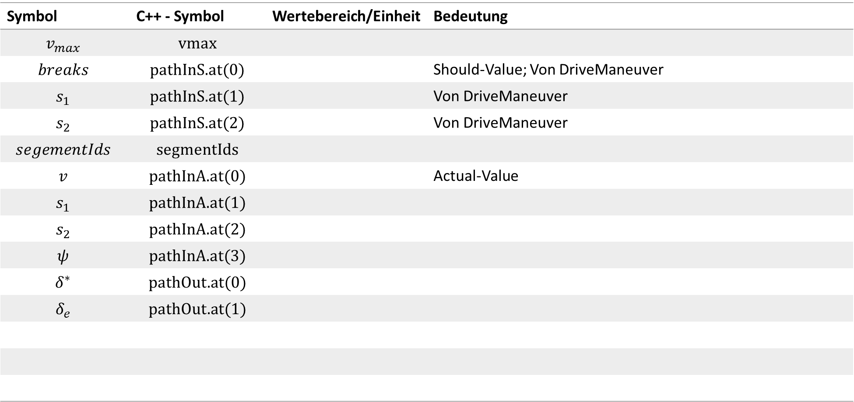
Symbol | C++ - Symbol | Wertebereich/Einheit | Bedeutung
$$v_{max}$$ | vmax
$$breaks$$ | pathInS.at(0) |  | Should-Value; Von DriveManeuver
$$s_{1}$$ | pathInS.at(1) |  | Von DriveManeuver
$$s_{2}$$ | pathInS.at(2) |  | Von DriveManeuver
$$segementIds$$ | segmentIds
$$v$$ | pathInA.at(0) |  | Actual-Value
$$s_{1}$$ | pathInA.at(1)
$$s_{2}$$ | pathInA.at(2)
$$ψ$$ | pathInA.at(3)
$$δ^{∗}$$ | pathOut.at(0)
$$δ_{e}$$ | pathOut.at(1)

Slide 2
Symbol | C++ - Symbol | Wertebereich/Einheit | Bedeutung
 | xs |  | Should
 | dist
 | ys |  | Arrays!!!
 | yds
 | ydds
 | xh |  | Hat
 | yh
 | ydh
 | yddh

