Slide 1
Project Report TOPIC 1: INTENSITY TRANSFORMATIONS & SPATIAL FILTERING
By
Moritz Hoehnel and Mattis Ritter

Slide 2

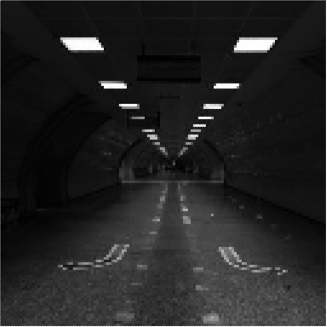
What can you see?

Slide 3
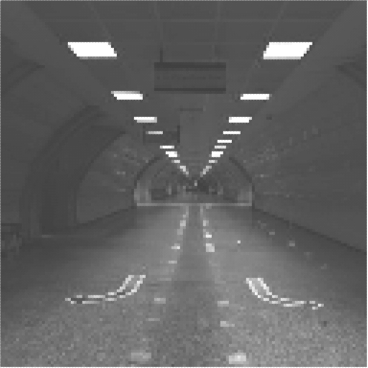
What can you see?

Slide 4
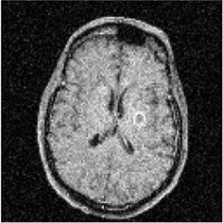
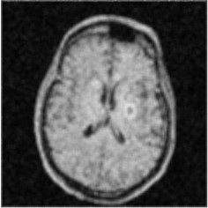
Have a noise corrupted picture?

Slide 5
INTENSITY TRANSFORMATION
Addition Transformation
+
No Merging of low intensity values
+
No unnatrual look because of shifted contrast

Slide 6
SPATIAL FILTERING
Average Filtering
+
Noise removal
+
Smoothening

Slide 7


Development Software - MIT Inventor
GUI design by drag and drop
Logic implementation with blocks
Emulator on Laptop
Creation of APK
.apk
Easy download to device via QR-Code

Slide 8


Terima kasih

