Slide 1
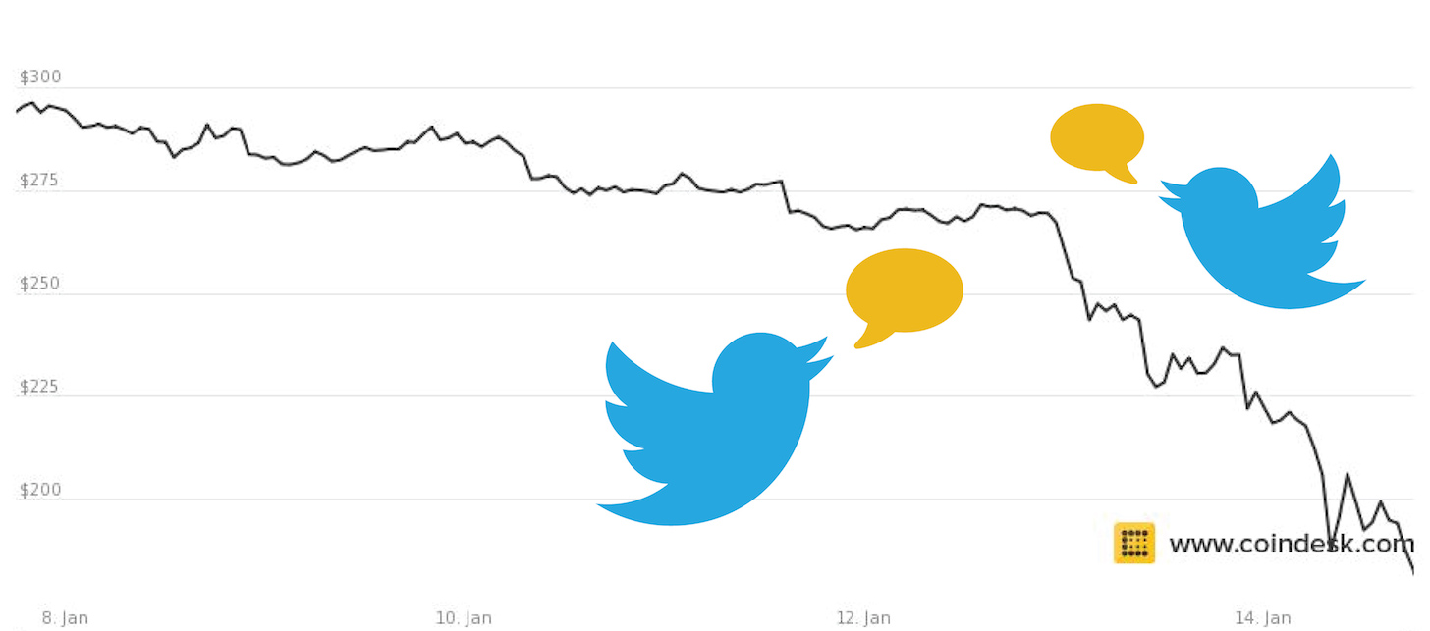
The Language of Bitcoin Twitter
Matt Ahlborg

Slide 2
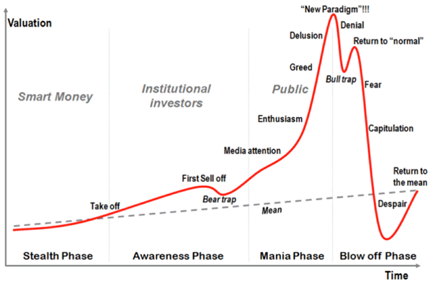
The Idea:
Cluster users based on topic modeling
Evaluate sentiment of each user cluster
Analyze differences in sentiment across user clusters over time

Slide 3
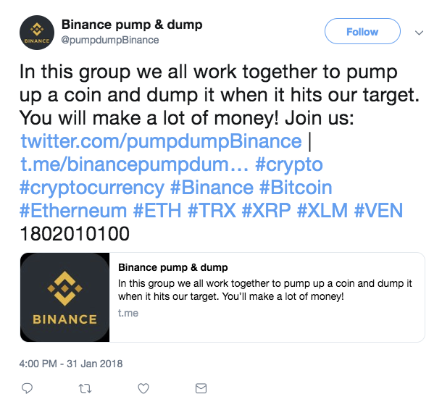
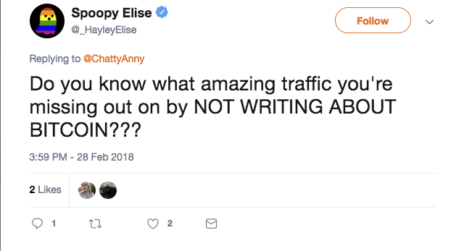
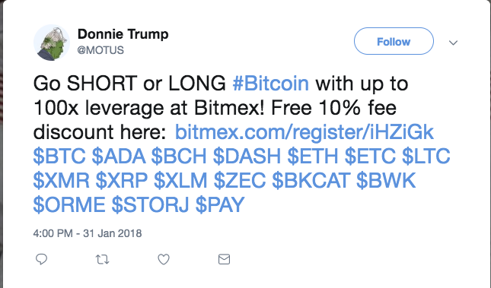
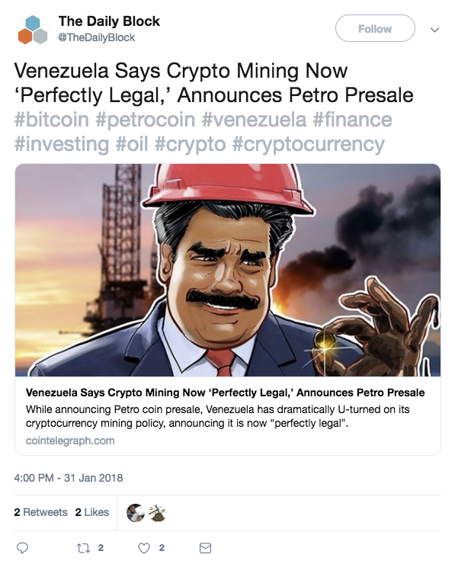
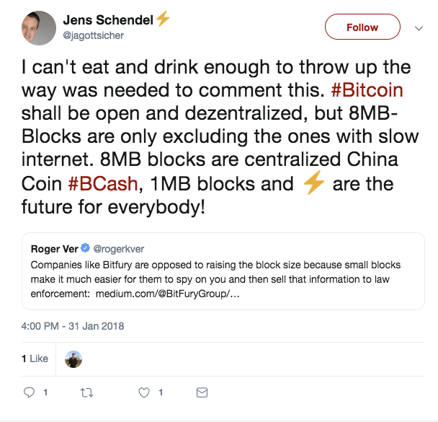

Slide 4
Pre-Processing
June 2017 to February 2018
Millions of ‘Bitcoin’ Tweets
Filter down by tweet volume
Filter down by similarity
Cluster individual tweets into user documents
Refine based on topic modeling results

Slide 5
Topics
Altcoins | Technological / General Sentiment | Market Sentiment | Multi-Level Marketing Schemes | Fork
ethereum | like | price | free | cash
eth | people | market | earn | bch
litecoin | know | current | sign | fork
ripple | value | analysis | join | bcash
ico | think | high | mining | core

Slide 6
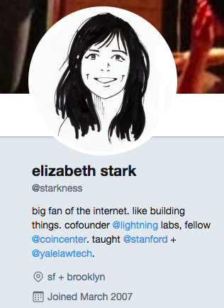
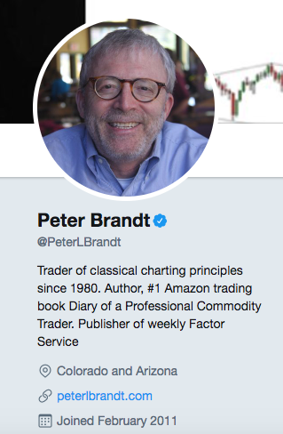
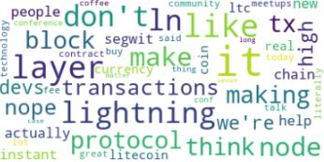
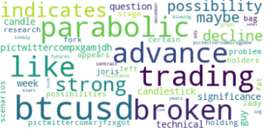
Technological
Market Sentiment

Slide 7
Further work:
Find the noobs
Place users into buckets according to account age, average likes, retweets
Lemmatize and create better word vectors on technological buzzwords
Add in more crypto terms to search
Apply sentiment analysis

