Slide 1
Mazerunner
Matt Johnson

Slide 2
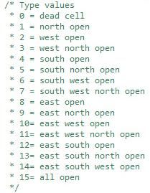
Overview
Goal: Create an agent that can traverse any maze under certain conditions.
Conditions:
Square grid
Open walls are based on binary
Agent can only sense the cell it is in
Maze is closed (except start and end point)

Slide 3


Plan from the start
Maze correctly displays using tileset
Generated from Prim’s Algorithm
Agent can traverse any maze thrown before it
Agent logs data and uses data for making best decision

Slide 4
How the agent works
CheckCell {
Begin
If(not at end){ If(current cell is a dead-end){ go back to last intersection; } Else if(current cell is tube){ continue path; } Else{ Log current cell as intersection; Pick random direction based on probability; CheckCell; } }
End;

Slide 5
Probability Calculations
Reads data from agent_data.ini
Get sum of times for viable direction of current cell
Divides successes of each viable direction by sum and put into array
Pick random number (Math.random();)
Decide direction based on random number
If west had 0 successes and north had 1, north will be picked every time.
If west had 1 success and north had 3, west will be picked 25% of the time.
(Given west and North are only viable directions)

Slide 6
Demo
A 5 x 3 maze
A 10 x 5 maze
A 15 x 10 maze

Slide 7
Improvements
A way to generate the mazes
Prim’s Algorithm
Learning based on the algorithm used
Agent being more abstract
Currently limited to square grid, relies heavily on data from each Cell
Noisy sensing
Gaussian smoothing algorithm

Slide 8
Contributions
Images: me
Documentation: me
Coding: me
All from scratch
No outside resources/contributions
Etc.

Slide 9
Questions

