Slide 1
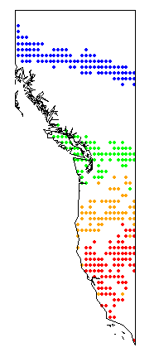
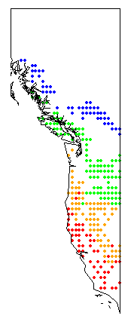
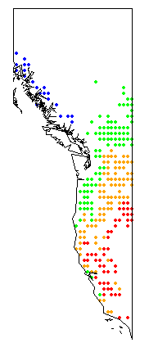

Mean annual temperature
Mean coldest month temperature
Mean warmest month temperature
Assuming elevation could be held constant at 415 m; whereabouts geographically would sites need to be located to experience the same general temperatures as the transplant across the elevational range boundary (+/- 0.5oC).
415m
1400m
2393m
3010m
Sites from Angert and Schemske 2005

