Slide 1
How to be a Good Developer
SESSION 2

Slide 2
Values
Simplicity
Communication
Feedback
Courage
Respect

Slide 3
Principles
Boy Scout Rule
Persistence Ignorance
You Aren’t Gonna
Need It
Keep It Simple
Stable Dependencies
Hollywood
Single Responsibility
Open-Closed
Liskov Substitution
Interface Segregation
Don’t Repeat Yourself
Inversion of Control
Dependency Inversion
Explicit Dependencies
Once and Only Once
Separation of Concerns
Tell, Don’t Ask
Encapsulation
Principle of Least Surprise

Slide 4
Patterns | Creational, Structural, Behavioural
Factory method
Abstract factory
Builder
Prototype
Singleton
Adaptor
Bridge
Composite
Decorator
Facade
Flyweight
Proxy
Chain of responsiblity
Command
Interpreter
Iterator
Mediator
Memento
Observer
State
Stategy
Template
Visitor

Slide 5
Value | Communication
We work together as a team and know how to communicate with each other
We share problems and speak to each other regularly to know what’s going on
We help each other where necessary

Slide 6
Principles | You Aren’t Gonna Need It
An extreme programming (XP) principle which states:

Slide 7
Always implement things when you actually need them, never when you just foresee that you need them.

Slide 8
Principles | You Aren’t Gonna Need It
In the context of XP it should be used with continuous refactoring, automated unit testing and continuous integration.
With continuous refactoring, a feature can be added later only when it becomes necessary.

Slide 9
Principles | Keep It Simple, Stupid
Given a range of solutions to a problem, choose the simplest.
This is not doing the quickest and easiest thing, rather the simplest.
In the context of You Aren’t Gonna Need It striving for the simplest solution makes it easier to refactor later.

Slide 10
Principles | Keep It Simple, Stupid
There will always be situations where thinking ahead and developing with the future in mind might be a good idea.
Think of this principle as an attempt to always aim for simple.
Complicated solutions may be more efficient and technically better, but this principle states that they may at best not be necessary and at worst cause more problems in themselves.

Slide 11
Pattern | Builder Creational
This pattern deals with the creation of complex aggregate objects.
It attempts to deal with the telescoping constructor anti-pattern in the abstract factory or factory method patterns.
Instead of using a constructor the pattern uses a builder object which accepts parameters step by step and produces a constructed object.

Slide 12
The telescoping constructor anti-pattern occurs when the increase in number and combination of constructor parameters leads to an ever-growing list of constructors.

Slide 13
Pattern | Builder Creational
This pattern deals with the creation of complex aggregate objects.
It attempts to deal with the telescoping constructor anti-pattern in the abstract factory or factory method patterns.
Instead of using a constructor the pattern uses a builder object which accepts parameters step by step and produces a constructed object.

Slide 14
Pattern | Builder Creational
It can also be useful for dealing with data that can’t be easily edited such as html code, SQL queries and which needs to be constructed in its entirety.
A builder can take the information necessary to build such data step by step.

Slide 15
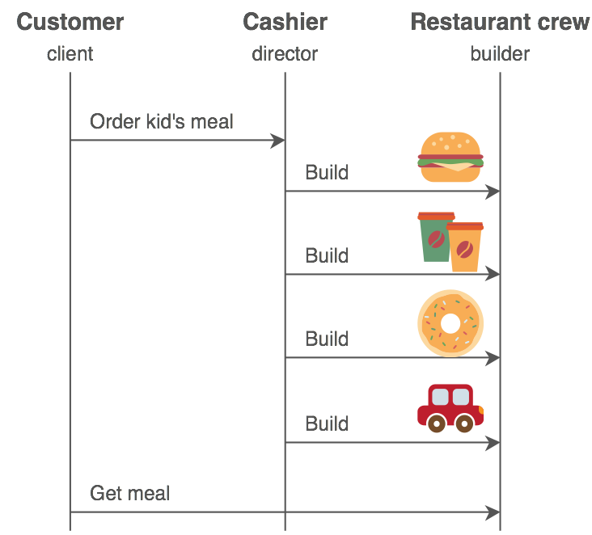
Pattern | Builder Creational

Slide 16
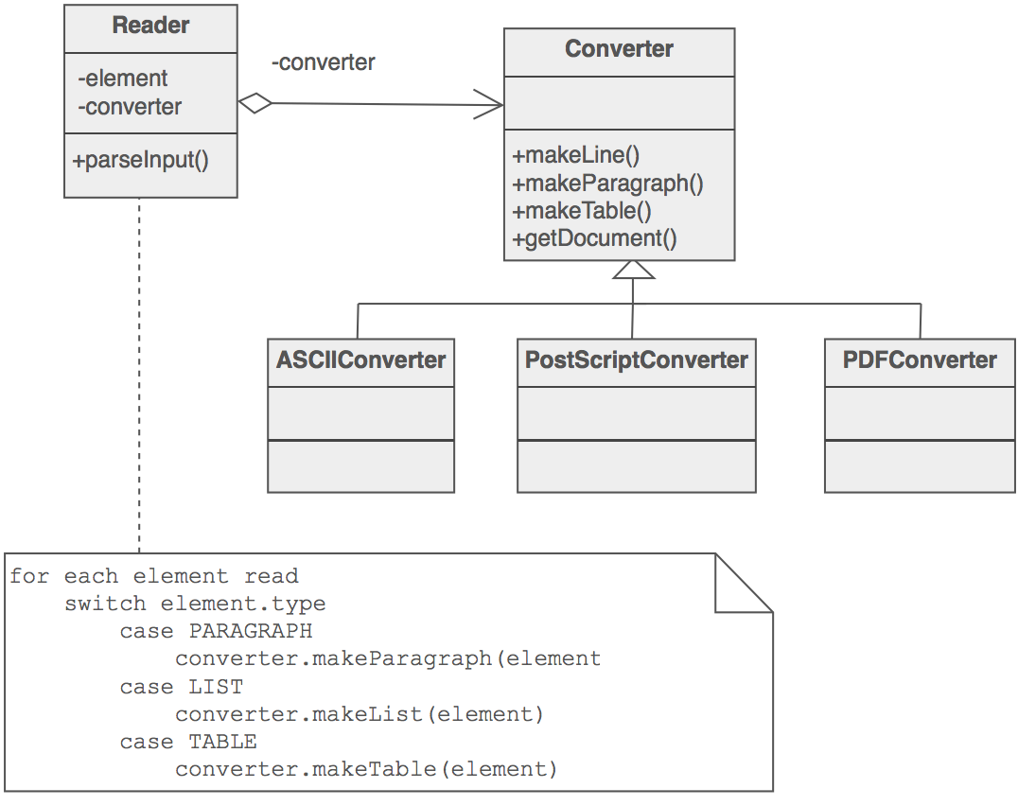
Pattern | Builder Creational

Slide 17
Pattern | Builder Creational
Source Making : Builder Design Pattern
https://sourcemaking.com/design_patterns/builder
Wikipedia: Builder Pattern
https://en.wikipedia.org/wiki/Builder_pattern

Slide 18
Pattern | Prototype Creational
This pattern is used when the type of objects being created are determined by an instance serving as a prototype which can be cloned to create new instances.
This is beneficial when
Using new would be an expensive operation
When an newly instantiated object needs to be an identical copy of another instance

Slide 19
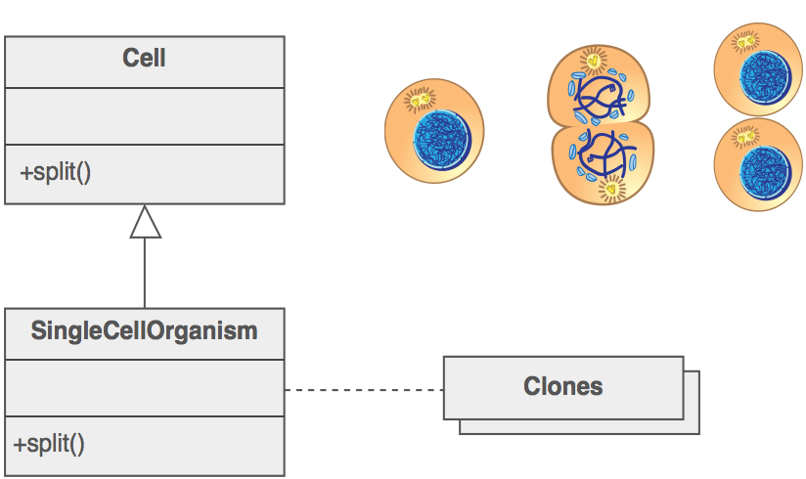
Pattern | Prototype Creational

Slide 20
Pattern | Prototype Creational
Source Making : Prototype Design Pattern
https://sourcemaking.com/design_patterns/prototype
Wikipedia: Prototype Pattern
https://en.wikipedia.org/wiki/Prototype_pattern

Slide 21
Next session
Value | Feedback
Principles | Stable Dependencies
Principles | Hollywood
Patterns | Singleton
Patterns | Adaptor

