Slide 1
How to be a Good Developer
SESSION 6

Slide 2
Values
Simplicity
Communication
Feedback
Courage
Respect

Slide 3
Principles
Boy Scout Rule
Persistence Ignorance
You Aren’t Gonna
Need It
Keep It Simple
Stable Dependencies
Hollywood
Single Responsibility
Open-Closed
Liskov Substitution
Interface Segregation
Don’t Repeat Yourself
Inversion of Control
Dependency Inversion
Explicit Dependencies
Once and Only Once
Separation of Concerns
Tell, Don’t Ask
Encapsulation
Principle of Least Surprise

Slide 4
Patterns | Creational, Structural, Behavioural
Factory method
Abstract factory
Builder
Prototype
Singleton
Adaptor
Bridge
Composite
Decorator
Facade
Flyweight
Proxy
Chain of responsiblity
Command
Interpreter
Iterator
Mediator
Memento
Observer
State
Stategy
Template
Visitor

Slide 5
Principles | Don’t Repeat Yourself
This principle states to remove both repetition of process and repetition of logic.

Slide 6
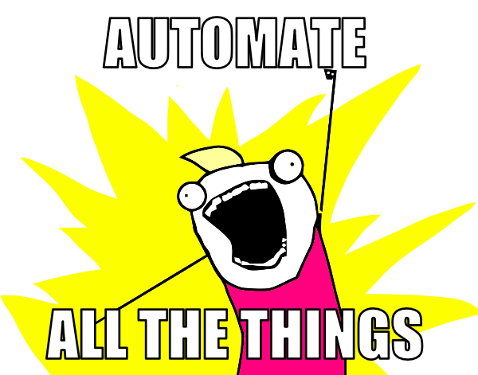

Slide 7
Principles | Inversion of Control
A principle in which custom-written portions of a computer program receive the flow of control from a generic framework.

Slide 8
Principles | Inversion of Control
Traditional control
main
Method 1
Method 2
Method 3
Method 4

Slide 9
Principles | Inversion of Control
Inverted control
Module 1
Module 2
IoC Container
Module 3
Module 4

Slide 10
Pattern | Proxy Structural
This pattern is centred around creating a placeholder for another object to control access to it.
There are 4 common situations where it’s applicable

Slide 11
Pattern | Proxy Structural
A virtual proxy for expensive to create objects. The real object is created first accessed
A remote proxy to provide a local instance for an object that is in a different address space
A protective proxy controls access to a private object. The proxy checks permissions of a caller before allowing access
A smart proxy adds additional actions on access like reference counting, loading or synchronisation.

Slide 12
Pattern | Proxy Structural
Accessor
Far Away
Resource
Class A
Resource
uses

Slide 13
Pattern | Proxy Structural
Accessor
Far Away
Proxy
Far Away
Resource
Class A
Proxy
Resource
uses
cached access

Slide 14
public interface Image {
void display();
}
public class ProxyPatternDemo {
public static void main(String[] args) {
Image image = new ProxyImage("test_10mb.jpg");
//image will be loaded from disk
image.display();
System.out.println("");
//image will not be loaded from disk
image.display();
}
}
public class RealImage implements Image {
private String fileName;
public RealImage(String fileName){
this.fileName = fileName;
loadFromDisk(fileName);
}
@Override
public void display() {
System.out.println("Displaying " + fileName);
}
private void loadFromDisk(String fileName){
System.out.println("Loading " + fileName);
}
}

Slide 15
Pattern | Proxy Creational
Source Making : Proxy Design Pattern
https://sourcemaking.com/design_patterns/proxy
Wikipedia: Proxy Pattern
https://en.wikipedia.org/wiki/proxy_pattern

Slide 16
the behavioural design patterns identify common communication patterns between a client and code, and try to remain loosely coupled whilst enabling this communication

Slide 17
Pattern | Chain of Responsibility Behavioural
This pattern is concerned with the scenario of a client having a request which can be dealt with by multiple receivers.
As a way of avoiding coupling, it recommends chaining handlers so that the request can be passed from one to the next until a handler accepts and deals with the request.
The number of handlers isn’t known beforehand and they can be configured dynamically.

Slide 18
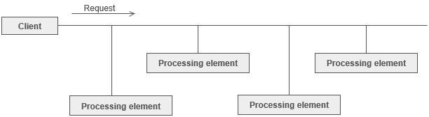
Pattern | Chain of Responsibility Behavioural

Slide 19
[Flags]
public enum LogLevel
{
None = 0, // 0
Info = 1, // 1
Debug = 2, // 10
Warning = 4, // 100
Error = 8, // 1000
FunctionalMessage = 16, // 10000
FunctionalError = 32, // 100000
All = 63 // 111111
}

Slide 20
/// <summary>
/// Abstract Handler in chain of responsibility pattern.
/// </summary>
public abstract class Logger
{
protected LogLevel logMask;
// The next Handler in the chain
protected Logger next;
public Logger(LogLevel mask)
{
this.logMask = mask;
}
/// <summary>
/// Sets the Next logger to make a list/chain of Handlers.
/// </summary>
public Logger SetNext(Logger nextlogger)
{
next = nextlogger;
return nextlogger;
}
public void Message(string msg, LogLevel severity)
{
if ((severity & logMask) != 0)
//True only if all logMask bits are set in severity
{
WriteMessage(msg);
}
if (next != null)
{
next.Message(msg, severity);
}
}
abstract protected void WriteMessage(string msg);
}

Slide 21
public class ConsoleLogger : Logger
{
public ConsoleLogger(LogLevel mask)
: base(mask)
{ }
protected override void WriteMessage(string msg)
{
Console.WriteLine("Writing to console: " + msg);
}
}
public class EmailLogger : Logger
{
public EmailLogger(LogLevel mask)
: base(mask)
{ }
protected override void WriteMessage(string msg)
{
// Placeholder for mail send logic, usually the email configurations are saved in config file.
Console.WriteLine("Sending via email: " + msg);
}
}

Slide 22
public class ConsoleLogger : Logger
{
public ConsoleLogger(LogLevel mask)
: base(mask)
{ }
protected override void WriteMessage(string msg)
{
Console.WriteLine("Writing to console: " + msg);
}
}
public class EmailLogger : Logger
{
public EmailLogger(LogLevel mask)
: base(mask)
{ }
protected override void WriteMessage(string msg)
{
// Placeholder for mail send logic, usually the email configurations are saved in config file.
Console.WriteLine("Sending via email: " + msg);
}
}

Slide 23
class FileLogger : Logger
{
public FileLogger(LogLevel mask)
: base(mask)
{ }
protected override void WriteMessage(string msg)
{
// Placeholder for File writing logic
Console.WriteLine("Writing to Log File: " + msg);
}
}

Slide 24
public class Program
{
public static void Main(string[] args)
{
// Build the chain of responsibility
Logger logger, logger1, logger2;
logger = new ConsoleLogger(LogLevel.All);
logger1 = logger.SetNext(new EmailLogger(LogLevel.FunctionalMessage | LogLevel.FunctionalError));
logger2 = logger1.SetNext(new FileLogger(LogLevel.Warning | LogLevel.Error));
// Handled by ConsoleLogger since the console has a loglevel of all
logger.Message("Entering function ProcessOrder().", LogLevel.Debug);
logger.Message("Order record retrieved.", LogLevel.Info);
// Handled by ConsoleLogger and FileLogger since filelogger implements Warning & Error
logger.Message("Customer Address details missing in Branch DataBase.", LogLevel.Warning);
logger.Message("Customer Address details missing in Organization DataBase.", LogLevel.Error);
// Handled by ConsoleLogger and EmailLogger as it implements functional error
logger.Message("Unable to Process Order ORD1 Dated D1 For Customer C1.", LogLevel.FunctionalError);
// Handled by ConsoleLogger and EmailLogger
logger.Message("Order Dispatched.", LogLevel.FunctionalMessage);
}
}
}

Slide 25
Pattern | Chain of Responsibility Structural
Source Making : Chain of Responsibility Design Pattern
https://sourcemaking.com/design_patterns/chain_of_responsibility
Wikipedia: Chain of Responsibility Pattern
https://en.wikipedia.org/wiki/chain-of-responsibility_pattern

Slide 26
Next session
Principles | Dependency Inversion
Principles | Explicit Dependencies
Patterns | Command
Patterns | Interpreter

