Slide 1
How to be a Good Developer
SESSION 9

Slide 2
Values
Simplicity
Communication
Feedback
Courage
Respect

Slide 3
Principles
Boy Scout Rule
Persistence Ignorance
You Aren’t Gonna
Need It
Keep It Simple
Stable Dependencies
Hollywood
Single Responsibility
Open-Closed
Liskov Substitution
Interface Segregation
Don’t Repeat Yourself
Inversion of Control
Dependency Inversion
Explicit Dependencies
Once and Only Once
Separation of Concerns
Tell, Don’t Ask
Encapsulation
Principle of Least Surprise

Slide 4
Patterns | Creational, Structural, Behavioural
Factory method
Abstract factory
Builder
Prototype
Singleton
Adaptor
Bridge
Composite
Decorator
Facade
Flyweight
Proxy
Chain of responsiblity
Command
Interpreter
Iterator
Mediator
Memento
Observer
State
Stategy
Template
Visitor

Slide 5
Principles | Tell, Don’t Ask
This principle encourages the combination of data and the code that operates on the data.
Making objects that have behaviour with data means less duplicated code operating on the data, and more reusability.

Slide 6
public class CpuMonitor
{
public int Value { get; set; }
}
public class Client
{
public void AlertService(List<CpuMonitor> cpuMonitors)
{
foreach (var cpuMonitor in cpuMonitors)
{
if (cpuMonitor.Value > 90)
{
// alert
}
}
}
}

Slide 7
public class CpuMonitor
{
private readonly int _alertThreshold;
public CpuMonitor(int alertThreshold)
{
_alertThreshold = alertThreshold;
}
public int Value { get; set; }
public bool ExceedsThreshold { get { return Value >= _alertThreshold; } }
}
public class Client
{
public void AlertService(List<CpuMonitor> cpuMonitors)
{
foreach (var cpuMonitor in cpuMonitors)
{
if (cpuMonitor.ExceedsThreshold)
{
// alert
}
}
}
}

Slide 8
public class CpuMonitor
{
private readonly int _alertThreshold;
private readonly Action<CpuMonitor> _alertAction;
public CpuMonitor(int alertThreshold, Action<CpuMonitor> alertAction)
{
_alertThreshold = alertThreshold;
_alertAction = alertAction;
}
public int Value { get; set; }
public bool ExceedsThreshold { get { return Value >= _alertThreshold; } }
public void Sample()
{
if (ExceedsThreshold)
{
_alertAction(this);
}
}
}
public class Client
{
public void AlertService(List<CpuMonitor> cpuMonitors)
{
foreach (var cpuMonitor in cpuMonitors)
{
cpuMonitor.Sample();
}
}
}

Slide 9
Principles | Tell, Don’t Ask
As most principles this should be balanced with other points
Persistence Ignorance recommends can lead to data models that can go straight into databases. Behaviour attached to these models may be difficult.

Slide 10
Principles | Encapsulation
This principle is a key component of Objected-Oriented Programming.
As a principle it reminds us to think about object we create.
Objects should manage their own behaviour and state so that callers don’t need to concern themselves with the inner workings.
Objects should keep their internal state valid, allowing it to be modified by controlled accesors

Slide 11

ICEBERG CLASS
It’s cool to hide your code

Slide 12
encapsulation inheritance polymorphism abstraction

Slide 13
Pattern | Memento Behavioural
This pattern deals capturing an object’s internal state so that it can be reused later.
The snapshot of the state is the memento.
It’s made up of
Originator
Caretaker
Memento

Slide 14
/// <summary>
/// The 'Originator' class
/// </summary>
class Originator
{
private string _state;
// Property
public string State
{
get { return _state; }
set
{
_state = value;
Console.WriteLine("State = " + _state);
}
}
// Creates memento
public Memento CreateMemento()
{
return (new Memento(_state));
}
// Restores original state
public void SetMemento(Memento memento)
{
Console.WriteLine("Restoring state...");
State = memento.State;
}
}
/// <summary>
/// The 'Memento' class
/// </summary>
class Memento
{
private string _state;
// Constructor
public Memento(string state)
{
this._state = state;
}
// Gets or sets state
public string State
{
get { return _state; }
}
}
/// <summary>
/// The 'Caretaker' class
/// </summary>
class Caretaker
{
private Memento _memento;
// Gets or sets memento
public Memento Memento
{
set { _memento = value; }
get { return _memento; }
}
}
}
Originator
Memento
Caretaker

Slide 15
/// <summary>
/// MainApp startup class for Structural
/// Memento Design Pattern.
/// </summary>
class MainApp
{
/// <summary>
/// Entry point into console application.
/// </summary>
static void Main()
{
Originator o = new Originator();
o.State = "On";
// Store internal state
Caretaker c = new Caretaker();
c.Memento = o.CreateMemento();
// Continue changing originator
o.State = "Off";
// Restore saved state
o.SetMemento(c.Memento);
// Wait for user
Console.ReadKey();
}
}

Slide 16
Pattern | Memento Behavioural
Source Making : Memento Design Pattern
https://sourcemaking.com/design_patterns/memento
Wikipedia: Memento Pattern
https://en.wikipedia.org/wiki/memento_pattern

Slide 17
Pattern | Observer Behavioural
This pattern forms the basis of model-view-controller (MVC).
It describes an object with a state which has listeners that register to be notified of changes.
When the changes occur the listeners check the object for the current state.

Slide 18
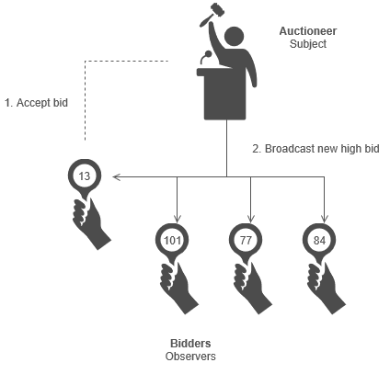
Pattern | Observer Behavioural

Slide 19
/// <summary>
/// The 'Subject' abstract class
/// </summary>
abstract class Subject
{
private List<Observer> _observers = new List<Observer>();
public void Attach(Observer observer)
{
_observers.Add(observer);
}
public void Detach(Observer observer)
{
_observers.Remove(observer);
}
public void Notify()
{
foreach (Observer o in _observers)
{
o.Update();
}
}
}
/// <summary>
/// The 'ConcreteSubject' class
/// </summary>
class ConcreteSubject : Subject
{
private string _subjectState;
// Gets or sets subject state
public string SubjectState
{
get { return _subjectState; }
set { _subjectState = value; }
}
}

Slide 20
/// <summary>
/// The 'Observer' abstract class
/// </summary>
abstract class Observer
{
public abstract void Update();
}
/// <summary>
/// The 'ConcreteObserver' class
/// </summary>
class ConcreteObserver : Observer
{
private string _name;
private string _observerState;
private ConcreteSubject _subject;
// Constructor
public ConcreteObserver(
ConcreteSubject subject, string name)
{
this._subject = subject;
this._name = name;
}
public override void Update()
{
_observerState = _subject.SubjectState;
Console.WriteLine("Observer {0}'s new state is {1}",
_name, _observerState);
}
// Gets or sets subject
public ConcreteSubject Subject
{
get { return _subject; }
set { _subject = value; }
}
}
}

Slide 21
/// <summary>
/// MainApp startup class for Structural
/// Observer Design Pattern.
/// </summary>
class MainApp
{
/// <summary>
/// Entry point into console application.
/// </summary>
static void Main()
{
// Configure Observer pattern
ConcreteSubject s = new ConcreteSubject();
s.Attach(new ConcreteObserver(s, "X"));
s.Attach(new ConcreteObserver(s, "Y"));
s.Attach(new ConcreteObserver(s, "Z"));
// Change subject and notify observers
s.SubjectState = "ABC";
s.Notify();
// Wait for user
Console.ReadKey();
}
}

Slide 22
Pattern | Observer Behavioural
Source Making : Observer Design Pattern
https://sourcemaking.com/design_patterns/observer
Wikipedia: Observer Pattern
https://en.wikipedia.org/wiki/observer_pattern

Slide 23
Pattern | State Behavioural
The state pattern describes a state machine made from objects.
Each state is encapsulated into an object which is switched to during state transitions.
All states derive from a base class or interface.

Slide 24
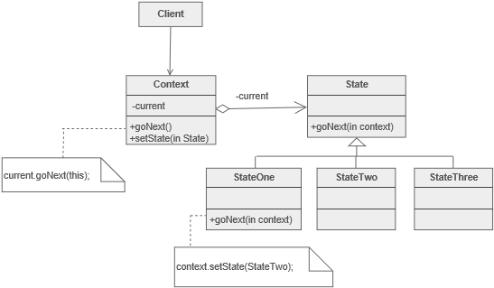
Pattern | State Behavioural

Slide 25
/// <summary>
/// The 'State' abstract class
/// </summary>
abstract class State
{
public abstract void Handle(Context context);
}
/// <summary>
/// A 'ConcreteState' class
/// </summary>
class ConcreteStateA : State
{
public override void Handle(Context context)
{
context.State = new ConcreteStateB();
}
}
/// <summary>
/// A 'ConcreteState' class
/// </summary>
class ConcreteStateB : State
{
public override void Handle(Context context)
{
context.State = new ConcreteStateA();
}
}
/// <summary>
/// The 'Context' class
/// </summary>
class Context
{
private State _state;
// Constructor
public Context(State state)
{
this.State = state;
}
// Gets or sets the state
public State State
{
get { return _state; }
set
{
_state = value;
Console.WriteLine("State: " + _state.GetType().Name);
}
}
public void Request()
{
_state.Handle(this);
}
}

Slide 26
/// <summary>
/// MainApp startup class for Structural
/// State Design Pattern.
/// </summary>
class MainApp
{
/// <summary>
/// Entry point into console application.
/// </summary>
static void Main()
{
// Setup context in a state
Context c = new Context(new ConcreteStateA());
// Issue requests, which toggles state
c.Request();
c.Request();
c.Request();
c.Request();
// Wait for user
Console.ReadKey();
}
}

Slide 27
Pattern | State Behavioural
Source Making : State Design Pattern
https://sourcemaking.com/design_patterns/state
Wikipedia: State Pattern
https://en.wikipedia.org/wiki/state_pattern

Slide 28
Next session
Principles | Principal of Least Surprise
Patterns | Strategy
Patterns | Template Method
Patterns | Visitor

