Slide 1
Can improving a person's mood affect their ability to play football
By Matthew Jones

Slide 2
Introduction
About me
What I am going to go through:
Main ideas of the project
Background research
Key technologies
Project plan and evaluation
Any questions

Slide 3

Main Ideas
The aim of the project –
Is it possible to affect a person's mood to allow them to play better in a football match.
Goals for this project:
Create an app to calm or energise a player
Record player data with and without app use
Compare and evaluate results

Slide 4
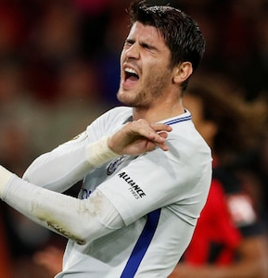
Main ideas
What is the problem?
A way a player thinks can affect their whole game
External factors affect people all the time
Players antagonise the opposition

Slide 5
Background Research
Negative emotions can affect nearly all parts of a player's game.
The four main emotions are stress, anxiety, tension and aggression.
Breathing techniques can be used to stop these emotions and are recommended by the NHS.

Slide 6
Potential Issues and problems
Time of using the app.
App must work for all when in use.
Mood and behaviour, hard to analyse.

Slide 7
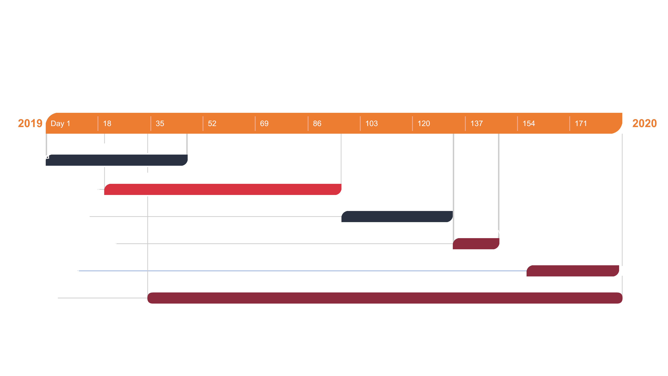

Slide 8

Any Questions?

