Slide 1
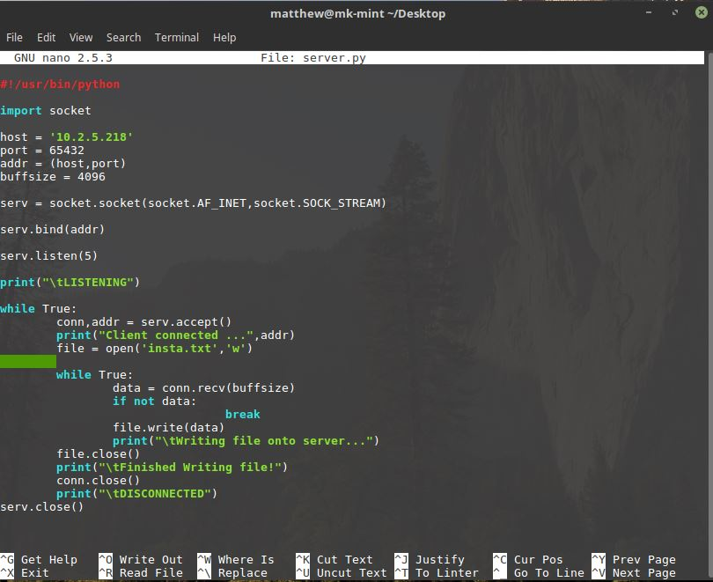
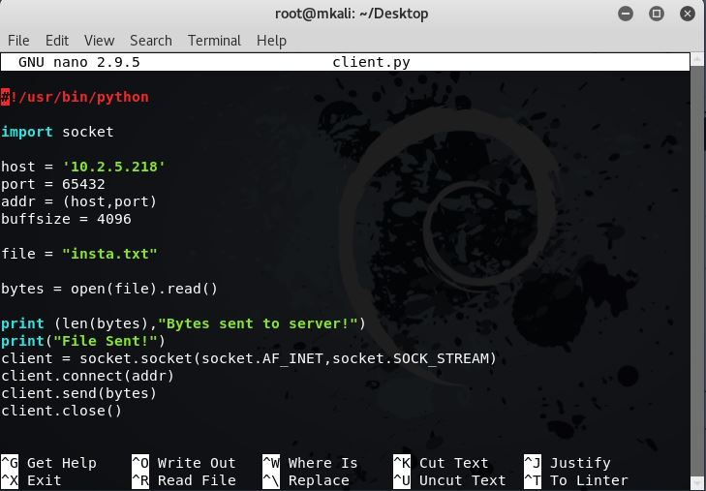
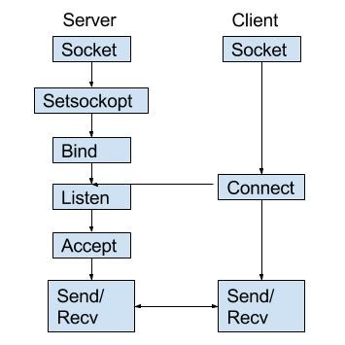
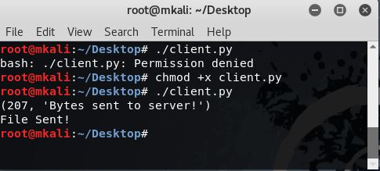
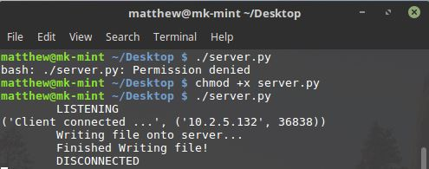
SOCKET PROGRAMMING
b/w Two Virtual Machines
Using Python
Socket programming is a way of connecting two nodes on a network to communicate with each other. One socket(node) listens on a particular port at an IP, while other socket reaches out to the other to form a connection. Server forms the listener socket while client reaches out to the server.
SERVER (Mint Linux)
CLIENT (Kali Linux)
Create Socket
Configure Tcp/Udp
Bind the Host ip address
and Port No.
4. Listen
5. Accept
Create Socket
Connect to Server
Send/Receive files
By
Matthew Kanaparthi (URK17CS148)

