Slide 1
28th International Turkish Cooperative Congress · ITCC-2026
Source-Grounded
Research Assistant
Retrieval-Augmented Generation that cites what it used — and refuses when the evidence is not there
Matt Karimov
[ Affiliation — department, university ]
14 August 2026 · Online session 15:30–16:30
Notes:
0:00–0:45 — Opening. Good afternoon. My name is [name], from [affiliation]. Thank you to the organising committee. Today I want to show you a research tool, and one design decision inside it that I think matters for anyone in this room who works with documents: this assistant refuses to answer when its document collection does not support an answer. TECH CHECK before you start: share the browser window, not the whole screen. Zoom to 125–150%.

Slide 2
THE PROBLEM
Asking a general chatbot about the literature
1
2
3
Fluent, not sourced
Invented citations
No audit trail
The prose reads like scholarship. The provenance behind it is simply absent.
Author, year and page numbers that look correct and refer to nothing that exists.
You cannot see which text produced the claim, so you cannot check the claim at all.
The failure mode is not that the answer is sometimes wrong.
It is that a wrong answer looks exactly like a right one.
ITCC-2026 · Source-Grounded Research Assistant
2
Notes:
0:45–2:30 — The problem. Three failures, and they compound. (1) Fluency without sourcing. A language model produces text that has the register of scholarship without the apparatus of scholarship. (2) Invented citations. This is the one most of us have seen — a citation with the right shape, the right author, a plausible year, and no referent. (3) No audit trail. This is the deepest one. Even when the answer is correct, you cannot demonstrate that it is correct. Land the bottom line slowly — it is the sentence the whole talk hangs on.

Slide 3
RELEVANCE
Why this matters for cooperative research
Cooperatives are governed by disclosure. Member control, democratic participation and external audit all rest on the same thing: a claim that can be traced back to a document.
Members
M
Trust rests on disclosure that can be checked, not on assurance that it exists.
Auditors
A
A finding is only a finding if it points at a specific passage of a specific document.
A research tool that cannot show its source reproduces exactly the problem that transparency law exists to solve.
Researchers
R
A literature review is judged on its citations before it is judged on its argument.
ITCC-2026 · Source-Grounded Research Assistant
3
Notes:
2:30–4:00 — Why this audience. I am not presenting a general-purpose chatbot. I am presenting an instrument for working with a defined body of documents — and cooperatives are, institutionally, a disclosure problem. Member control means nothing if members cannot verify. An audit finding that cannot point at a page is an opinion. And in our own work as researchers, a citation that does not resolve is a defect, not a stylistic choice. So the requirement I set myself was: every sentence the system produces must be traceable to a page.

Slide 4
The central commitment
“When the collection does not contain sufficient evidence,
the system says so — instead of filling the gap.”
A refusal is a statement about the collection, not about the world.
It is a correct outcome, not a system failure — and the interface is designed to show it that way.
Notes:
4:00–5:00 — The commitment. Slow down here; this is the thesis of the talk. Every other design decision follows from this one sentence. Note the second line carefully, because it is a claim about epistemics, not about engineering: when this system refuses, it is not telling you the answer is unknowable. It is telling you that THIS collection does not contain it. Those are different statements, and conflating them would be its own kind of dishonesty. Pause after the quote. Let it sit.

Slide 5
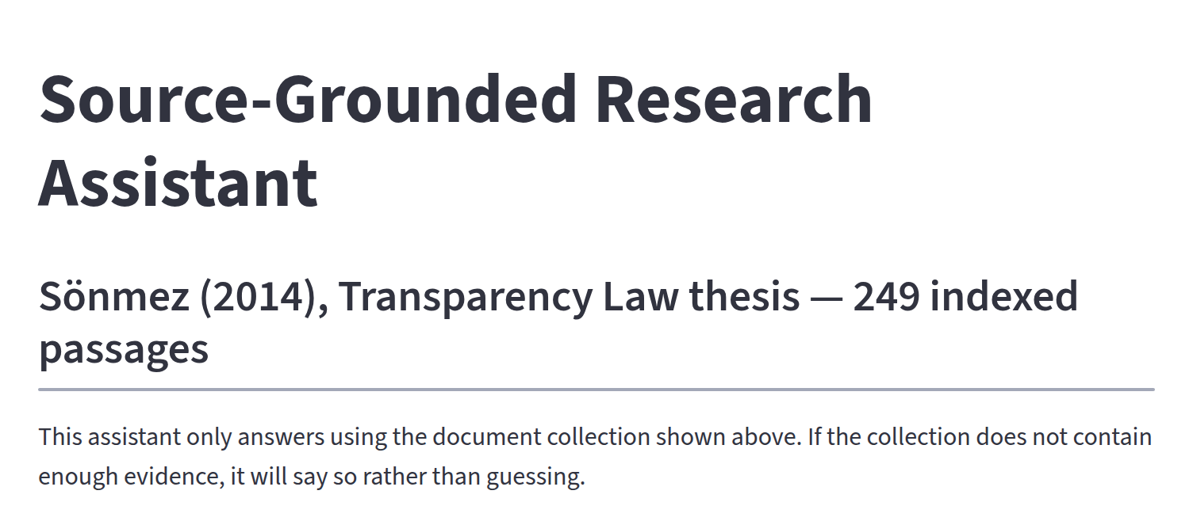
THE SYSTEM
What it is
A research assistant over an authorised collection — not a general chatbot.
Corpus today: one doctoral thesis on transparency law, 320 pages.
Indexed as 249 passages, each carrying its chapter, section and printed page.
Answers are composed only from passages retrieved for that question.
The collection and its size are printed above the chat box at all times — the reader always knows what is being searched.
Every answer carries citations that resolve to a page in the source.
ITCC-2026 · Source-Grounded Research Assistant
5
Notes:
5:00–6:15 — What it is. The corpus is deliberately small — one thesis — because the point of the prototype is the discipline of the pipeline, not the size of the library. The important word on this slide is 'authorised'. The collection is declared in advance. The system cannot reach outside it, and it cannot quietly supplement it from what the model happens to know. Point at the screenshot: the collection and its size are printed above the chat box, permanently.

Slide 6
HOW IT WORKS
One question, five stages
1
2
3
4
5
Ingest
Retrieve
Ground
Validate
Resolve
PDF extracted page by page. Chapter, section and printed page recorded for every passage.
The question is embedded and matched against 249 passages. Top 5 are selected.
Passages go to the model as opaque handles: [E1] … [E5].
Output is checked against the evidence before anything is shown.
Handles become page-numbered citations, by code, from stored provenance.
Three interfaces — a command line, an interactive prompt, and this web app — call one pipeline, so all three behave identically.
ITCC-2026 · Source-Grounded Research Assistant
6
Notes:
6:15–8:00 — The pipeline. Walk left to right, roughly 20 seconds per stage. (1) Ingest: provenance is captured at extraction time, and it is never rewritten afterwards. A chunk is never allowed to straddle a chapter boundary — a passage that spans two chapters would produce a citation that is false at one end. (2) Retrieve: cosine similarity, five passages. Deliberately simple and inspectable. (3) Ground: this is the stage the next slide is about. (4) Validate: blocking checks, before display. (5) Resolve: the page numbers are produced here, by code — not by the model. The banner matters for reproducibility: the demo you are about to see is not a separate implementation of the research tool. It is the same pipeline with a different front end.

Slide 7
THE KEY MECHANISM
The model never sees a page number
WHAT THE MODEL RECEIVES
WHAT THE READER RECEIVES
[E1] Sönmez (2014) — Chapter: Main Issues in
Corporate Governance — Section: 2.2.1 Imar Bank
“… the underlying reasons of this scandal,
‘shareholders’ fraud, poor management, insufficient
regulations’ and audit failure can be highlighted …”
“… insufficient regulations’ and audit failure ¹.”
1. Sönmez, M. (2014), Ch. “Main Issues in Corporate
Governance”, § 2.2.1 Imar Bank, pp. 88–89.
No page number anywhere in the model's input.
Resolved by code, from stored provenance — never by the model.
A page number that is not in the source extraction cannot reach the output. Not unlikely — impossible.
ITCC-2026 · Source-Grounded Research Assistant
7
Notes:
8:00–9:45 — The mechanism. This is the technical heart of the talk. Take your time. On the left is literally what the generation model is given: the passage text, the chapter, the section — and no page number anywhere in its input. The model refers to evidence by an opaque handle, E1. It cannot cite a page, because it has never been told one. On the right, after generation, the renderer replaces that handle with a footnote number and looks the page up in the stored provenance. So the usual failure — a fabricated page reference — is not made unlikely by better prompting. It is made structurally impossible. That distinction is the contribution. If one idea survives this talk, make it this slide.

Slide 8
OUTCOMES
Three answers, not one
Sufficient
Partial
Insufficient
The passages support an answer.
Part of the question is supported.
The collection cannot answer it.
Prose, superscript markers, a Sources line with real pages, and the limits of the answer stated.
The answer is given for the supported part, and the unsupported part is named explicitly.
A refusal, composed from retrieval metadata by code — naming what was searched, and what was not found.
The refusal text is written by the program, not by the language model — so it cannot be talked out of it.
ITCC-2026 · Source-Grounded Research Assistant
8
Notes:
9:45–10:45 — Three outcomes. Most systems have one outcome: an answer. This one has three, and the third is treated as a first-class result rather than an error path. 'Partial' matters more than it looks. Real scholarly questions are usually half-covered by any given source, and a system that has to choose between answering fully and refusing fully will overreach. Last line: because the refusal is assembled by code from retrieval metadata, it does not depend on the model's willingness to decline. Prompt pressure cannot dissolve it.

Slide 9
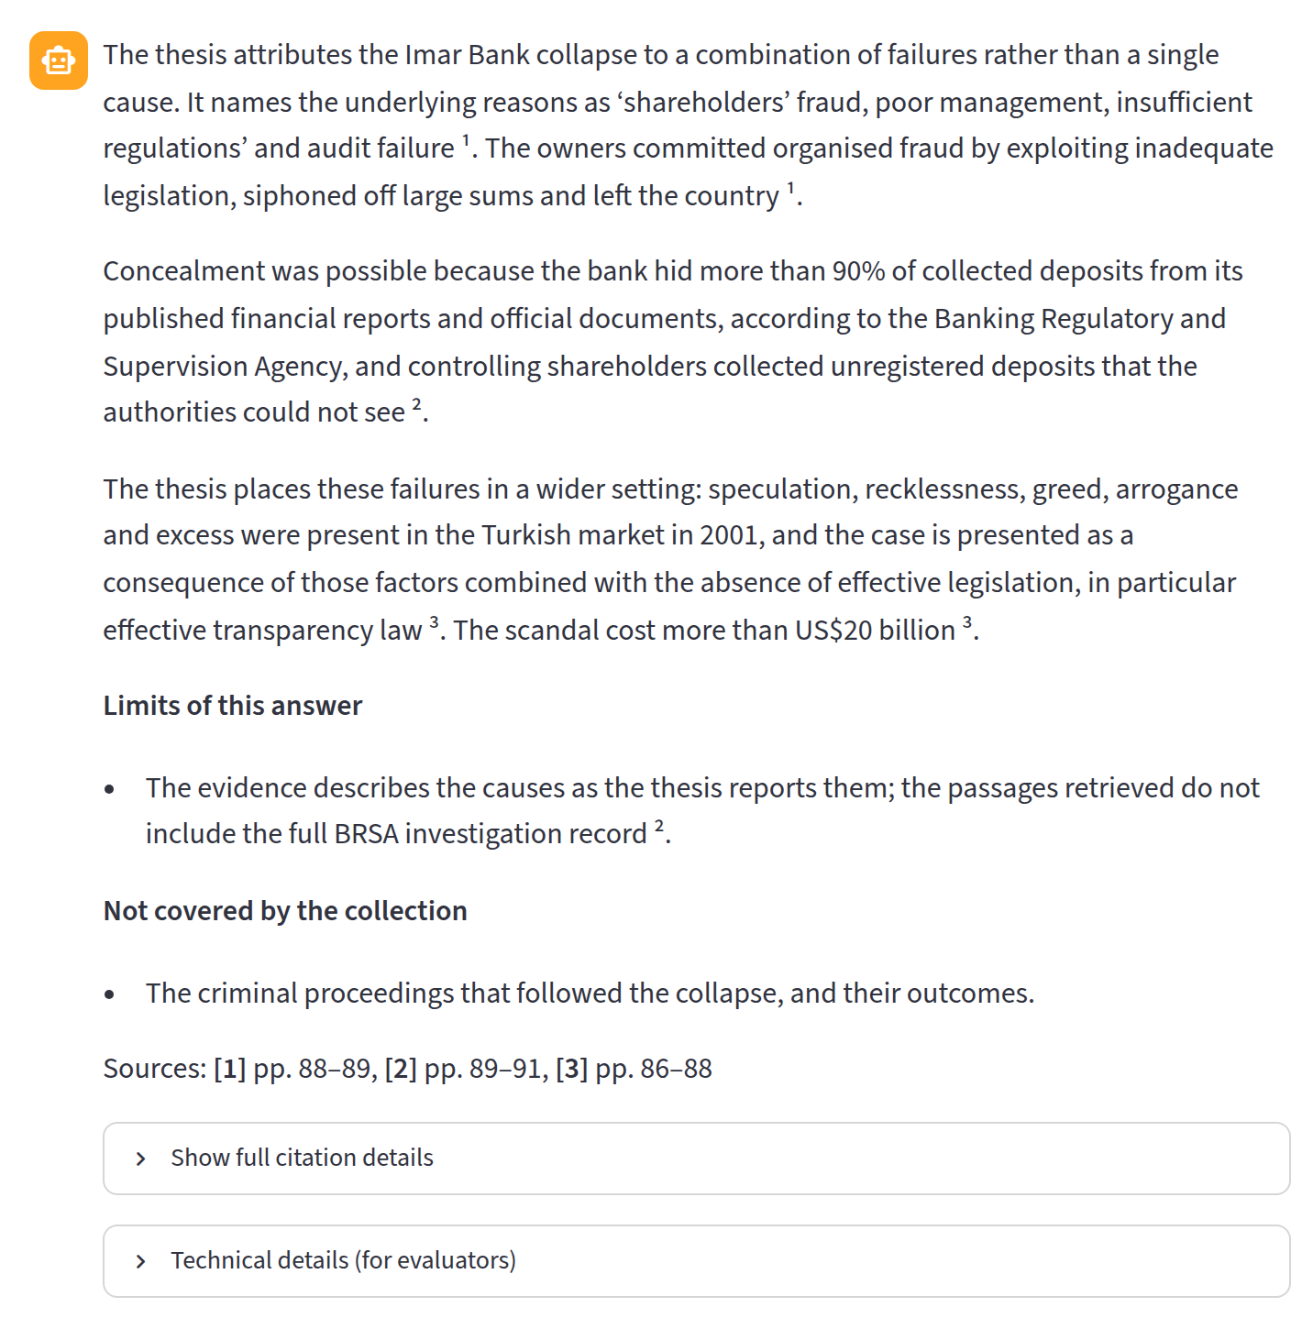
DEMONSTRATION 1
A grounded answer
“What were the main causes of the Imar Bank scandal in Turkey according to the thesis?”
1
Markers, not footnote codes
Each superscript points to one retrieved passage.
2
Sources resolve to pages
pp. 88–89, 89–91, 86–88 — read from the extraction, not generated.
3
Limits are stated
The answer says what the retrieved evidence does not establish.
4
Gaps are named
“Not covered by the collection” is part of the answer, not a disclaimer.
ITCC-2026 · Source-Grounded Research Assistant
9
Notes:
10:45–12:15 — Demo 1. Screenshots, not a live call — deliberately, so the timing is exact. Read one sentence of the answer aloud so the room hears the register: it is careful, it attributes, and it does not overstate. Then walk the four annotations. The one to dwell on is the third: the system volunteers the limits of its own answer. That is not politeness — it is the part a reviewer needs. If someone asks whether the prose is the model's: yes. What is NOT the model's is every page number on that screen.

Slide 10
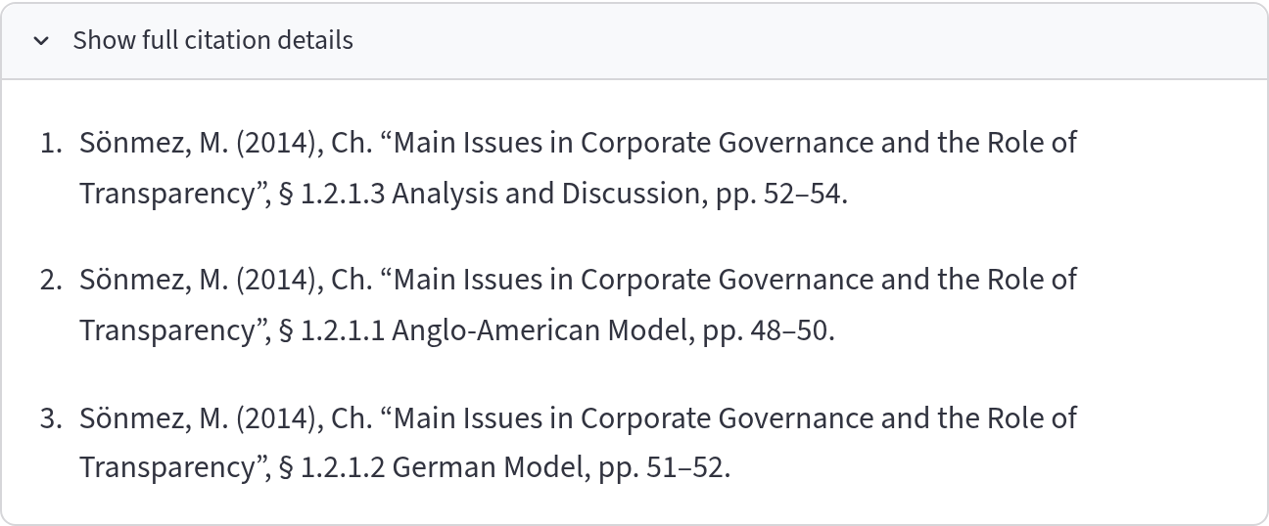
DEMONSTRATION 1
Every marker resolves to a citation
Chapter, section and printed page for each passage the answer used — one click away, so the main view stays readable while the full apparatus stays available.
These are the printed page numbers of the thesis — not PDF page indices.
ITCC-2026 · Source-Grounded Research Assistant
10
Notes:
12:15–13:00 — Citations. This is what a reader opens when they want to check a claim, and it is the reason I built the provenance layer first. Worth stating explicitly: these are the PRINTED page numbers from the thesis, not PDF page indices. The two differ by the front matter, and a citation that quietly used the wrong one would be useless to anyone trying to verify it. Where a page number was not printed on the source page, the system says so and flags it for human verification rather than guessing.

Slide 11
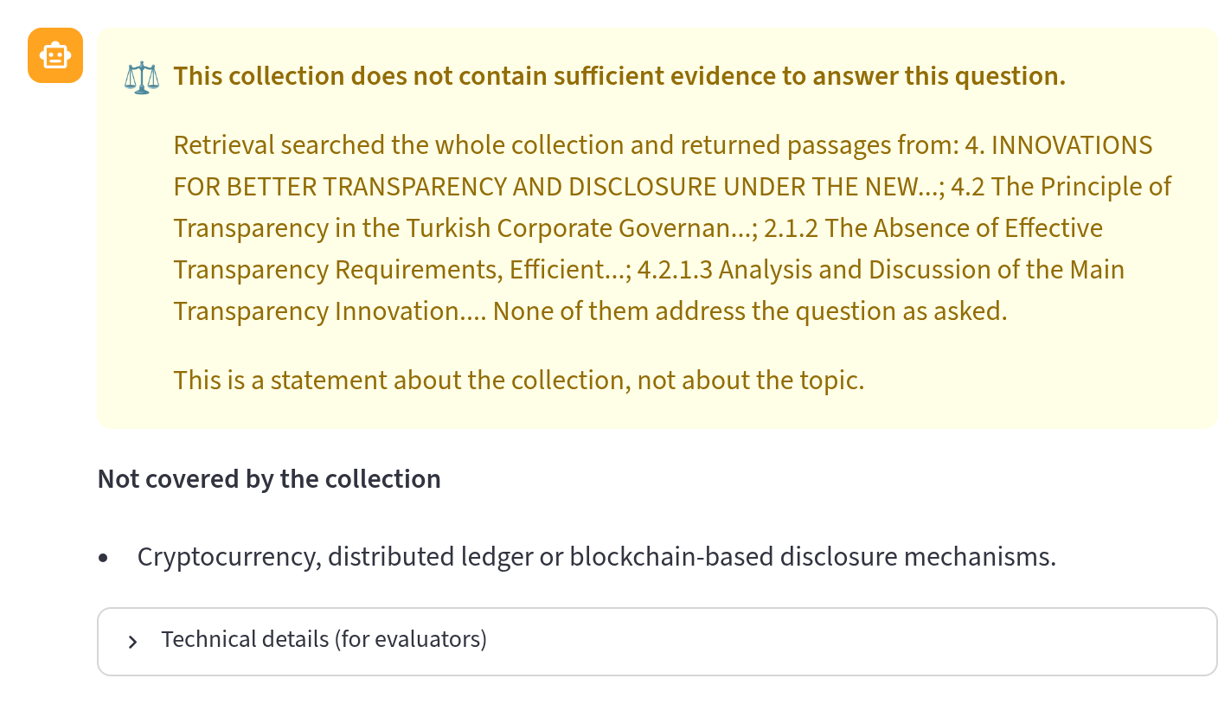
DEMONSTRATION 2
The refusal
“Does the thesis take a position on whether cryptocurrency-based disclosure mechanisms could improve financial transparency?”
The thesis was written in 2014. It has nothing to say about this.
A general chatbot would answer anyway — plausibly, and without a source.
The notice names what retrieval actually searched, so the refusal is inspectable.
Presented calmly, not as an error: yellow, not red. This is the system working.
ITCC-2026 · Source-Grounded Research Assistant
11
Notes:
13:00–14:30 — Demo 2. This is the slide I most want people to remember. Ask the room, rhetorically: what would your usual assistant do with this question? It would answer. Fluently. With confident structure. And nothing in the output would tell you the source said nothing. Notice the wording on screen: 'This collection does not contain sufficient evidence.' Not 'I don't know', not 'there is no research on this'. It is a claim about the collection, and it is one a reader can check. The colour choice is deliberate and I would defend it: refusals rendered as errors teach users to treat them as malfunctions to be worked around.

Slide 12
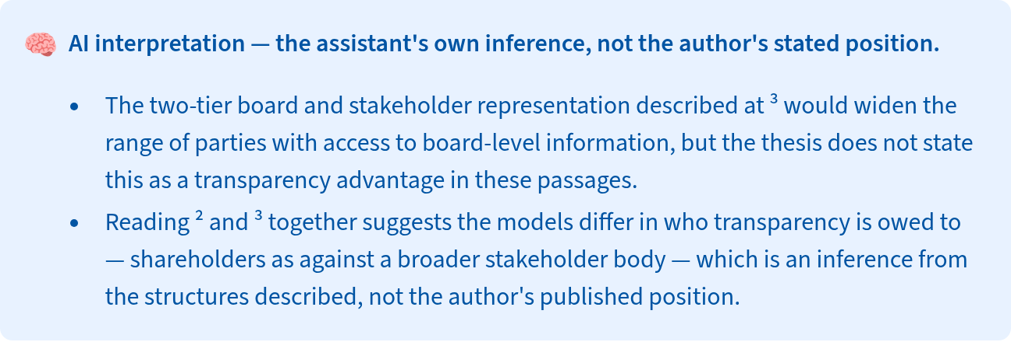
DEMONSTRATION 3
Where the assistant is inferring, it says so
“How does the thesis compare the Anglo-American and German models of corporate governance in terms of transparency?”
Separated
Inference is lifted out of the answer into its own labelled block.
Attributed
It states plainly that this is not the author's published position.
Still cited
The inference points at the passages it was drawn from.
The AI analyses; the researcher decides. Interpretation is offered as interpretation — never blended into the author's voice.
ITCC-2026 · Source-Grounded Research Assistant
12
Notes:
14:30–16:00 — Demo 3. This question is harder than it looks: the thesis describes both models, but it does not rank them on transparency. So an honest system has to do two things at once — report what is stated, and mark what it inferred. Read the second bullet on the screenshot aloud. Note the phrase 'which is an inference from the structures described, not the author's published position'. For a literature review this is the difference between a usable draft and an unusable one. If the tool blended inference into attribution, every sentence would need re-checking against the source — and the tool would have saved nobody any time.

Slide 13
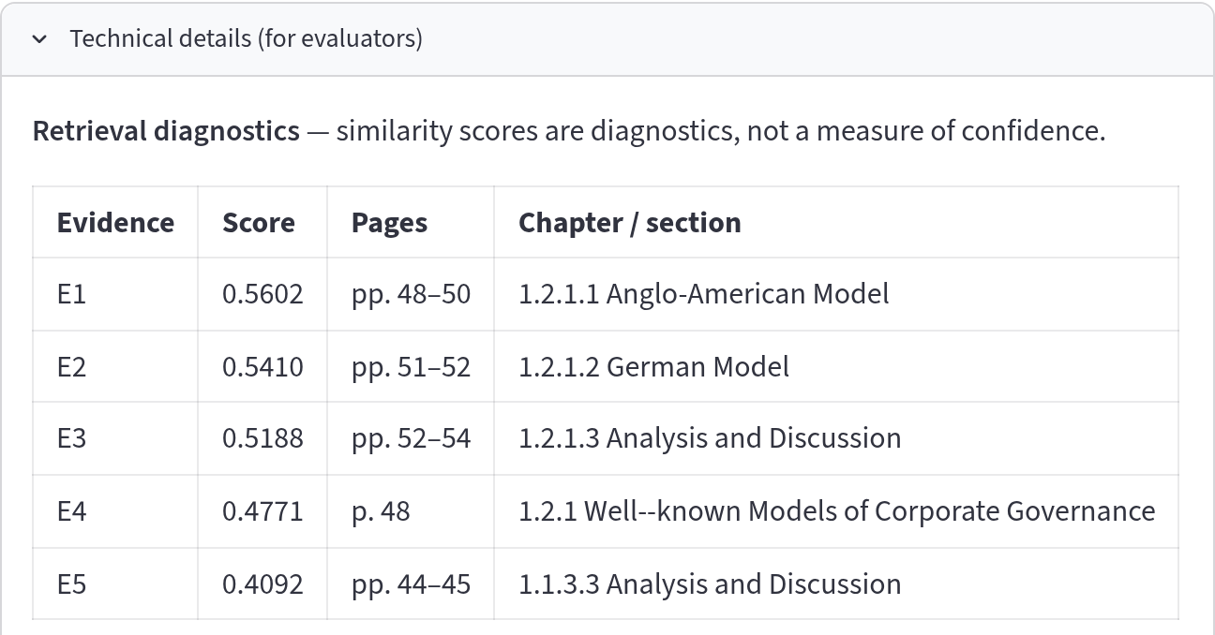
FOR EVALUATORS
What sits behind the answer
Scores are diagnostics
Similarity is never rendered as confidence, and never the sole basis for a refusal.
Citation check
Any handle the model used that was not in the evidence set is a recorded failure.
Page-invention check
If a page reference appears in generated text, the answer is flagged, not shown as clean.
Collapsed by default — present for anyone who wants it, absent for everyone who does not.
Failures are results
A validation failure is reported, never silently retried away.
ITCC-2026 · Source-Grounded Research Assistant
13
Notes:
16:00–17:15 — Evaluator view. Everything on the left is one click below the answer. The design principle: a lecturer should never have to look at it, and an examiner should never have to ask for it. The caption on the table is doing real work — 'similarity scores are diagnostics, not a measure of confidence'. Cosine similarity tells you a passage is lexically and semantically close. It does not tell you the answer is true, and presenting it as a percentage confidence would be a category error. The four checks on the right run before anything is displayed. If one fails, the answer is shown with a plain warning that it is not certified grounded — because in a research instrument, a failed check is itself a finding.

Slide 14
STATUS
Where the prototype stands
320
249
5
1
pages ingested
indexed passages
passages per answer
shared pipeline
Implemented
Not yet done — stated plainly
End-to-end ingestion with page provenance · chapter-bounded chunking · retrieval · grounded generation with refusal · blocking validation · three interfaces over one pipeline.
One document, English only · retrieval is brute-force cosine, not hybrid · no formal evaluation run yet · the RAG versus no-RAG comparison is designed but not executed.
ITCC-2026 · Source-Grounded Research Assistant
14
Notes:
17:15–18:00 — Status. Be straightforward here; an audience of researchers respects a clear boundary between what is built and what is claimed. Left: what runs today, end to end. Right: say this out loud rather than skipping it. One document. English only. The retrieval is the simplest thing that works. And the comparison that would actually test my research question — the same model answering with and without retrieved evidence — is designed but not yet run. If someone presses on effectiveness claims, this slide is your honest answer: I am presenting an instrument and its design rationale, not an evaluation result.

Slide 15
NEXT
Where this goes — and what it could hold
1
2
3
Corpus-agnostic by design
The controlled comparison
Measures, not impressions
The pipeline does not know it is reading a thesis. Cooperative statutes, member disclosures, audit reports, ICA principles and national cooperative law can replace the corpus without rewriting the retrieval or citation layers.
The same model, the same questions, with and without retrieved evidence — differing in exactly one variable. That comparison is the research question behind the tool.
Unsupported-claim rate, citation resolvability, refusal correctness on questions the corpus genuinely cannot answer, and agreement with a human reader.
The instrument is the contribution today. The evidence about whether grounding reduces unsupported claims comes next.
ITCC-2026 · Source-Grounded Research Assistant
15
Notes:
18:00–19:00 — Next steps. The first column is the one that connects back to this congress: nothing in the pipeline is specific to a law thesis. Point it at a cooperative's statutes, its audit reports, or a national cooperatives act, and the same guarantees hold — page-level citation, refusal when the corpus is silent. The second column is the real experiment, and the design constraint on it is strict: the two conditions must differ in exactly one variable, the presence of retrieved evidence. Anything else that differs invalidates the comparison. Third: what I would measure. Note that refusal correctness needs questions the corpus genuinely cannot answer — building that set honestly is harder than it sounds.

Slide 16
“The AI analyses;
the researcher decides.”
A system that can refuse is a system whose answers mean something.
Thank you — questions welcome
Matt Karimov · [ affiliation ] · [ email ]
Code and documentation: github.com/mattkari/source-grounded-rag
Notes:
19:00–20:00 — Close and questions. Return to the opening: the problem was never that these systems are sometimes wrong. It is that being wrong looks exactly like being right. Grounding and refusal are how you tell the two apart. LIKELY QUESTIONS: · 'Does it hallucinate?' — Fabricated PAGE references are structurally impossible; the model never sees a page. Misreading a passage is still possible, which is why the verbatim source is one click away. · 'Which model?' — Configurable. Embedding and generation are separate roles, and the index records which embedding model built it, so a mismatched model cannot query it. · 'Can it read Turkish?' — Not yet tested; extraction is language-agnostic, embeddings are the open question. Say so plainly. · 'Cost / can I run it?' — Runs on a laptop; the corpus is small; the index is a single file. · 'Is it public?' — Yes, repository link on screen.

