Slide 1
Banking Solution: Predicting Subscription Status of Term Deposit
Kaichong (Matt) Zhang, Flora Huang, Jiawei Yu

Slide 2
Business Problem and Methodology
As term deposits are a major source of income for a bank, it is important to predict whether customers will subscribe a term deposit in order to adjust the bank marketing strategy.
The Banking Dataset from a Portuguese banking institution is used for machine learning training and testing.
K-Nearest Neighbors, Logistic Regression, Decision Tree, and Random Forest classification algorithms are used.

Slide 3
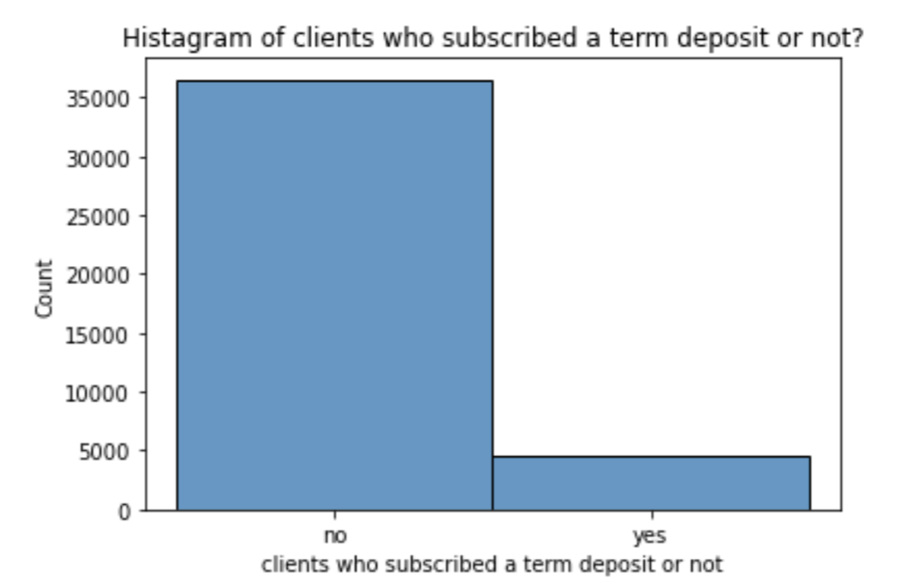
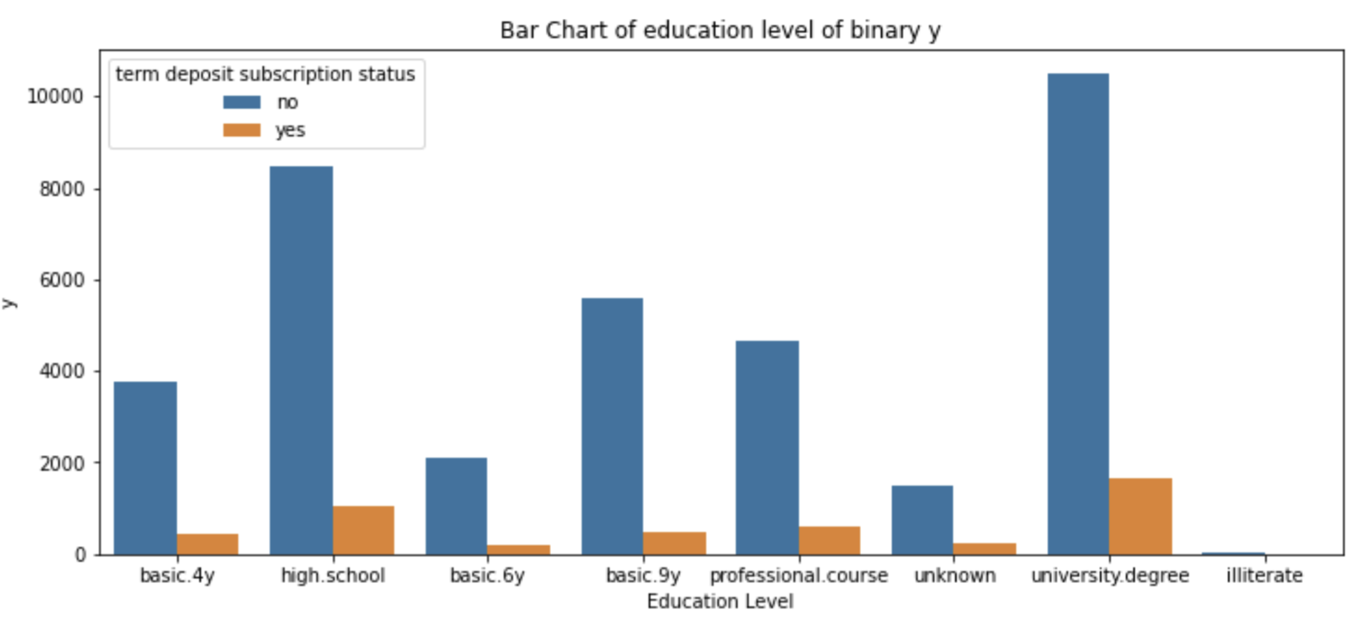
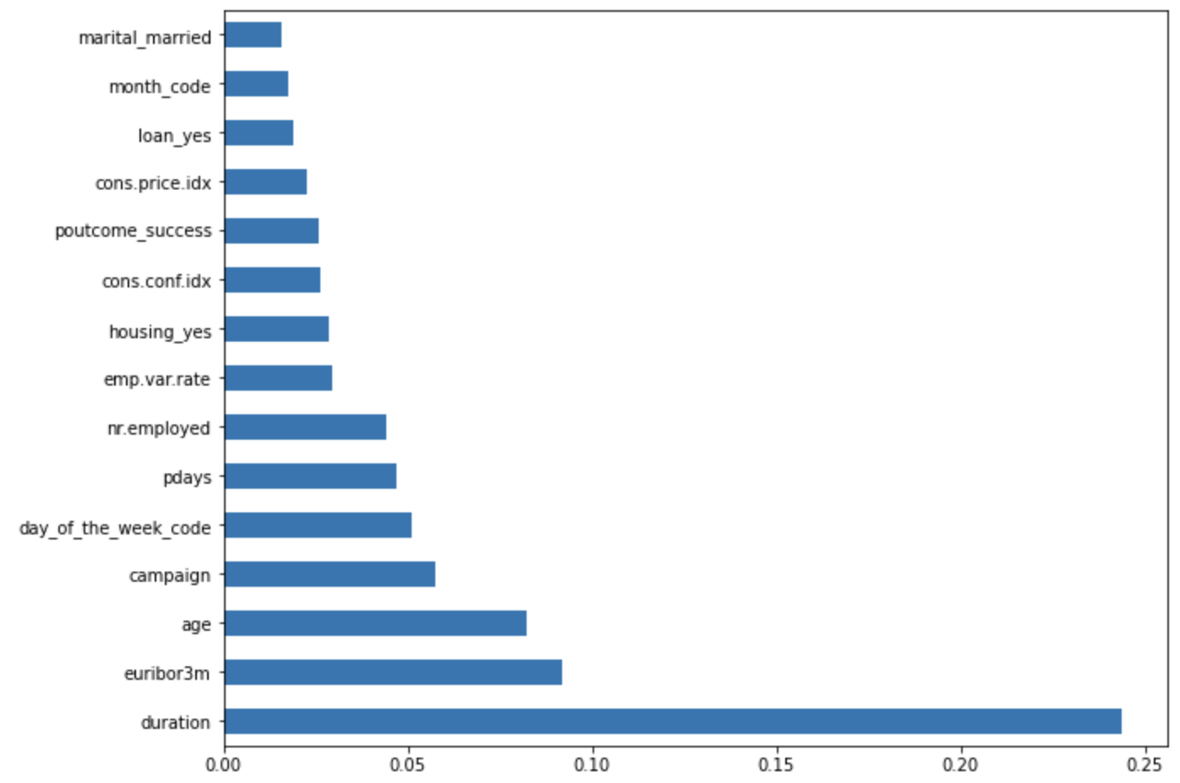
Exploratory Data Analysis
Majority of the people don’t subscribe the term deposits.
Education level is correlated with the subscription status, but it is not true that people with higher education level are more likely to subscribe.
Features like last contact duration, euribor 3-month rate, and age are more correlated to the subscription status and therefore deserve more attention in bank marketing.

Slide 4
Model Comparison and Selection
Model | Accuracy | 10-Fold Accuracy | ROC | Precision | Recall
KNN | 90.67 | 90.58 | 0.67 | 0.64 | 0.36
Logistic | 91.41 | 90.99 | 0.70 | 0.68 | 0.43
Decision Tree | 89.37 | 88.88 | 0.74 | 0.52 | 0.54
Random Forest | 91.09 | 90.95 | 0.71 | 0.52 | 0.54
Precision: % of true prediction when the model predicts ‘Yes’
Recall: % of true prediction when the actual observation is ‘Yes’

Slide 5
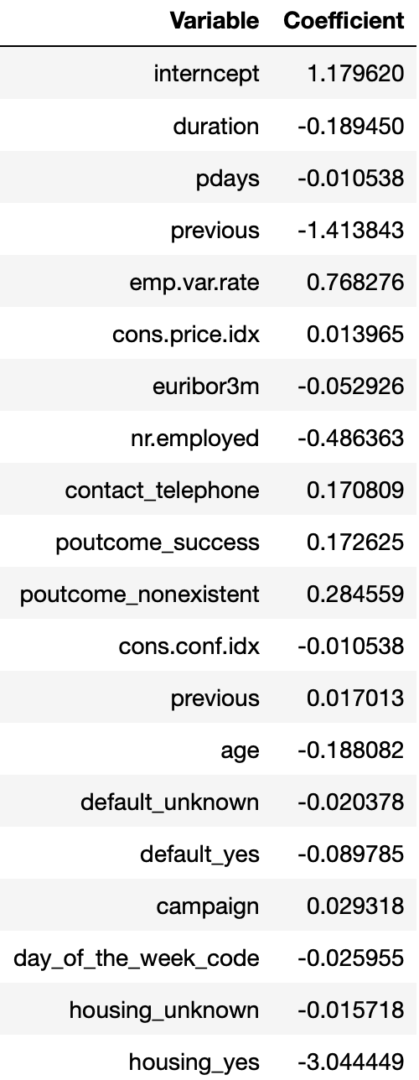
Final Model Evaluation & Business Insights
While performance of Logsitc and Random Forest are similarly good, we choose Logistic model as it has higher precision score. This is because we need a higher preicison score to maximize the return of term deposit marketing. In other words, we care more about the accuracy among the people that are modeled to be our target customers.
Logistic model is easy to implement and interpret and makes no assumptions about distributions of classes in feature space.
With similar accuracy and cross-validated accuracy, the Logistic model result tends to be robust.
From the coefficients on the right, we can figure out the correlation between each feature and the term deposit subscription status.

Slide 6
Limitation and Future Improvement
From the EDA, we know that most of the observations don’t subscribe to the term deposit. Such unbalanced dataset might lead to biased modeling and rpediction.
We can also try ensemble method that combines the good models together like the Logistic and Random Forest model.
The number of observation is 4118. Although it might be large enoguh for a simple project/prediciton, it is far from enoguh to make an accurate real-world prediction.
We can also try more advanced / black box models like neural network to achieve better accuracy at the expense of interpretability.

