Slide 1

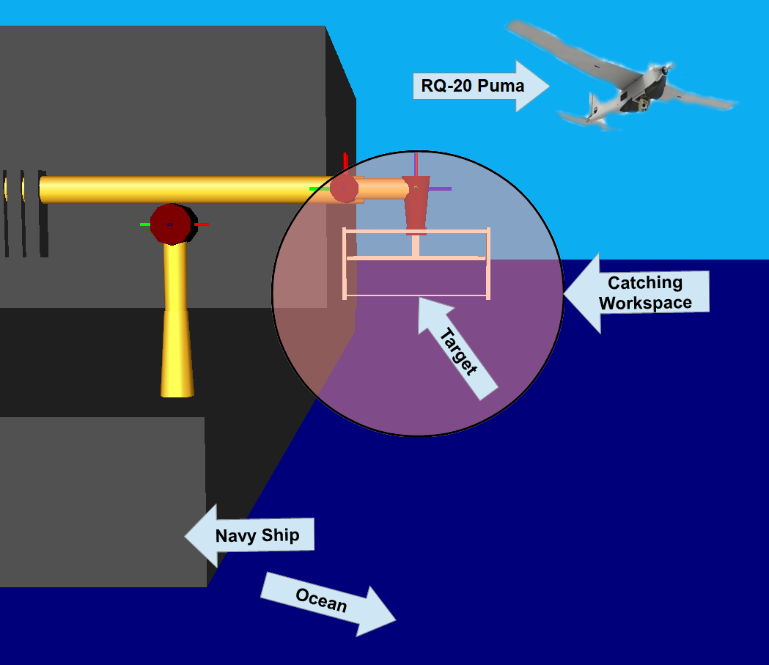
9-DEC-2019
ENAE692/Robot Project

