Slide 1

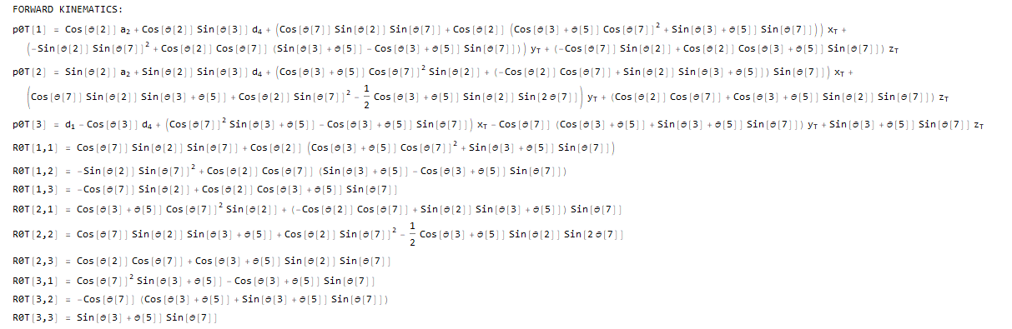
9-DEC-2019
ENAE692/Robot Project

Slide 2
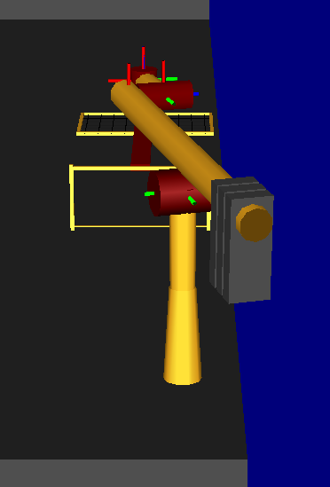
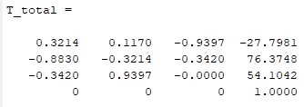
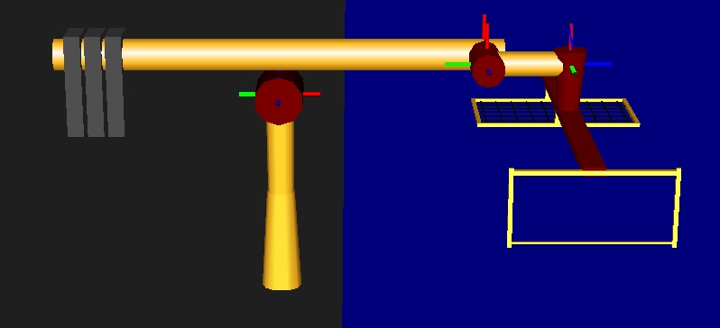
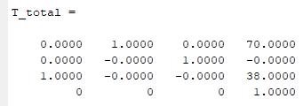
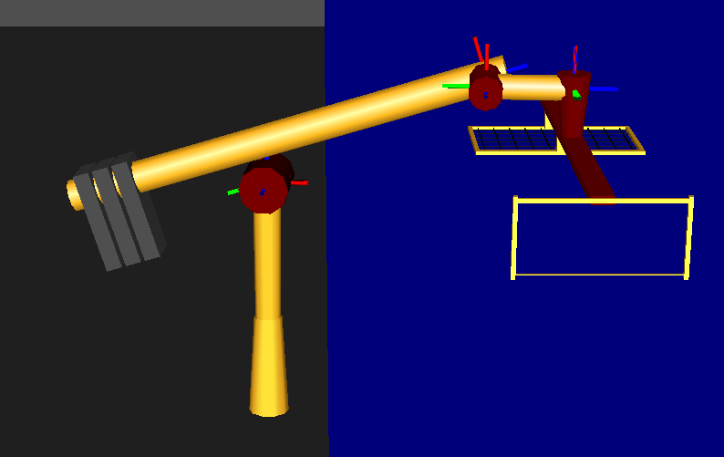
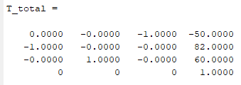
q = [50,1.92,1.57,50,0,0,-1.92]
  p0T=
  R0T=
q = [50,0,1.57,50,0,0,0]
  p0T=
  R0T=
  q = [50.8,1.57,1.75,50.85,-0.18,0,-1.57]
  p0T=
  R0T=
snapshot
9-DEC-2019
ENAE692/Robot Project

