Slide 1

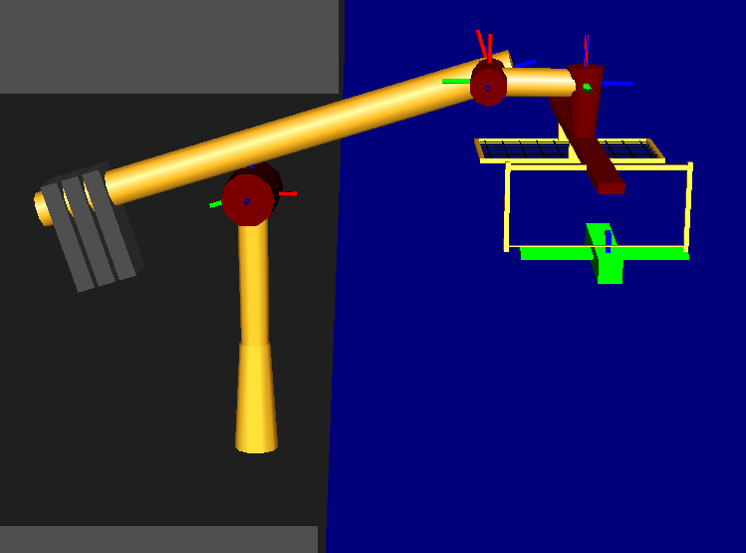
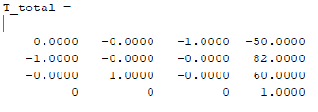
Maximum Task Force/Torque:
F_{MAX} = [0, 300N, 0], N_{MAX} = [0,0,0]
Workspace Pose:
Joint Position:
q_{T}= [50.77,1.57,1.75,50.84,-0.18,0,-1.57]
Force
τ = J*F=[0,-15000,-6369,295,
-3600,15000,15000]
ϑ^{Τ}(θ)
(Joint Torques)
9-DEC-2019
ENAE692/Robot Project

