Slide 1

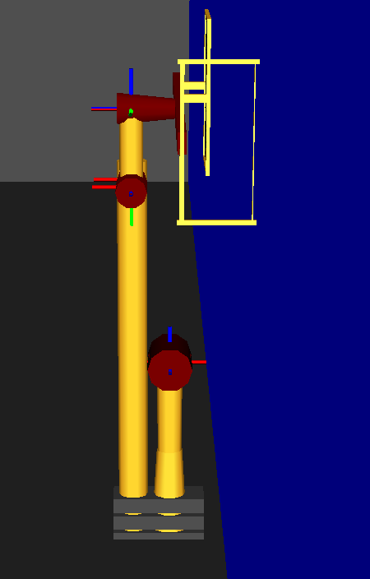
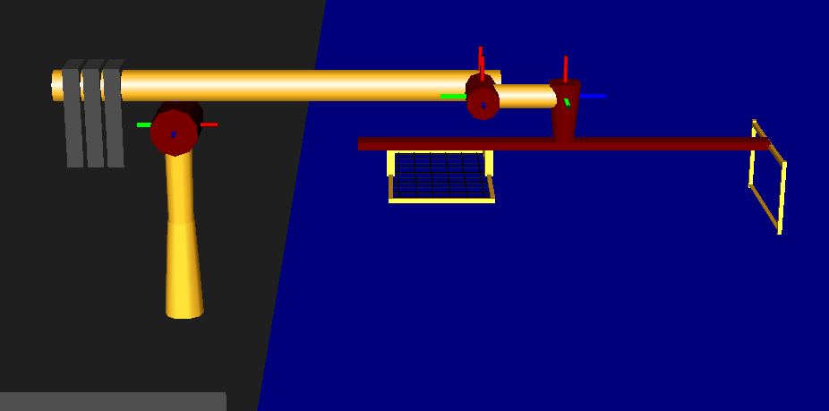
Internal:
Boundary:
linearly dependent columns
9-DEC-2019
ENAE692/Robot Project

