Slide 1
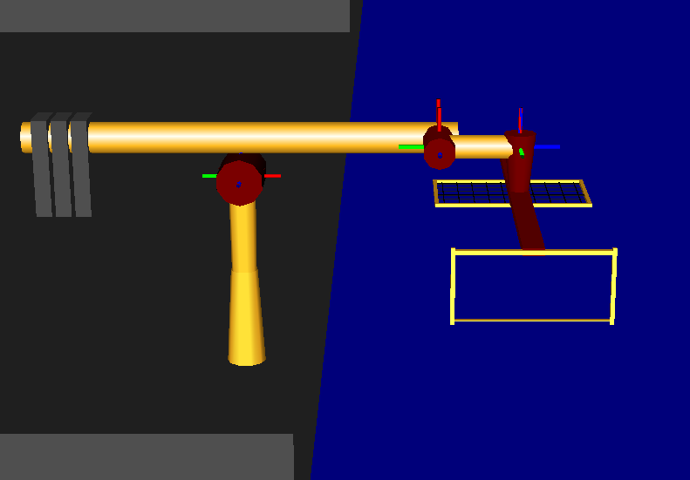
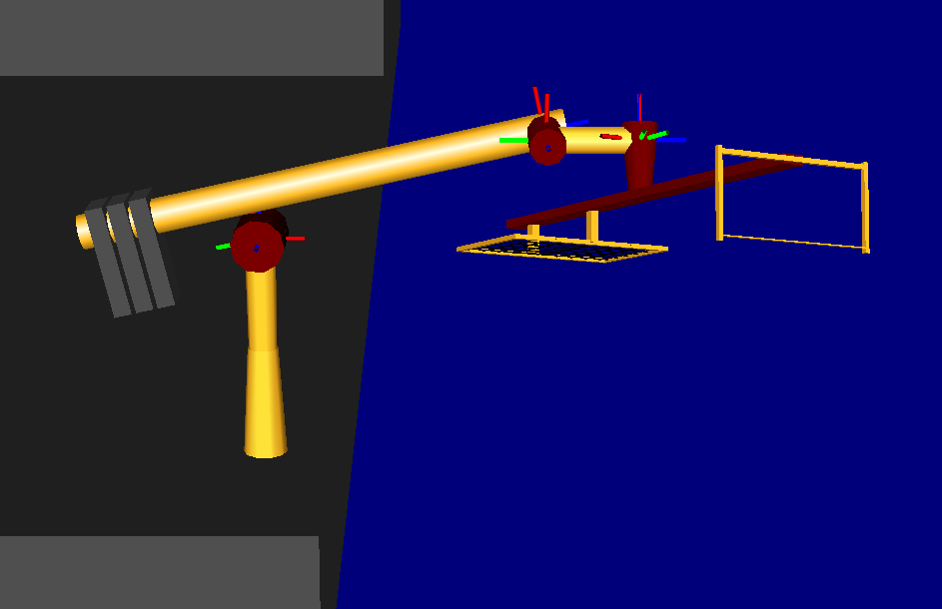
Inverse Kinematics (Test)
q_{START} = [50,0,pi/2,50,0,0,0]
⁰p_{GOAL}= [65,65,65],
⁰R_{GOAL}= [pi/8,-pi/8,0]=[yaw,pitch,roll]
show start configuration
Solution:
Q_{GOAL} = [50.84,0.32,2.09,72.63,-0.52,-0.39,0.077]
show end configuration
Solution Check:
⁰p_{T} (q_{GOAL}) = [65,65,65]
9-DEC-2019
ENAE692/Robot Project

