Slide 1
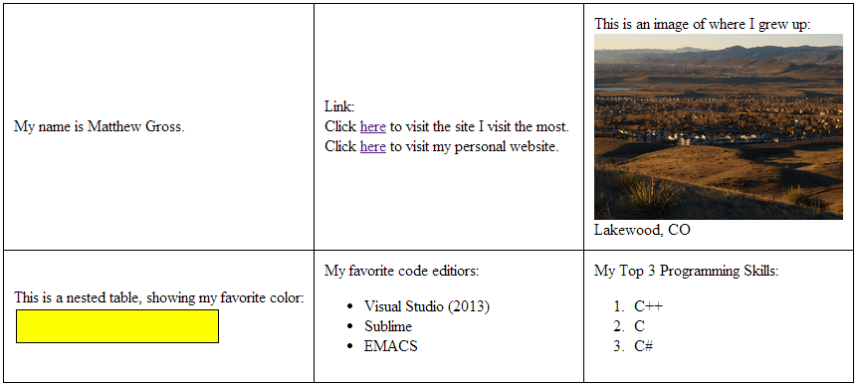

Slide 2
<!DOCTYPE html PUBLIC "-//W3C//DTD XHTML 1.0 Transitional//EN" "http://www.w3.org/TR/xhtml1/DTD/xhtml1-transitional.dtd">
<html xmlns="http://www.w3.org/1999/xhtml">
<head>
<meta http-equiv="Content-Type" content="text/html; charset=utf-8" />
<title>Challenge 0</title>
</head>
<body>
<table cellpadding="10" align="center" style="border-spacing: 0; border: solid; border-color: black; border-width: 1px;">
<tr>
<td style="border-right: solid; border-bottom: solid; border-color: black; border-width: 1px;">
My name is Matthew Gross.
</td>
<td style="border-right: solid; border-bottom: solid; border-color: black; border-width: 1px;">
Link:
<br />
Click <a href="https://apps.facebook.com/candycrush/" target="_blank">here</a> to visit the site I visit the most.
<br />
Click <a href="http://www.mattkgross.com" target="_blank">here</a> to visit my personal website.
</td>
<td style="border-bottom: solid; border-color: black; border-width: 1px;">
This is an image of where I grew up:<br />
<img src="http://www.mountainhomesofdenver.com/lakewood_area/lakewood.jpg" style="width: 250px; height: 187px;" /><br />
Lakewood, CO
</td>
</tr>
<tr>
<td style="border-right: solid; border-color: black; border-width: 1px;">
This is a nested table, showing my favorite color:<br />
<table>
<tr>
<td style="background-color: yellow; width: 200px; height: 30px; border: solid; border-width: 1px; border-color: black;">
</td>
</tr>
</table>
</td>
<td style="border-right: solid; border-color: black; border-width: 1px;">
My favorite code editiors:<br />
<ul>
<li>Visual Studio (2013)</li>
<li>Sublime</li>
<li>EMACS</li>
</ul>
</td>
<td>
My Top 3 Programming Skills:<br />
<ol>
<li>C++</li>
<li>C</li>
<li>C#</li>
</ol>
</td>
</tr>
</table>
</body>
</html>

