Slide 1
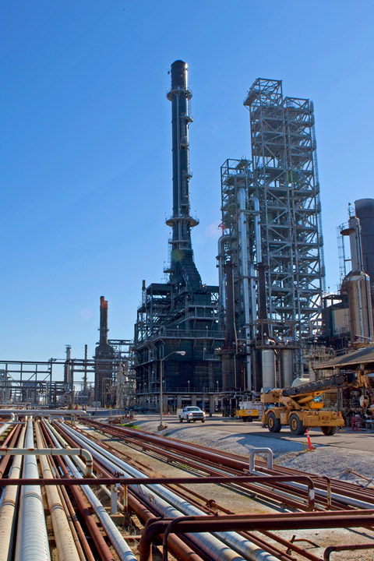
Common Data Model (CDM)
Themis Team
2021/02/05
Notes:
Image description: Pascagoula Refinery, Mississippi

Slide 2
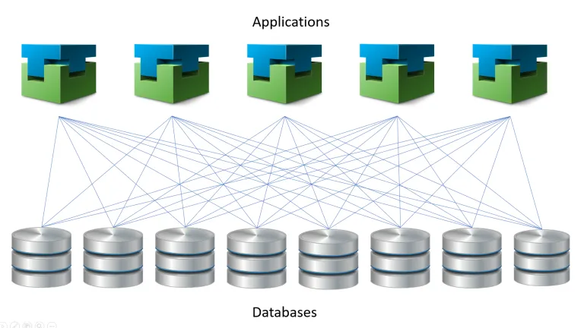
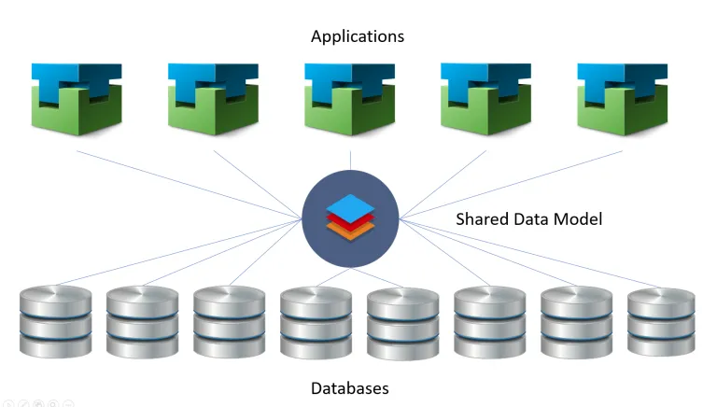
CDMs provide semantic consistency and facilitate interoperability
Shared data language used by business and analytical applications to provide semantic consistency and facilitate interoperability
Enables consistency of data and its meaning across applications and business processes
Set of standardized, extensible data schemas published by Microsoft

Slide 3
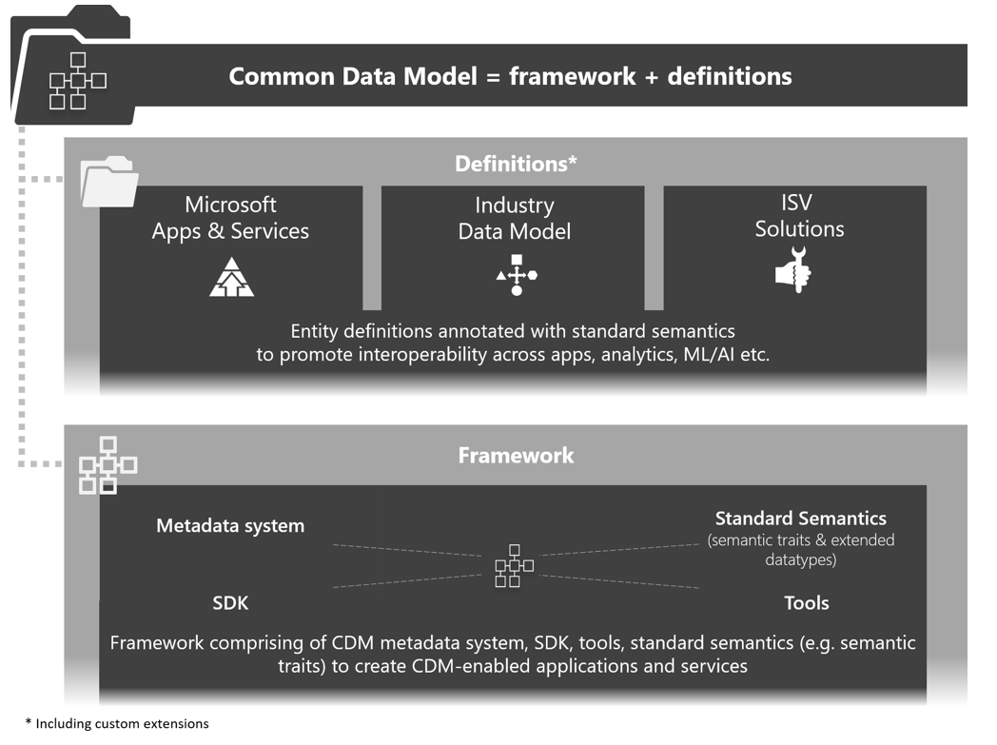
Microsoft Common Data Model Capability

Slide 4
Industry Data Workbench
Platform that enables organizations across industries to describe their data estate using comprehensive best in-class data models called as Industry Data Models (IDM)
Industry Data Models contain a large set of entities and attributes specific to an industry for defining data, and are defined using Common Data Model (CDM) framework enabling interoperability with analytics products such as Dynamics 365, Power BI, etc.
IDW accelerates unlocking value out of data by enabling organizations :
Bring any or all of their data together and add semantics using IDM to make it self-describing,
Accelerate the consumption of data for reporting/insights/analytics needs through automated ETL/ELT data flows using IDM semantics, and
Integrate with a rich ecosystem of ready-to-integrate partner solutions (data enrichment or analytics) for domain specific use cases.

Slide 5
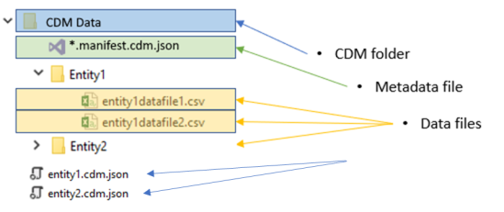
CDMs will live in the data lake to facilitate metadata discovery and interoperability
Enables discoverability based on data-producer metadata
Enables the obtaining of semantic information about entity records / attributes and links to underlying data files
Indicates compliance with Common Data Model standard entities
Provides information about when entities were most recently updated
CDMs will live in the Produced folder of the Data Lake

Slide 6




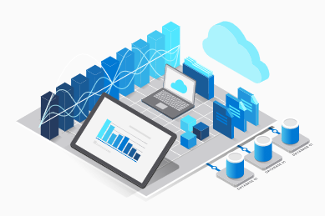


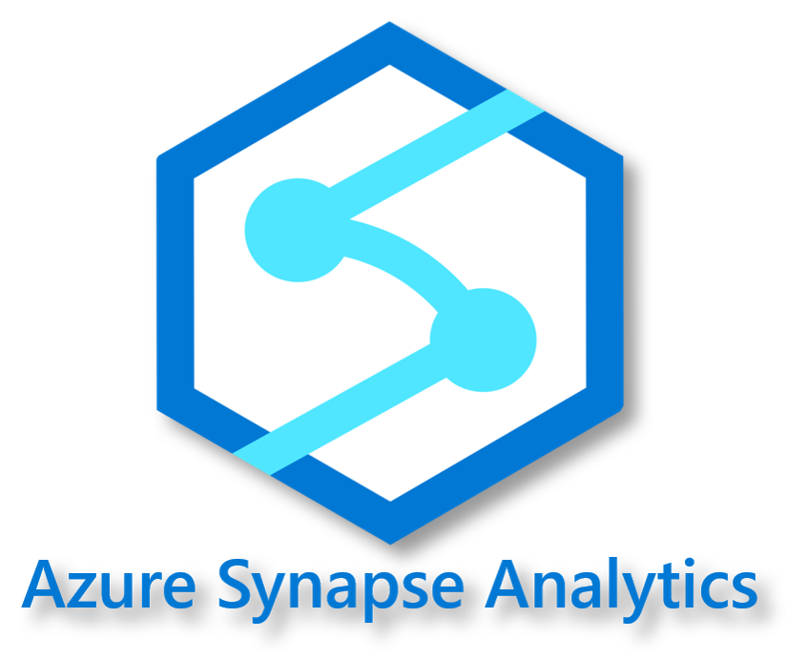


Proposed Architecture to Incorporate IDW and CDM into the Chevron Digital Ecosystem
Enterprise Data Architect
Platform Approver
Azure Data Services
Models Approved
Utilizes CDM Data and Resolved Entities
Develop Model
Deployment Pipeline Deploys CDMs
Utilizes CDM Schemas and Refined Data
PR Directive File
Generates CDM
Data and
Resolved Entities
Data Architect
Central CDM Repository
Data Lake
Synapse Analytics
IDW
Cross-Platform/Enterprise
Platform 1 creates data model in workspace
Platform 2 creates data model in workspace
Composite Model is governed by 3rd party
Power BI
Platform 1
Platform 2

Slide 7
Sharing Models from Central CDM Workspace to Other Workspaces

Slide 8
Central CDM Synapse Workspace Environments
Sandbox – S019
Test – T001
Production – P001
Who
Themis Team
Workshop Users
Themis Team
Data Architects
Develop Ansible roles and automation
Test Ansible roles and automation
Workshop environment
Develop and Publish CDMs
What
CVX-CDM
Feature Branch: Develop CDMs
Master Branch: Live, Synced with other workspaces
Repository Setup
CVX-CDM-Non-Prod
CVX-CDM-Non-Prod

Slide 9
CI/CD Pipelines
Central CDM Workspace
Sandbox Synapse
Test Synapse
Prod Synapse
Other Synapse Workspaces
CVX-CDM-Synapse ADO Pipeline
Manages Synapse Environments
CVX-CDM-PR-Approvers ADO Pipeline
Adds Dynamic Approvers
CVX-CDM Repo
CVX-CDM-Deployment ADO Pipeline
Deploys CDMs to workspaces

Slide 10
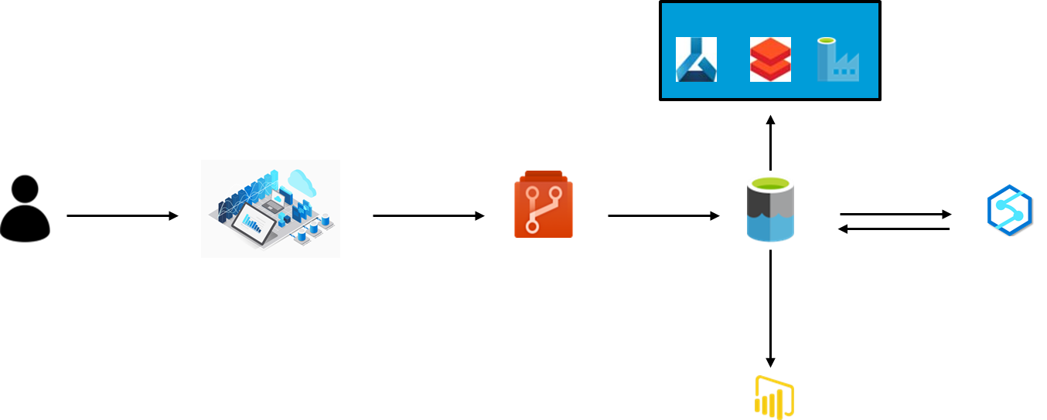
IDW will use the Directive File to create Logical and Physical Schemas
Data Architect will use IDW to build Model. IDW will output a Directive File.
Directive File will be checked into the Central Repo.
IDW CLI will utilize the Directive File to generate Logical/Physical schema and put it on the lake

Slide 11
CDM Modeling

Slide 12
CDM Manifest
Defines scope of the data model
Contains a list of all the entities that make up the model and where to find their JSON files
Contains a list of all the relationships in the data model, as defined by each entity
Details around the location and format of corresponding data partitions

Slide 13
Foundational Traits, Logical Definitions, and Physical Definitions comprise a CDM
Logical Model
Physical Model
Set of entities and the relationships between those entities without any specification of what the final set of attributes would be
Provides foundation to form the Physical model
Describes data needs for a single object but could be integrated with other logical data models
Defines implementation of the data model
Developed for a specific implementation purpose
Final attribute and deployment details specified

Slide 14
Logical and Physical Model Uses
Produced ADLS2 Container
Physical Schema (DW)
Physical Data (DW)
Refined ADLS2 Container
Models ADLS2 Container
Physical Schema (ADLS)
Physical Data (ADLS)
Dataset
Dataset
Logical Schemas
Dataset
Dataset
Physical Schema (PBI)
Physical Data (PBI)
Physical Schema (ML)
Physical Data (ML)
ADF Pipeline

Slide 15

Chevron CDM Model
Physical
CDM
Data
Manifest
Physical Entity
Logical Entity
Physical Model
Enterprise Model (Composite Models)
Logical
Manifest
Logical Entity
Logical Entity
Manifest
Logical Entity
Logical Entity
Platform Model
MSFT CDMs
Manifest
Logical Entity
Logical Entity
Logical Entity
Manifest
Logical Entity
Logical Entity
Logical Entity
Chevron Custom Models
CVX Core Base Types & Definitions
Foundational
Manifest
Logical Entity
MSFT Base Types
Manifest
Logical Entity
Foundations Traits

Slide 16
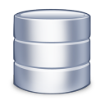
Enterprise and Business Unit Solutions are built using the Platform CDMs
BU Specific Solution
BU Specific Solution
Enterprise Solution
Enterprise Solution
Chevron CDM
Platform 1 CDM 1
Platform 1 CDM N
Platform 2 CDM 1
Platform 2 CDM N
Platform N CDM 1
Platform N CDM N
Platform 1
Platform 2
Platform N

Slide 17
CDMs in the Data Lake
Data Lake Container
Data Lake Container
model
produced
CDM Data
default.manifest.cdm.json
CDM
schema.cdm.json
Chevron Common Data Models
Platform
Chevron-CDM
Data Product
Platform
platform.manifest.cdm.json
default.manifest.cdm.json
Data Product
config.json
_allimports.cdm.json
Partition
dataProduct.manifest.cdm.json
data.parquet
dataProduct.cdm.json
Data in Parquet Format
MSFT-Base-Type
MSFT-OG-CDM
Microsoft Foundational Traits
Microsoft Oil & Gas Models

Slide 18

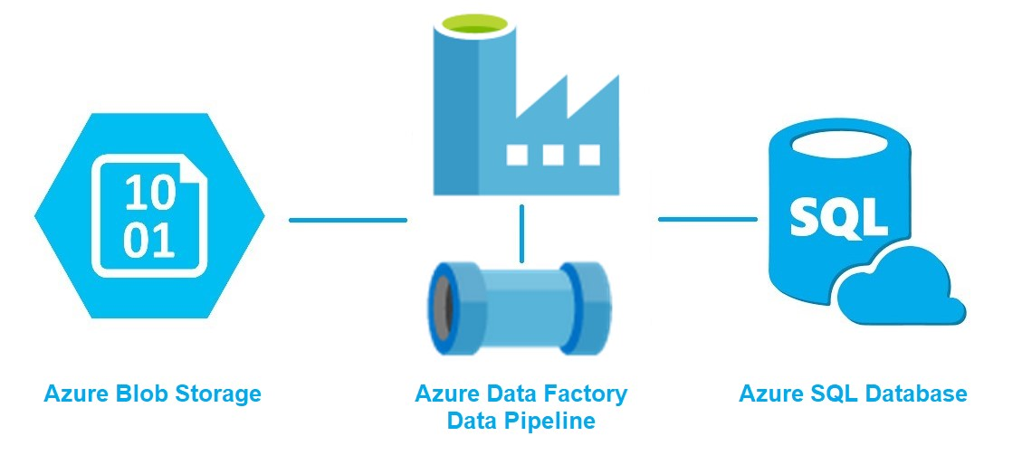
CDM Ingestion will use Logical Schema and Refined Data and Physical Schema to create CDM Data
Synapse Analytics
CDM Logical Schema
CDM Physical Schema
Refined Data
CDM Data

Slide 19

Data Architects and Engineers will build pipelines and check artifact into platform repo
Check-in JSON Artifact
Build deploys to other environments
Develop Pipeline
Ansible playbook/role
Data Architect/Engineer
Dev Platform Synapse Workspace
Platform Synapse Repo
Azure DevOps Pipeline
Prod Platform Synapse Workspace
Data Architect will create pipeline in DEV Workspace
Data Engineer sets up transformations in pipeline (Data Flow/Spark Notebook with DETK)
DA/DE grab artifact and put it in the platform repo
DA/DE will create Ansible Playbook that calls Ansible Synapse Role
ADO pipeline will use Ansible playbook and Ansible Synapse role to deploy pipeline

Slide 20
IDW can generate Synapse Pipelines to use Logical/Physical Schema and Physical Data to move data to DW/ADLS/Other Systems
Synapse Analytics
CDM Logical Schema
CDM Data
Destination System
CDM Physical Schema

Slide 21
Data Architects and Engineers will use Ansible Synapse Role to generate DW/ADLS pipelines
Prod Platform Synapse Workspace
Use Ansible Synapse Role
Build deploys to other environments
Data Architect/Engineer
Platform Synapse Repo
Azure DevOps Pipeline
DA/DE will create Ansible Playbook that calls Ansible Synapse Role
ADO pipeline uses playbook to deploy DW pipeline
Dev Platform Synapse Workspace

Slide 22
CDM Versioning

Slide 23
CDMs need to be versioned so consumers are not disrupted by breaking changes, while progress is being made on CDMs
Consumers can choose to get the most up-to-date CDMs, the supported CDMs, or a previous version of a CDM.
Consumers should be able to switch between versions easily without extensive changes
Versioning process should be automated, and source controlled

Slide 24


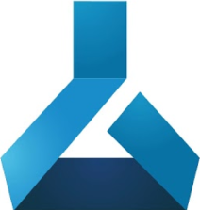


APIs and Azure Data Services will be using the versioned CDMs
API Generator
Utilizes CDM Schemas to generate Open API Specs
Utilizes CDM Schemas to generate Open API Specs
Pull Request Changes to CDM Schemas
Deployment Pipeline Deploys CDMs
Utilizes CDM Logical Schemas
Data Architect
Central CDM Repository
Data
Lake
Azure Data Services

Slide 25
Version numbers and retention policy
Version numbers will be X.X.X (semantic versioning)
Major version – updated if a new entity is added or a breaking change is committed (e.g. changing a name of a field, making a field required from optional)
Minor version – updated if a new attribute is added to an entity
Revision version – updated if a bug was fixed in an entity
Retention Policy
We are working on figuring out what the optimal retention policies will be for older versions

Slide 26

Bug fixes and updates would need to follow different versioning strategies
Bug Fixes
Enterprise Model
V1
Platform Directive
Platform Model
V1
Enterprise Model
V1
V1
Platform Model Data
Consumer Systems
V1
V1
Updates
V2
Enterprise Model
Platform Directive
Platform Model
V2
V2
Enterprise Model
V2
Platform Model Data
Consumer Systems
V2
V2

Slide 27
Appendix

Slide 28
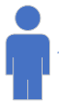
Proposed Architecture to Incorporate CDM into the Chevron Digital Ecosystem
Data Architect

Slide 29


Microsoft Power Platform can be utilized to build the CDM for out-of-the-box functionality
Power Apps
Data Lake
Source
Create CDMs
Export Snapshot Data as CSV
Pros:
Utilize Power Apps UI to allow developers to build CDMs
Snapshot is saved as CSVs to be utilized by CDMs
Cons:
CDMs can not be leveraged by APIs outside of Power Platform
CDMs are not source controlled

Slide 30

Another option is to create CDMs in a central repository which is synced to the Data Lake
Data Central Repo
Data Lake
Develops CDM
CDM.json
CDM.json
Pros:
CDMs are source controlled
CDMs can be used for analytics use cases and operational use cases
Cons:
No UI to develop CDMs
Could leverage Data Marketplace or CheDDr
Would need to convert Parquet data to CSV

Slide 31
Build upon previous option by utilizing Data Marketplace to build CDMs
Data Central Repo
Data Lake
Data Marketplace
Creates CDM
CDM.yaml
Convert
CDM.json
Pros:
Developers would have a UI to build the CDMs
Cons:
Unknowns around CheDDr

Slide 32
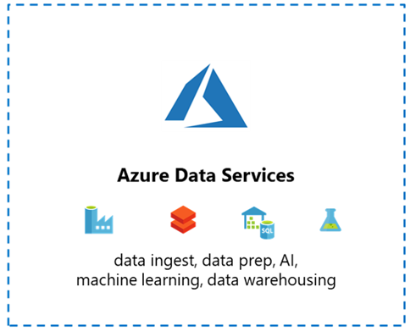
CDMs can be used by Data Consumers to build dashboards, ML, and Analytics
Data Lake
CDM.json
CDM.csv
Azure Data Services understand how to read CDM Metadata Files
Data will be coming from the *.csv files

Slide 33


OpenAPI Spec utilizes the central repo to reference CDMs
Azure API Management
OpenAPI Spec
Data Central Repo
OpenAPI spec will reference the CDM.yaml in the central repo
OpenAPI spec lives in Azure API Management

Slide 34

Bundle CDMs into versioned folders in the Data Lake Model Container
Chevron Data Lake – Model Container
Pull Request Creates Release Pipeline
Pull Request to Dev
dev
Pull Request to Master
release
Central CDM Repository
Release Pipeline
Overview
Dev folder has a snapshot of the dev branch
Released folder has snapshot of master branch
Pull request into dev would trigger a release into dev folder
Pull request into master would deploy CDMs into release folder
Additional Research Needed
API generator compatibility with this process
Handling physical CDM data models create using previous versions of CDMs

Slide 35
Version CDMs by Files in the Central CDM Repo
Central CDM Repository
Chevron Data Lake – Model Container
dataProduct.X.X.X.manifest.cdm.json
Pull Request Creates Release
Deployed to Data Lake
dataProduct.X.X.X.manifest.cdm.json
dataProduct.X.X.X.cdm.json
dataProduct.X.X.X.cdm.json
Release Pipeline
Overview
Data Architect would create a new file for modifications and new manifest with the new version
Pull Request Approvers would need to ensure that is the case
Repo is synced with the Data Lake when released
Dependent manifests/entities will need to be updated to use new version

Slide 36
Bundle CDMs into versioned folders in the Data Lake Model Container
Chevron Data Lake – Model Container
Pull Request to Master
Version x.x.x
Pull Request Creates Release Pipeline
Pull Request to Master
latest
Central CDM Repository
Release Pipeline
Release Every Quarter
release 20.1
Overview
Each version folder has a snapshot of the CDM repo
Dev folder has a snapshot of the dev branch
Latest folder has a snapshot of the master branch
Release folder has a snapshot of the supported version
Automated versioning
Consumers can point to a versions based on their needs
Quarterly Releases allow for batched deployment of changes
Each new version will have a full copy of the repository
Additional Research Needed
API generator compatibility with this process
Handling physical CDM data models create using previous versions of CDMs

Slide 37
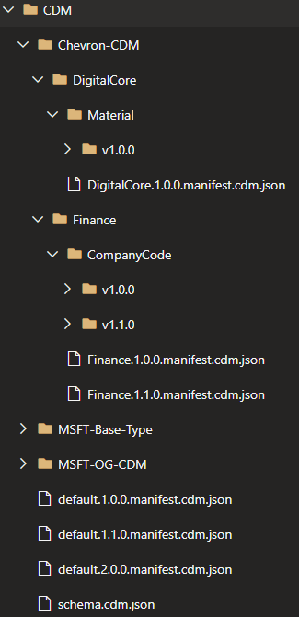
Versioned default.manifest and platform.manifest with version folders in data products
Central CDM Repository
Chevron Data Lake – Model Container
Pull Request to Master
Deployed to Data Lake
Release Pipeline

Slide 38
Data Pipelines will use the version of the manifest which contains the version of the data product they need to generate CDM Data
Azure Data Services
Chevron Data Lake – Model Container
Azure Data Services
Utilize V1 CompanyCode
Utilize V2 CompanyCode

Slide 39
API Developers will pick a version of manifest that has the version of the data product they need to build an OpenAPI Spec
API Generator
Central CDM Repository
Utilize V1 CompanyCode
Utilize V2 CompanyCode
API Generator
Chevron Data Lake – Model Container
Utilize V1 CompanyCode
Utilize V2 CompanyCode

Slide 40
Directive files pull requested into Master branch of the CVX-CDM repository will be deployed using an ADO Pipeline and Ansible Playbook
CVX-CDM Repository
Playbook
Ansible Command
Synapse/IDW
Data Lake
PR to Master
Environment
Get Access Token
REST API Call
Get Data Lake Access Key
REST API Call
Look at changed files
Shell Command
For each changed file
Return Changed Files
Create Directive
REST API Call
Directive Exists
Create Logical Schema
REST API Call
Logical Schema Exists
Create Physical Schema
REST API Call
Physical Schema Exists
Create Pipeline
REST API Call
Pipeline Exists
* This diagram does not include dynamic approvers, which is already part of the CVX-CDM playbook

Slide 42
CDM and ADER

Slide 43





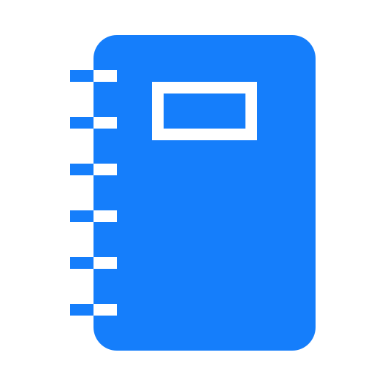

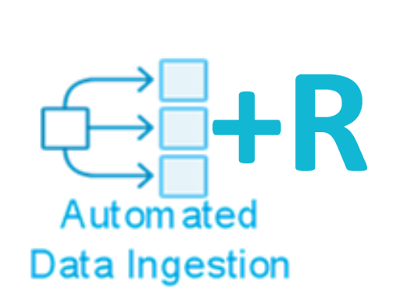



CDM in ADER
IDW Synapse
Models created in IDW and deployed to Data Lake
Data Lake
Source Schema
Target Schema
Source Schema
Target Schema
Source Schema
Target Schema
Map source schema to source CDM Schema
Models consumed as input/output schema by Notebook
DETK + Spark Notebooks
Notebooks provide transformation information
DETK + Spark Notebooks
DETK + Spark Notebooks
ADER Calls notebook to generate Synapse Pipeline
ADER
ADER
ADER
ADER Provisions pipeline
Source
Raw
Data is moved through pipeline
Refined
Produced

