Slide 1


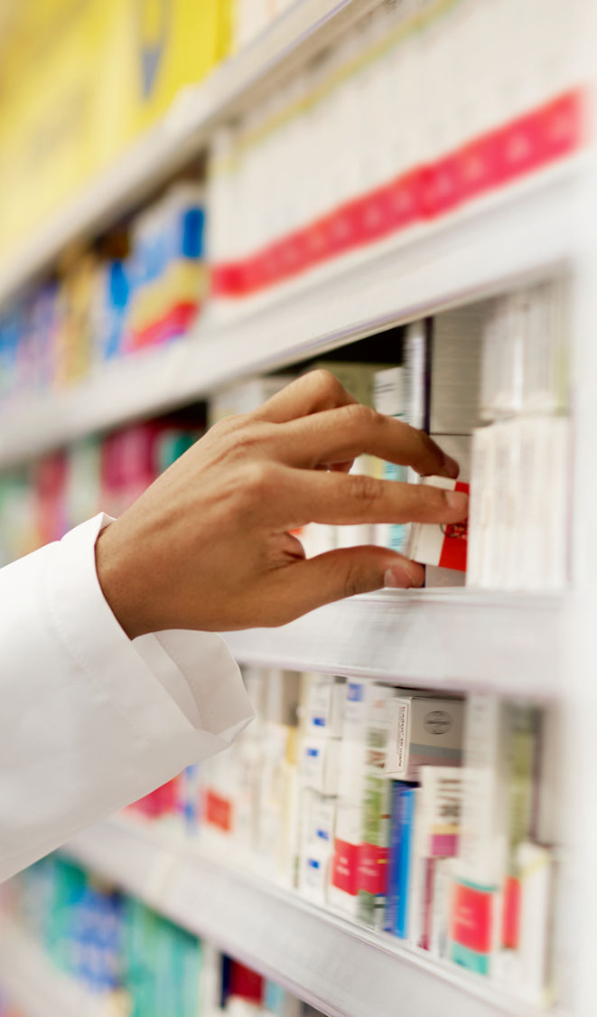
Reproducibility of Interactive Analyses
PHUSE US Connect Orlando
OS10
Matthew Kumar & Srinivas Veeragoni
SBU Oncology
Oncology Digitalization &
Computational Science
March 8 2023

Slide 2
Agenda
Introduction
Case Study
Prototype
Discussion
Questions

Slide 3
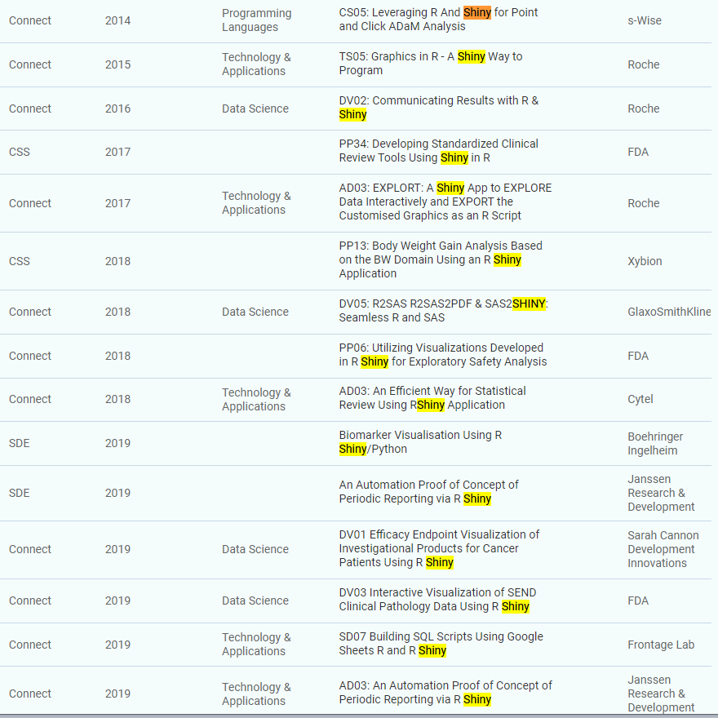
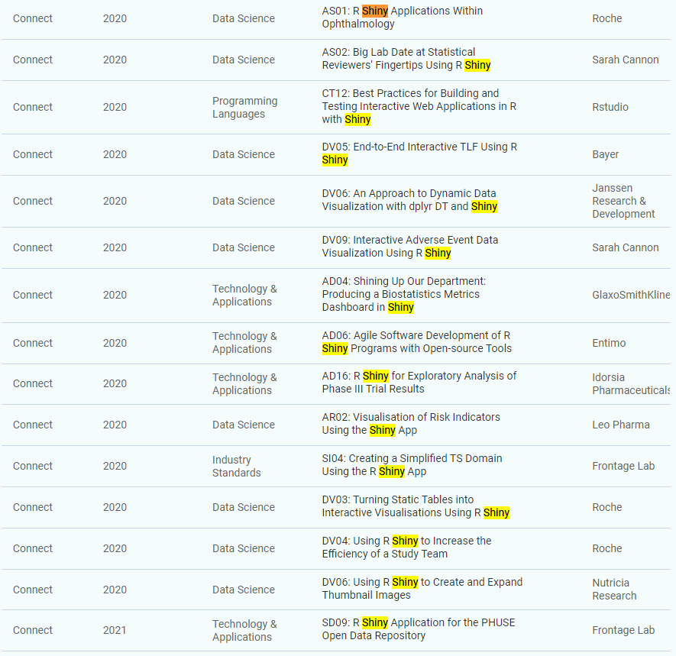
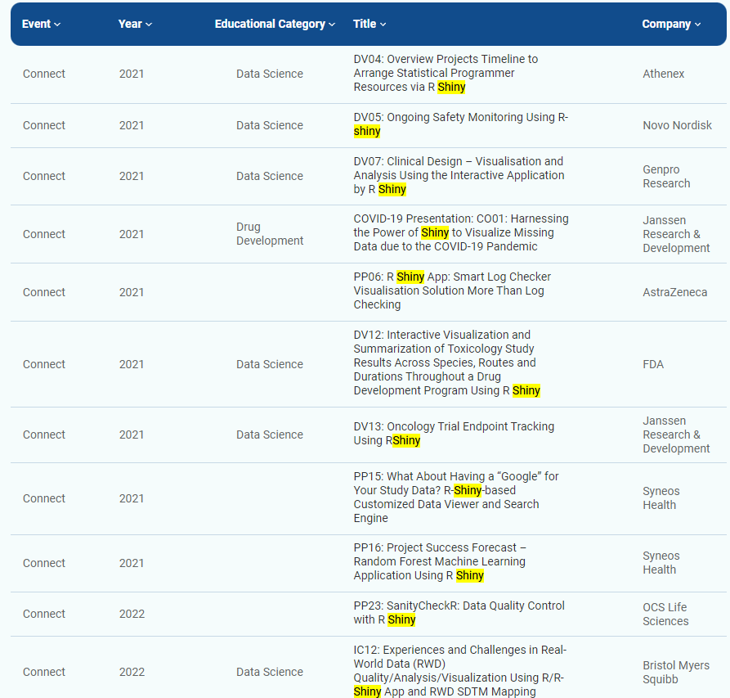
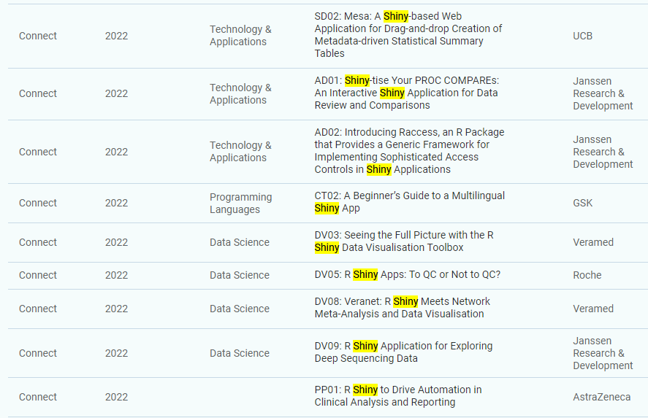
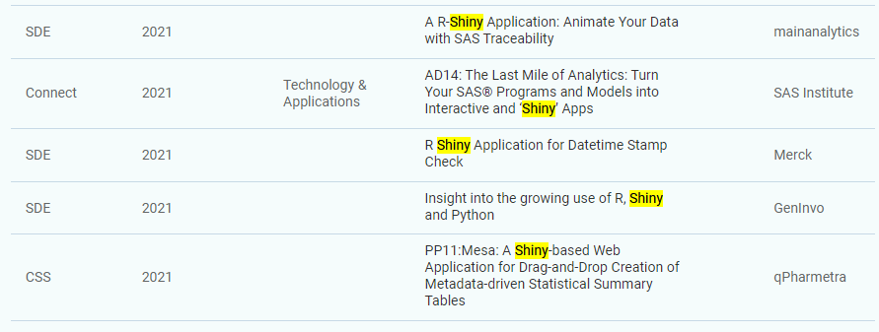
Introduction
R and Shiny have seen significant adoption in Pharma data science, notability in the statistical programming space
Well suited for experimentation and investigation of clinical data: “what if” analyses
Utility as general-purpose tools: task automation, report generation
Some examples…

Slide 4
Introduction
These apps are evolving from an exploratory state to pivotal decision-making tools in clinical analysis and operations
Reproducibility is a central to the work we preform and results/insights we deliver in our industry
This becomes a key consideration to be aware of as we continue to develop Shiny apps
User-derived insights through user-actions
“state” of a shiny app
How and what to capture?
Can we do anything with it?

Slide 5
Case Study Setup
Motivation: Can we reproduce a result created in a Shiny app in an external (e.g. production) environment?
Basis for case-study: reproducing a plot that is interactively created in a Shiny app
Waterfall plot for change in tumor sizes (%)
Capturing the associated code for execution in an external (e.g. production) environment
Make the experience accessible and streamlined for users
Target users: statistical analysts
Getting Started
What technical and domain expertise do we need?
What is the landscape of development and production environments?
How does this all fit together?
Notes:
Mention answers on how to get started are covered AFTER the prototype slides

Slide 6
Case Study Setup
Assembled a small dedicated team of clinical data scientists, statistical analysts and a data engineer to work collaboratively on all aspects of a prototype:
Understanding domain requirements from statistical programming
What kind of specifications/customizations are typical of a waterfall plot? Initial ggplot2 code
Code generation experimentation and implementation
Deep dive and toy examples with the shinymeta package
Setting up a development environment to mimic the production environment
renv for R and package dependencies, git for code versioning, collaboration
Refinement and testing of prototype
‘Compatible’ ggplot2 code
Release for focus group testing + feedback
Notes:
Mention answers on how to get started are covered AFTER the prototype slides

Slide 7
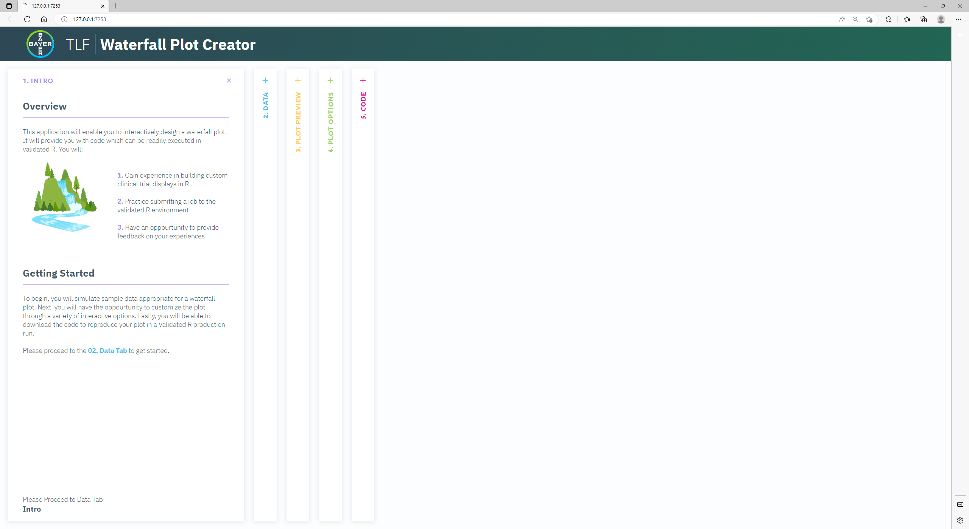
…some weeks later
1
2
1
App body
2
Intro Panel: Overview, intent and user instructions

Slide 8
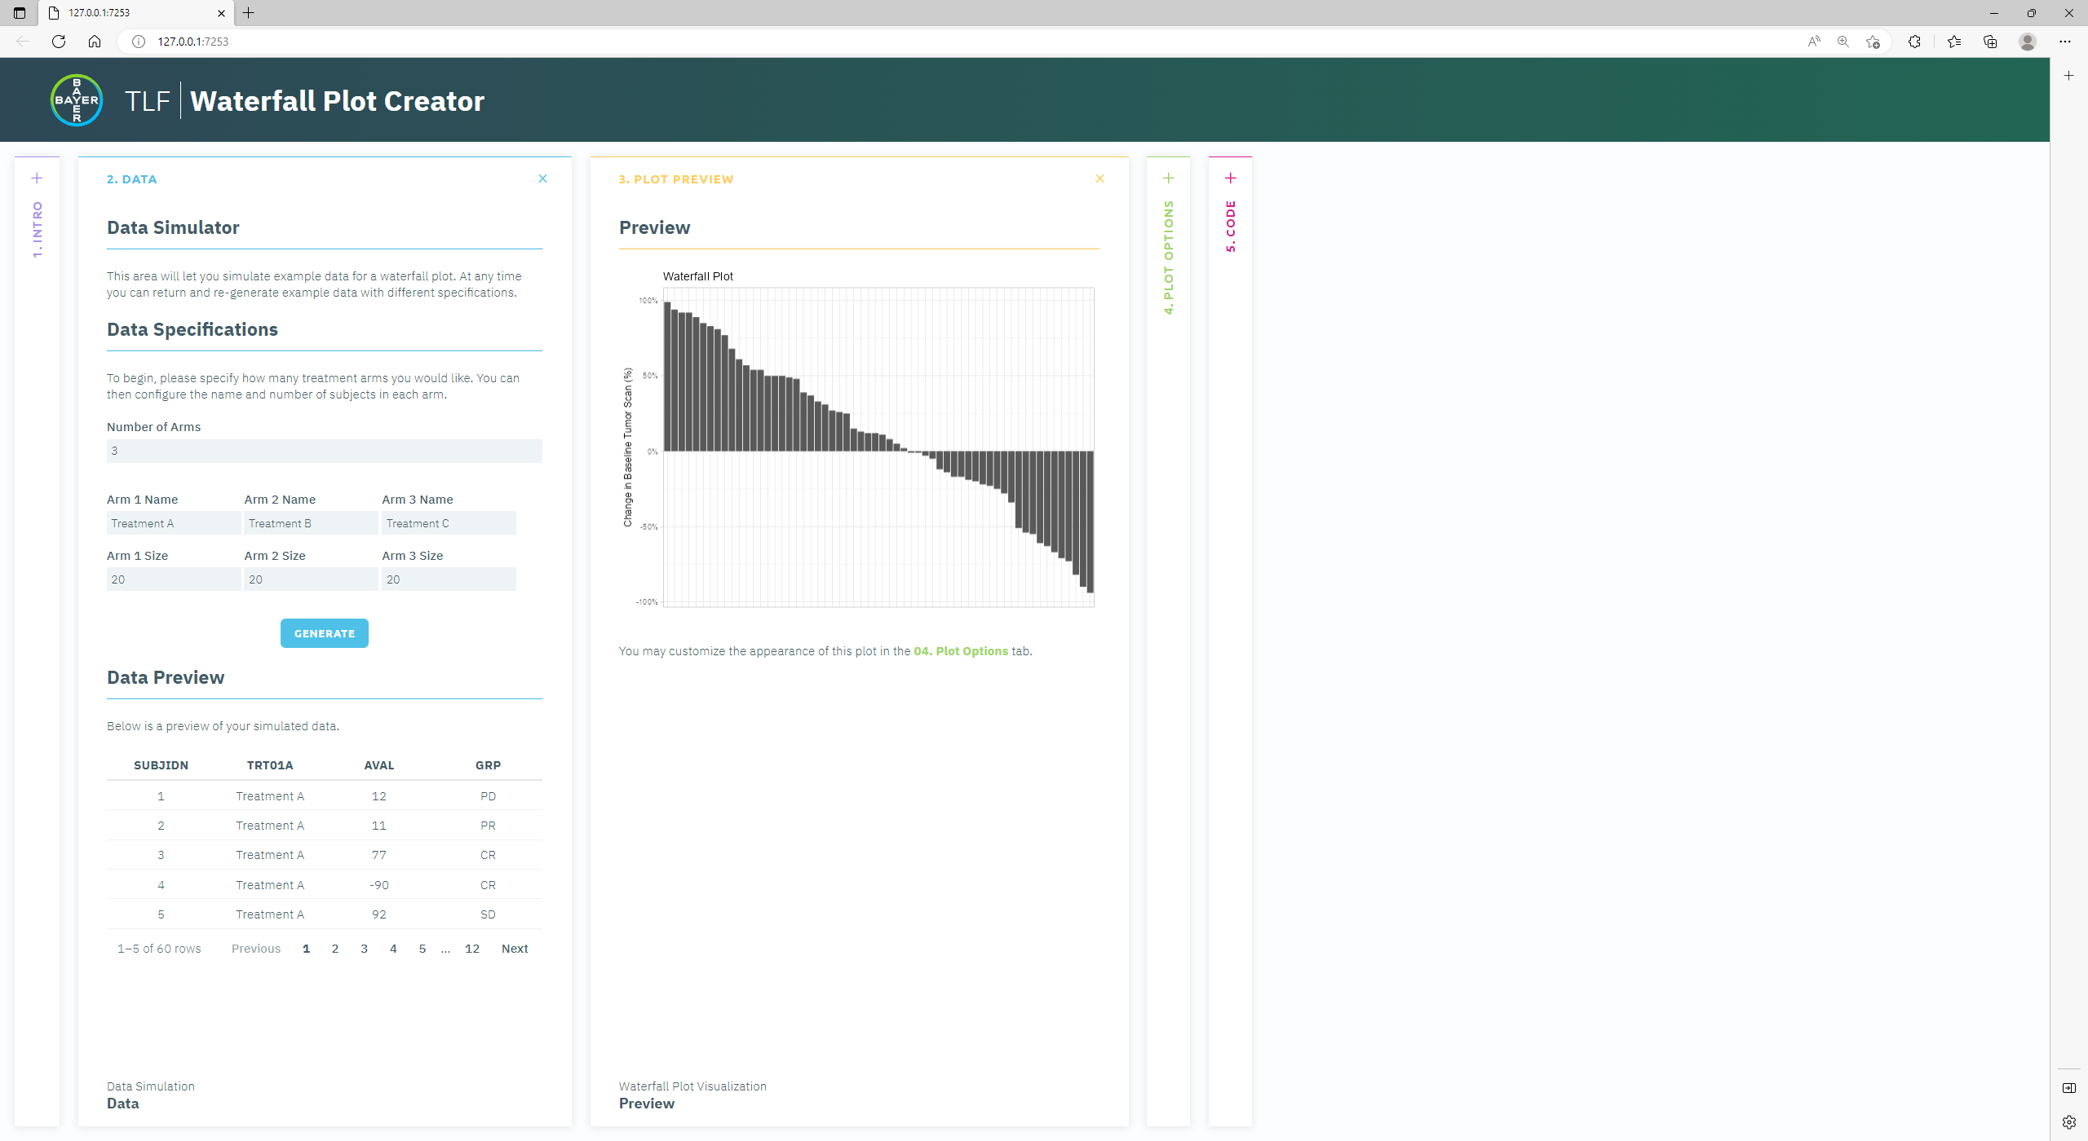
Prototype: Data + Plot Preview
1
4
1
Data Panel: Simulate data for visualization
2
Parameters for simulated data: # of arms, arm N’s, and arm Names
2
3
Tabular view of simulated data
4
Preview Panel: Continuously updated preview of plot
3

Slide 9
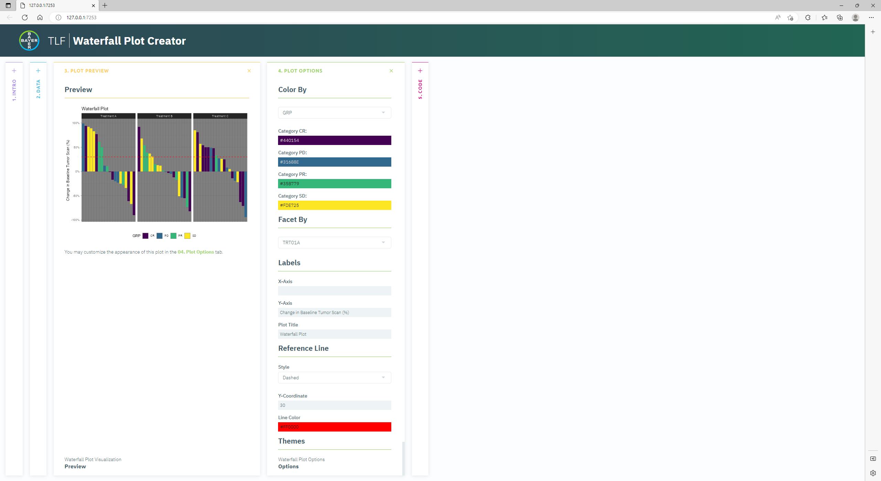
Prototype: Plot Preview + Plot Options
1
2
1
Preview Panel: Continuously updated preview of plot
2
Options Panel: Customizations for the plot

Slide 10
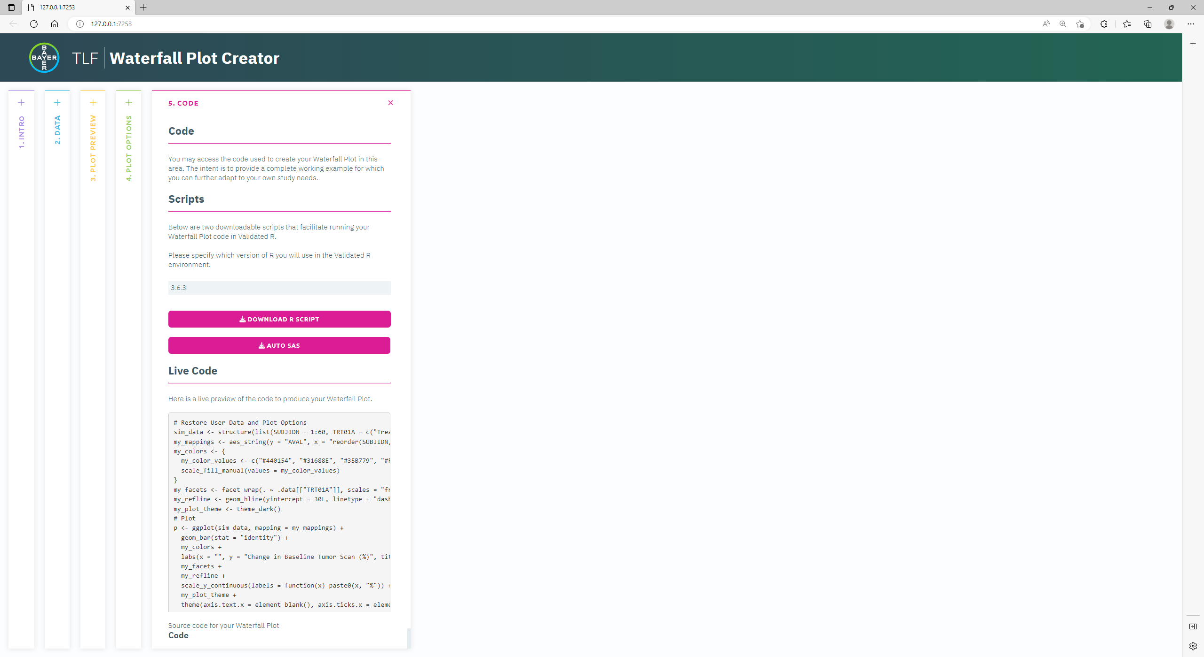
Prototype: Code
1
1
Code Panel: Code for plot
2
Download Code as an executable R script
2
3
Continuously updated preview of plot code
3

Slide 11
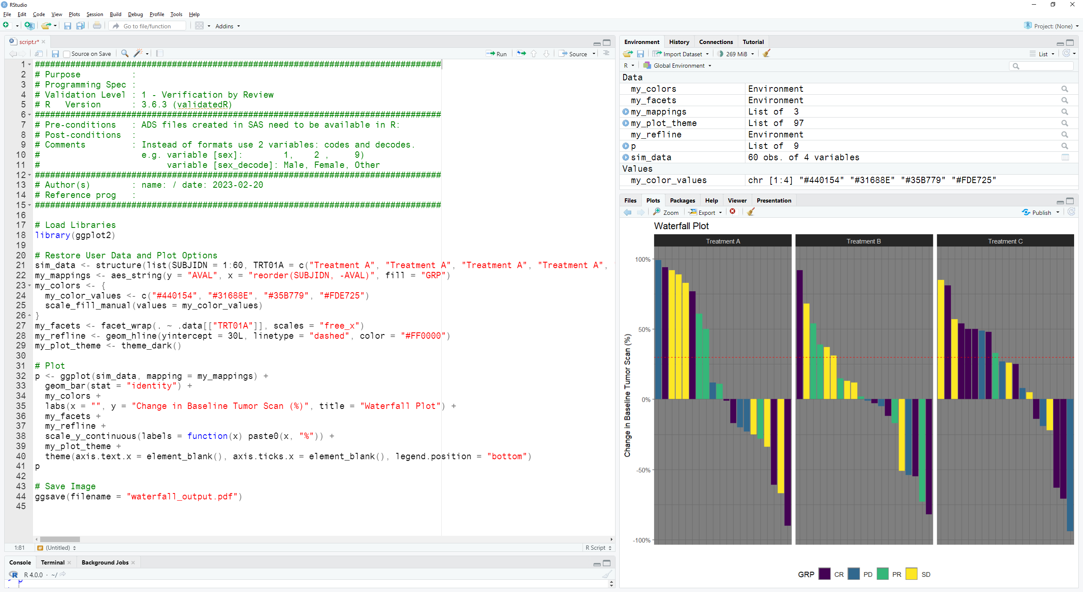
Prototype: Downloadable R Script
Additional R Script features

Slide 12
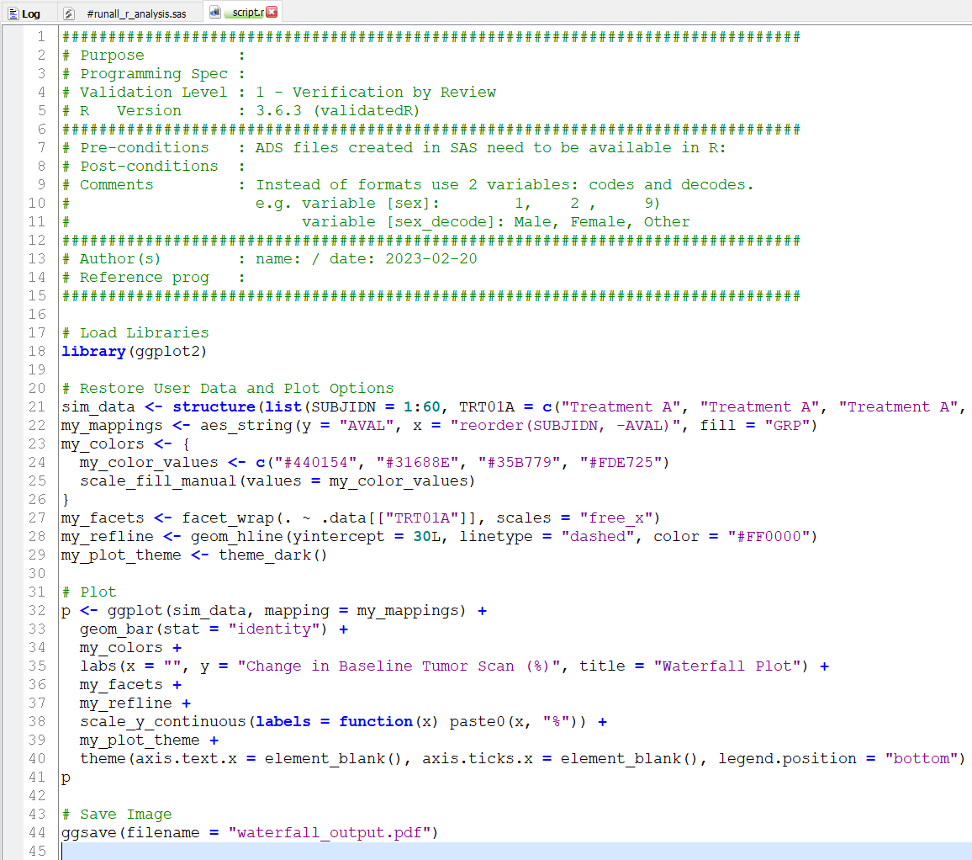
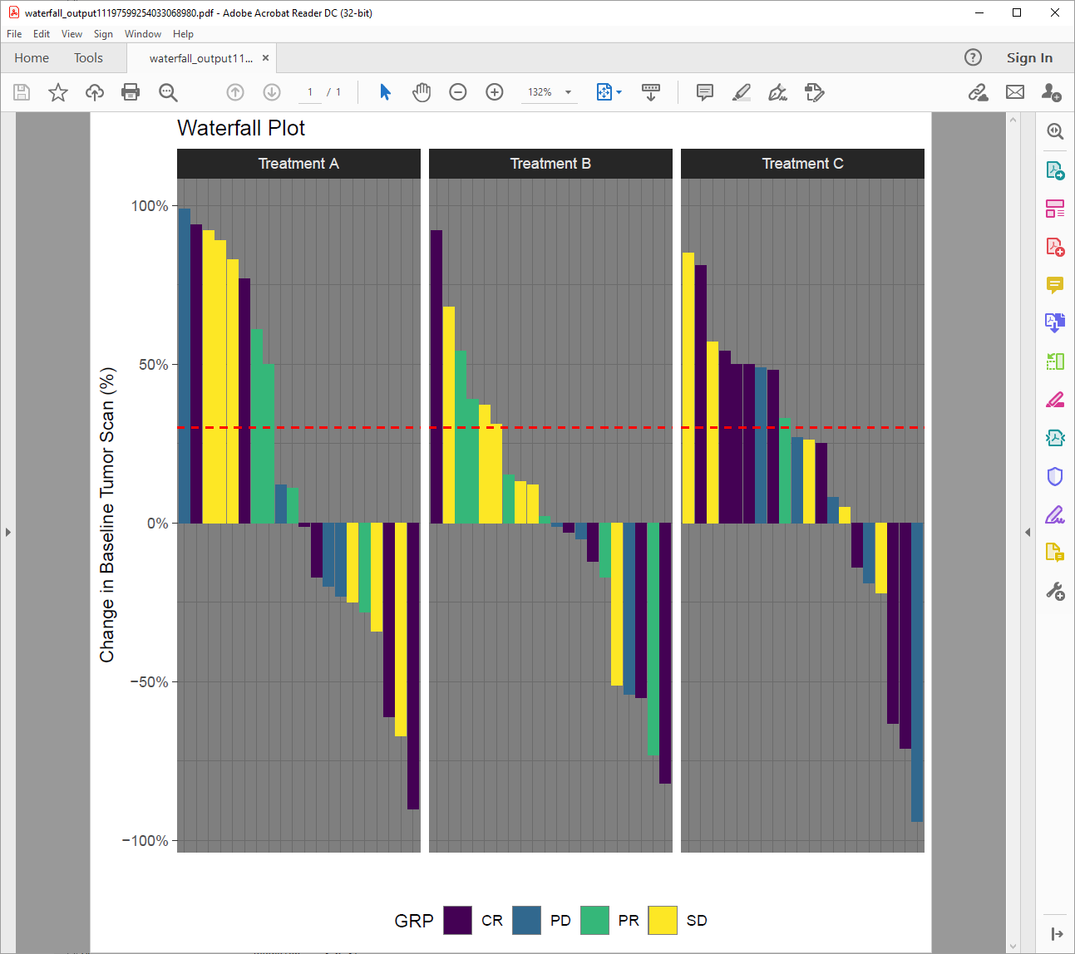
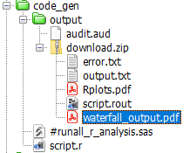
Outcome: Testing Script in Production

Slide 13
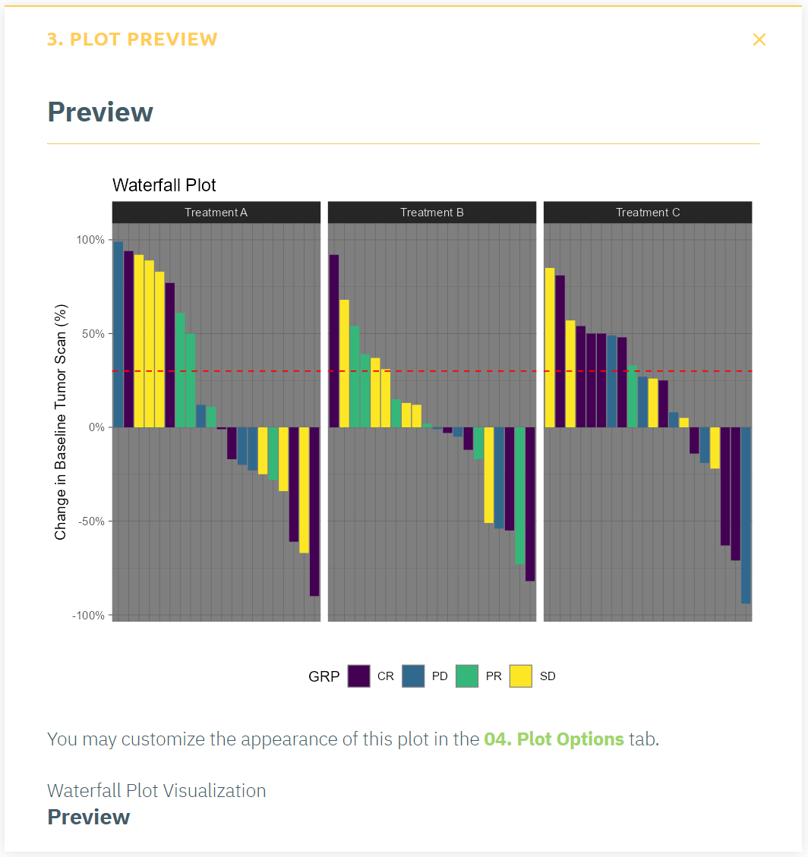
Outcome: Comparing of Results

Slide 14
Outcome: Discussion
Case-study successfully demonstrated the feasibility of reproducing a result created in a Shiny app in an external environment using code generation
Visual inspection might be sufficient for verifying graphical results
vdiffr package for visual regression testing and graphical diffing
More complex use cases (i.e. involving statistical calculations) may require
Deeper environment setup and configuration (OS level considerations, external software libraries)
Containerization may be useful
Notes:
Mention answers on how to get started are covered AFTER the prototype slides

Slide 15
Takeaways
shinymeta is an incredibly powerful package that can assist in helping expose the code in Shiny apps for reproducibility purposes
Code generation in existing apps versus new apps
Both are possible, though depending on complexity, retrofitting can be laborious
Discuss at requirements gathering phase whether this feature is needed and develop accordingly
Package and package version needs to be aligned in development and production environments
What’s available? What’s not? What’s available, but different?
How to structure “base” code
Other uses of code generation
Identifying interesting subsets of patients or events for use outside the app
Trial design, simulation-based uses
As a bridging or learning tool for new R programmers
Notes:
Mention answers on how to get started are covered AFTER the prototype slides

Slide 16
Contact
If you have any questions or comments or want to collaborate, please reach out:
Matthew Kumar E-mail: matthew.kumar@bayer.com
Srinivas Veeragoni E-mail: srinivas.veeragoni@bayer.com

Slide 17
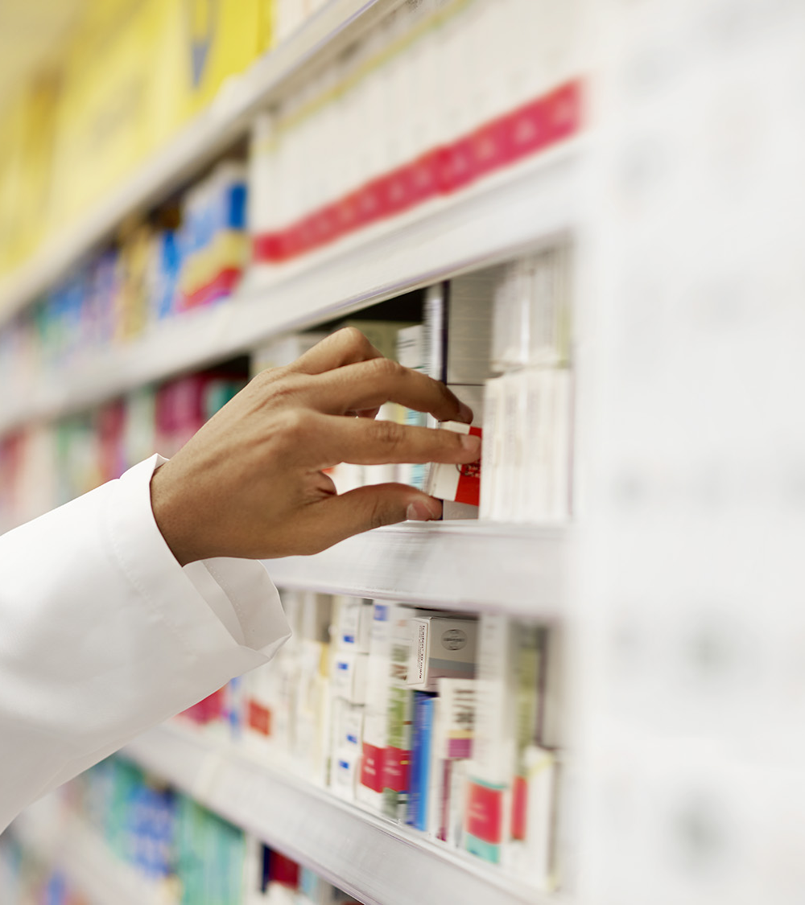
Thank you!

Slide 18
Questions?

