Slide 1
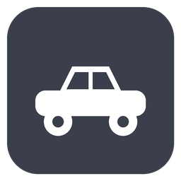
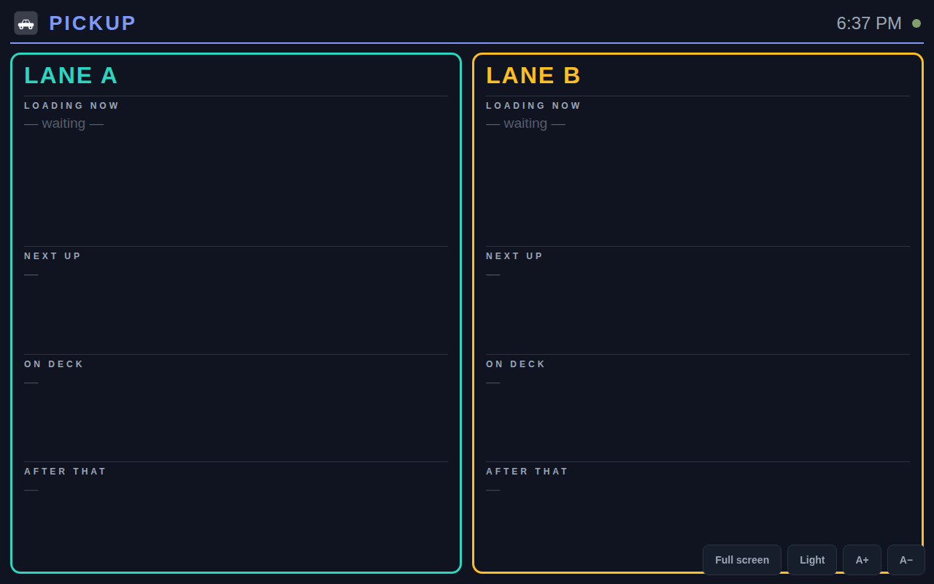
Pickup
Car-line dismissal, simplified.
A self-hosted pickup board for schools — tablets on the line, one screen in the gym, and every device in sync. No clipboards, no radios.
Introduction & how to use

Slide 2




What it is
A staff member walks the car line entering hang-tag numbers. A TV in the building shows which students should walk out to which lane. A marshal at the curb taps kids off as they get in their cars — and every screen stays in step.
20 min
2 lanes
1 container
the daily dismissal window it is built for
shown independently, side by side
everything runs on your own network
Pickup · Introduction & how to use
2

Slide 3




How it works
1
2
3
Walk the line
The board shows the waves
Load the cars
Type each car’s hang tag on a tablet as it pulls in.
Students walk out to the right lane, grouped into waves.
The marshal taps each child in; the car clears itself.
Every action syncs to every screen in about a second — the walker tablets, the marshal’s device, and the gym TV always agree.
Pickup · Introduction & how to use
3

Slide 4


Four screens, one system
Line Walker
Marshal
A big numeric keypad. Pick the lane, type a hang tag, press Enter. Unknown or duplicate tags are refused instantly.
See the cars loading now with each child’s name. Tap each one as they get in; the car clears itself when everyone’s in.
TV Display
Admin
The gym board — two lanes, read-only, and built to never go blank. No login needed.
Roster import, students, settings, branding, and backups — all behind a PIN.
Pickup · Introduction & how to use
4

Slide 5
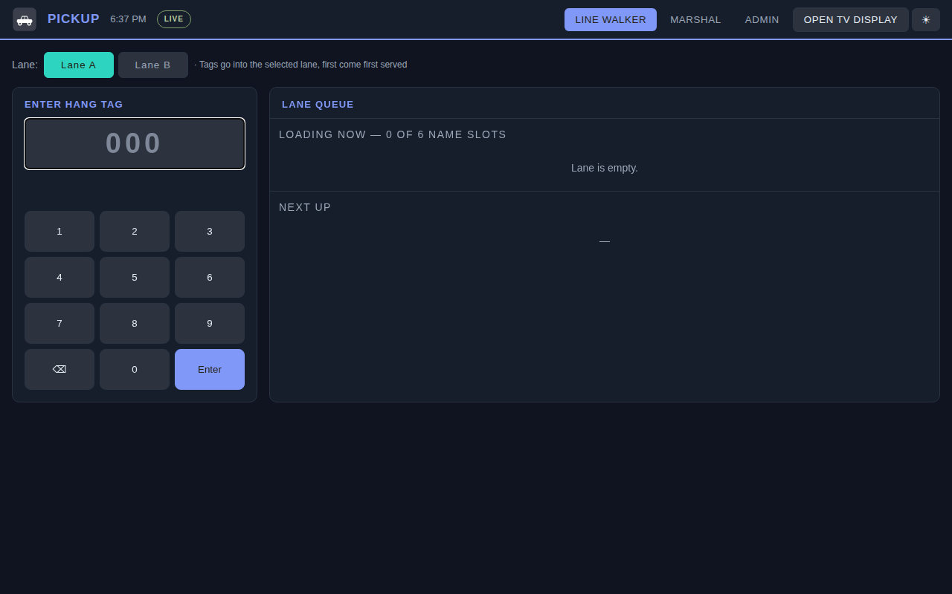

Line Walker
Pick the lane
Tap Lane A or Lane B — whichever the car pulled into.
Enter the tag
Tap the hang-tag number on the on-screen keypad and press Enter.
Instant feedback
Unknown tags and duplicates are rejected right away, with the reason.
Offline-safe
If Wi-Fi drops, entries are held on the device and sent when it reconnects.
Pickup · Introduction & how to use
5

Slide 6


Marshal
At the curb, the marshal works one lane and clears cars as kids climb in.
See who’s loading
The cars in the loading group show each child’s name and their coloured waiting spot.
Tap them in
Tap each child as they get in. When the last sibling is in, the car releases itself and the queue advances.
Release the whole wave
When the front row pulls away together, one tap on “Release all” clears the group and pulls the next wave forward.
It only ever touches the loading group — “Next Up” is always left alone.
Pickup · Introduction & how to use
6

Slide 7

The gym board
Two lanes at a glance
Loading now, plus the next waves, side by side.
Read-only
It sends nothing and needs no login — safe on any screen.
Never goes blank
If the network drops it keeps showing the last list and reconnects on its own.
Pickup · Introduction & how to use
7

Slide 8
Coloured waiting spots
1
2
3
4
5
6
Stand on your spot
Each child in the loading group gets a coloured dot and stands on the matching painted spot on the ground.
Readable for everyone
Every dot shows its number, so colour-blind kids aren’t left guessing — spots 1 and 6 are green and red.
Re-flows automatically
Siblings take consecutive spots, and numbers renumber from 1 as cars load and leave.
Pickup · Introduction & how to use
8

Slide 9

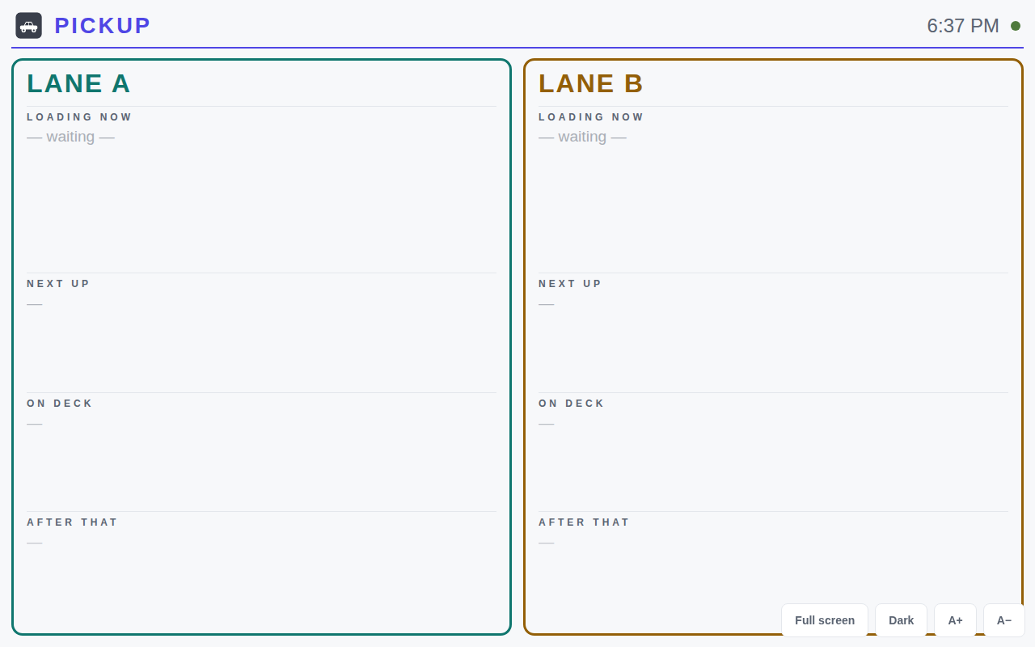


Make it yours
Name & subtitle
Set the title and the line beneath it to your school.
Your logo
Shows on the staff app, the TV board, and the browser tab.
Full colour scheme
Pick your school colours — light and dark, by swatch or hex code.
It’s all in Admin › Branding, and every screen updates live — no reload.
The same board in light mode — every colour is yours to set.
Pickup · Introduction & how to use
9

Slide 10

Set it up, then forget it
GET STARTED
DAY TO DAY
One container
Run docker compose up; it answers on the server’s IP, port 8888.
Nothing, really
The queue clears itself at midnight; staff just open the app and go.
Set it up once
Change the admin PIN, import your roster, set your branding.
Back it up
After roster changes, download one .db file — it restores everything.
Keep it on your LAN
No internet exposure — the design assumes a trusted building network.
Pickup — car-line dismissal, simplified.
Pickup · Introduction & how to use
10

