Slide 1
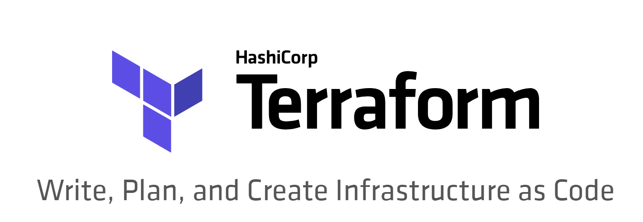

Slide 2
Terraform
“Terraform is a tool for building, changing, and versioning infrastructure safely and efficiently. Terraform can manage existing and popular service providers as well as custom in-house solutions.
Configuration files describe to Terraform the components needed to run a single application or your entire datacenter. Terraform generates an execution plan describing what it will do to reach the desired state, and then executes it to build the described infrastructure. As the configuration changes, Terraform is able to determine what changed and create incremental execution plans which can be applied.”
https://www.terraform.io/intro/index.html

Slide 3
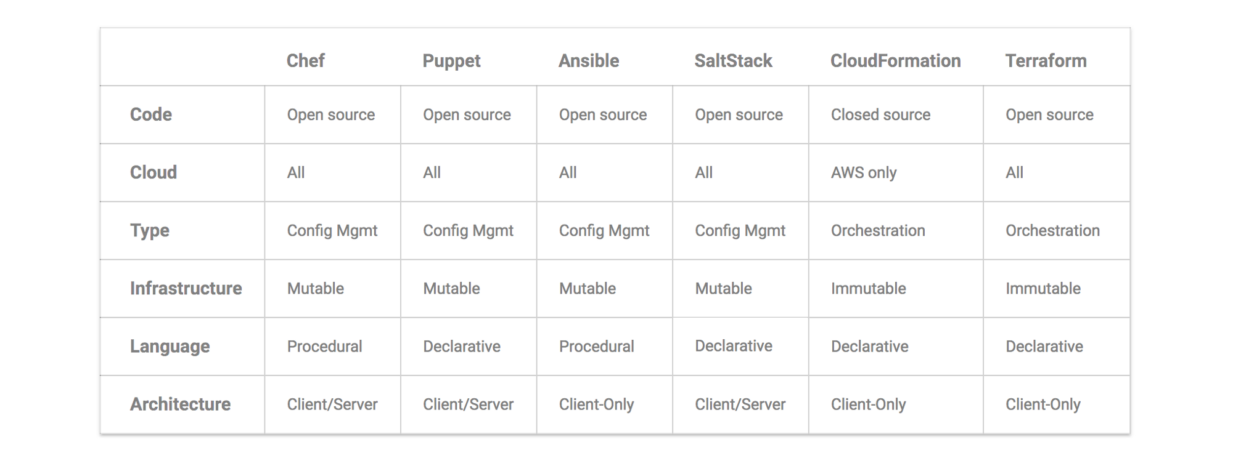
Infrastructure as Code – Tools comparison
https://blog.gruntwork.io/why-we-use-terraform-and-not-chef-puppet-ansible-saltstack-or-cloudformation-7989dad2865c

Slide 4
Orchestration vs Config Management
Good Uses for Configuration Management Tools
Install and manage software on exiting servers/infrastructure
Repeatable tasks (Windows Updates, Deploying software, copying files, updating Env variables, etc)
Good uses for Orchestration Tools
Create, modify, provision servers/Infrastructure

Slide 5
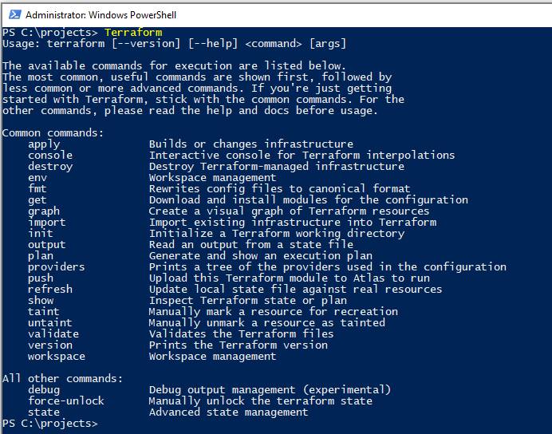
Getting started with Terraform
Download => https://www.terraform.io/downloads.html
Add executable to system path
Reboot

Slide 6
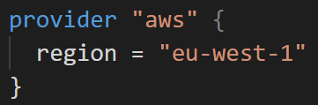
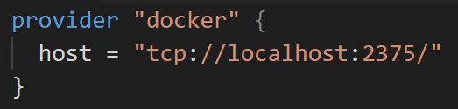
Terraform - Providers
Terraform is agnostic to the underlying platforms by supporting providers. A provider is responsible for understanding API interactions and exposing resources. Providers generally are an IaaS (e.g. AWS, GCP, Microsoft Azure, OpenStack), PaaS (e.g. Heroku), or SaaS services (e.g. Terraform Enterprise, DNSimple, CloudFlare).
https://www.terraform.io/docs/providers/index.html

Slide 7
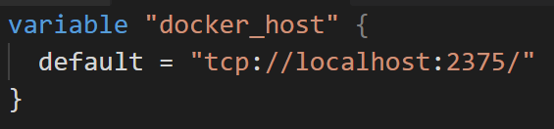
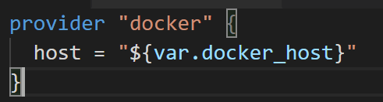
Variables
Declare a variable:
Usage:

Slide 8
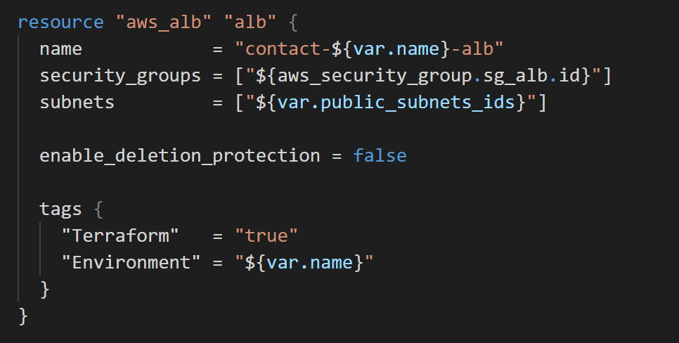
Resources
The most important thing you'll configure with Terraform are resources. Resources are a component of your infrastructure. It might be some low level component such as a physical server, virtual machine, or container. Or it can be a higher level component such as an email provider, DNS record, or database provider.
https://www.terraform.io/docs/configuration/resources.html

Slide 9
Commands
init Initialise a new or existing Terraform configuration
plan Generate an show an execution plan
apply Builds or changes infrastructure
destroy Destroy Terraform-managed infrastucture

Slide 10
Workspaces are your friend
list List all existing workspaces
select Select a workspace
new Create a new workspace
delete Destroy Terraform-managed infrastucture

Slide 11

Locals are also your friend
Local values assign a name to an expression, that can then be used multiple times within a module.

