Slide 1

A Classification Algorithm Detecting Major Depressive Disorders in Wrist Actigraphy Data
Presentation by: Matt LeGro
07/09/21
Notes:
NOTE:
To change the image on this slide, select the picture and delete it. Then click the Pictures icon in the placeholder to insert your own image.

Slide 2
Presentation Outline
Research Motivation
Discuss data source and relevant background
Describe constructed features
Present Model Performance

Slide 3
Motivation for Algorithm Development
From the National Institute of Mental Health (NIMH), over 20% of US Adults have mental illnesses meeting clinical diagnostic criteria
Of the 20%, more than half did not receive Mental Health Services
Wearable sensors rise in popularity; People have phones!
Proof of concept: Additional health recommendations and alerts to broadly benefit the health of society through quantitative validation and early detection of illness

Slide 4
A Brief Literature Review
Altered, usually reduced, motor activity is an integral component of clinical diagnoses of depressive states
Circadian rhythms are often disrupted in those afflicted
Actigraphy is a non-invasive method of collecting long term data from which information on activity levels and sleep quality can be derived

Slide 5
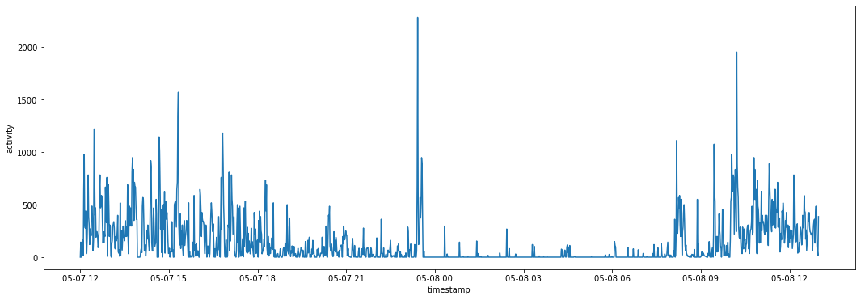
Actigraphy Data
Data was sourced from the Depresjon Dataset, originally collected for a study on the motor activity of schizophrenic and majorly depressed subjects
23 Unipolar or Bipolar patients and 32 healthy controls wore a wrist actigraph on their right wrist constantly for anywhere between 13 and 35 days
Activity is recorded as a sum of movements greater than 0.05g over every minute

Slide 6
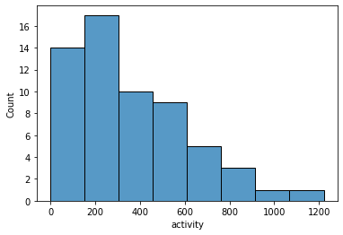
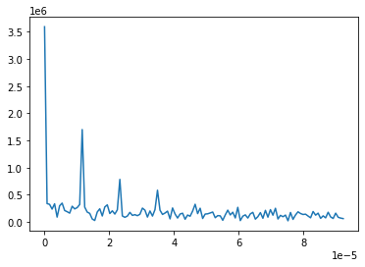
Constructed Features Based on Domain Knowledge
Time Domain
Frequency Domain
Statistics generated from half-hour lapses in the subject’s actigraphy time series:
Total
Maximum
Median
Average
Standard Deviation
Variance
The strength and period in hours of a subjects three strongest circadian cycles determined by DFT analysis
In additional to the statistical measures, features were generated identifying blocks occurring during traditional nighttime (9pm-7am), whether or not the patient was likely asleep or interrupted sleep, the number of restful minutes, and the number of minutes of zero activity

Slide 7
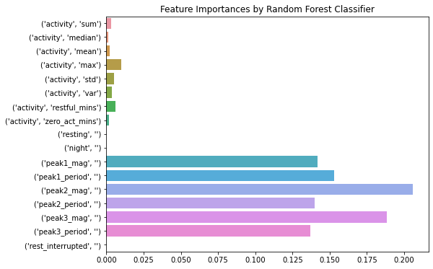
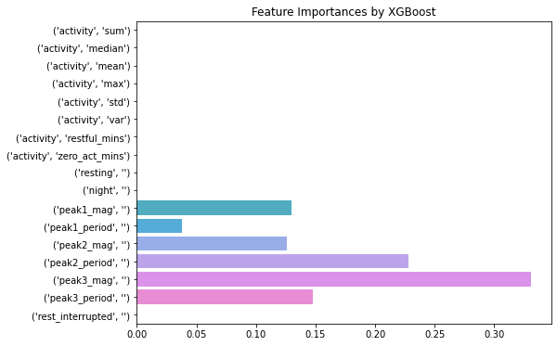
Model Performance
Standard XGBoost and Random Forest classifiers achieved 100% accuracy in classifying half hour lapses as belonging to healthy or afflicted individuals

Slide 8
Summary
Two classification algorithms were trained and were able to correctly classify with 100% accuracy actigraphy data sourced from healthy subjects and patients affected by Major Depressive Disorders
The major factors in classification are presence and strength of circadian rhythms
In the future, investigate other features and algorithms for improving efficacy of classifier without frequency analysis

Slide 9
Thank You!
Questions?
Email: mlegro93@gmail.com
LinkedIn: https://www.linkedin.com/in/matthew-legro-8b60211b6/

