Slide 1
An Analysis of Theatrical Movie Releases: A SUMMARY OF PREDICTORS IN THE PRODUCTION OF MOVIES WITH HIGH RETURN ON INVESTMENT

Slide 2
Presentation Roadmap
Outline the business objective
Describe the data source and preparation methods
Summarize results and discuss interpretations
Provide actionable insights

Slide 3
Business Objective
Global Box Office Revenue hit a new record in 2019 at $42.5 billion and has been growing every year
Netflix is reported to invest $15 billion on new content; Prime Video and Apple TV+ at $6 billion; Hulu, Disney+ and HBO Max are all coming in around $3 billion
Enable Microsoft to join the media industry as a production company and grow shareholder value
Determine features of successful theatrical movie releases to guide Microsoft in producing films that will generate profit

Slide 4
Data Preparation
The data used in the analysis comes from The Numbers (TN), The Movie Database (TMDb), and the Internet Movie Database (IMDb)
Being interested in profitable movies, as many records as possible containing budget and revenue were collected, but to determine features of successful films, we need other attributes as well
Our initial TN dataset had both financial fields, but lacked other categorical information
Our TMDb and IMDb datasets had plenty of descriptive information, but no financial necessary

Slide 5
Data Preparation
To improve the TMDb dataset, it was found that information about individual movies could be easily retrieved using a unique movie ID via their web API. Thus, for each movie in the initial TMDb set, additional information including budget, revenue, and importantly, the IDMb unique ID was retrieved
To improve the TN dataset, the unique IMDb was found and assigned based on the title and release year of movies in the TN dataset. Once an IMDb ID was assigned, it could easily be related to the other tables in which IMDb is an identifier
Finally, the expanded TN and TMDB datasets were combined and checked for duplicate records for a final collection of movies with the required budgetary information and maximal categorical attributes

Slide 6
Data Preparation
tconst | Title | Genres | runtime_ minutes | vote_ average | vote_count | budget_est | worldwide_gross | release_ week_day | release_ day | release_ month | release_ year
tt0892769 | How to Train Your Dragon | ['Fantasy', 'Adventure', 'Animation', 'Family'] | 98 | 8.095082 | 618909 | 165000000.0 | 494874875.5 | 4 | 26 | 3 | 2010
tt1228705 | Iron Man 2 | ['Adventure', 'Action', 'Science Fiction'] | 124 | 6.996308 | 670058 | 185000000.0 | 622544860.0 | 4 | 7 | 5 | 2010
Note: For duplicate rows when merging TN and TMDb, if records existed in both, all numeric columns were averaged and categorical columns were kept from the TMDb dataset
In analysis, additional aggregate categories such as Return on Investment were included (ROI), plus binning categories were defined, such as ranges for budget, and ROI percentage

Slide 7
Questions for Review
How much should be spent on production?
What type of movie is most often high in ROI percentage?
Once the movie is produced, when should it be released?

Slide 8
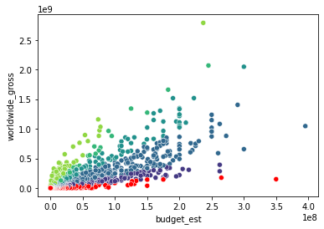
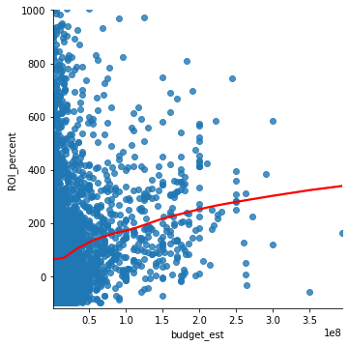
What should be spent on production?

Slide 9
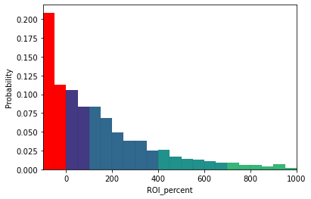
What should be spent on production?

Slide 10
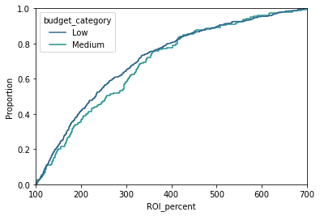
What should be spent on production?

Slide 11
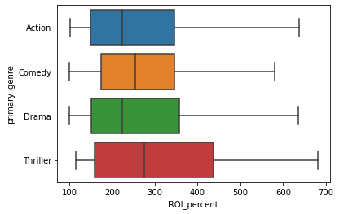
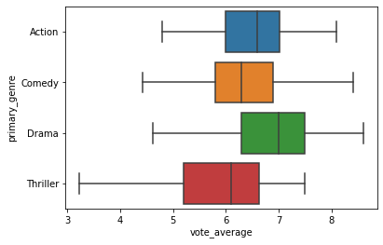
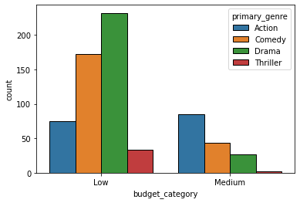
What types of movies produce high returns?

Slide 12
What types of movies produce high returns?

Slide 13
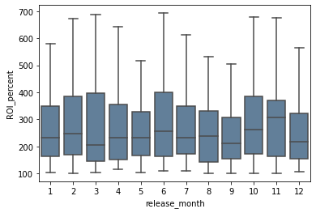
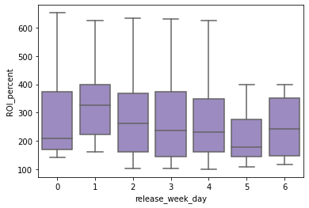
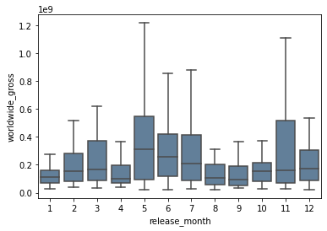
When to release?

Slide 14
Summary
In general, spending more on production will increase the return on the original investment
Of the different movie genres, Thriller movies are least often produced but tend to yield the highest ROI and ROI may be less affected by production quality
To maximize availability on theatrical release, release movies on a Monday evening in one of the early summer months

Slide 15
Future Avenues of Exploration
These datasets and analysis only investigates returns based on reported worldwide box office gross numbers and estimated production budgets. The theatrical release of a blockbuster film does not account for a majority of movie-related income; there is home entertainment sales (DVDs), Video on Demand and Streaming Services, Television airtime, and merchandising. On the other hand, costs related to these are also not explored; manufacturing DVDs and merchandise, deals with streaming service providers and television providers, etc. Similarly, ROI’s presented here have the potential to be hugely overinflated because it is unclear exactly what is included in the production budget estimate. It may be that marketing and other costs related solely to the theatrical release have not been accounted for.
We primarily looked at a subset of our movie collection where we required movies to make a profit (have ROI > 0). In the future, we can double check that the described features hold true only for profitable movies, increasing our confidence
We have access to data connecting movie cast and crew to IMDb ID’s which we have for every movie in our collection dataset. While for Thrillers it may not be as important, it may be that there are a subset of the production crew that is a better predictor of high return movies
As it relates to the first concern, the pandemic, and the rise of streaming services.. Is theatrical release worth it as a new production company with plenty of capital?

Slide 16
Thank You!
Questions?
Github Repo: https://github.com/mattlegro/dsc-phase-1-project
Email: mlegro93@gmail.com
LinkedIn: https://www.linkedin.com/in/matthew-legro-8b60211b6/

