Slide 2
Building great libraries using .NET Standard
Matthew Leibowitz
Software Engineer Guy
@mattleibow maleib@microsoft.com

Slide 3
What is .NET Standard?

Slide 4
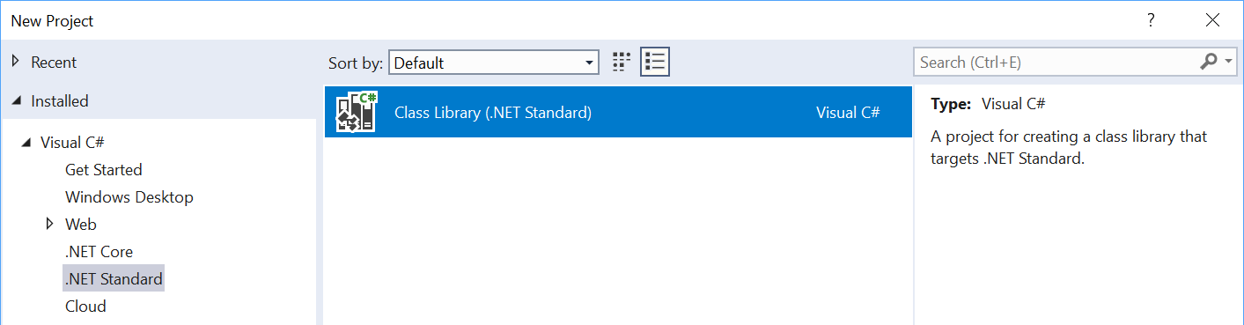
What is .NET Standard?
.NET Standard is a specification
A set of APIs all .NET platforms have to implement
.NET Standard
C# / F# / VB.NET Code
Compiler
.NET Core / FX / Mono
~ ~
~
~
XML Schema
XML
Validator
XML Parser
.NET Standard
.NET Core / FX / Mono
~
~
HTML specification
Browsers
$ dotnet new classlib -o My.Class.Library

Slide 5
What’s in .NET Standard?
Microsoft.Win32.SafeHandles
System
System.CodeDom.Compiler
System.Collections
System.Collections.Concurrent
System.Collections.Generic
System.Collections.ObjectModel
System.Collections.Specialized
System.ComponentModel
System.ComponentModel.Design
System.ComponentModel.Design.Serialization
System.Configuration.Assemblies
System.Data
System.Data.Common
System.Data.SqlTypes
System.Diagnostics
System.Diagnostics.CodeAnalysis
System.Diagnostics.Contracts
System.Diagnostics.SymbolStore
System.Diagnostics.Tracing
System.Drawing
System.Dynamic
System.Globalization
System.IO
System.IO.Compression
System.IO.IsolatedStorage
System.IO.MemoryMappedFiles
System.IO.Pipes
System.Linq
System.Linq.Expressions
System.Net
System.Net.Cache
System.Net.Http
System.Net.Http.Headers
System.Net.Mail
System.Net.Mime
System.Net.NetworkInformation
System.Net.Security
System.Net.Sockets
System.Net.WebSockets
System.Numerics
System.Reflection
System.Reflection.Emit
System.Resources
System.Runtime
System.Runtime.CompilerServices
System.Runtime.ConstrainedExecution
System.Runtime.ExceptionServices
System.Runtime.InteropServices
System.Runtime.InteropServices.ComTypes
System.Runtime.Serialization
System.Runtime.Serialization.Formatters
System.Runtime.Serialization.Formatters.Binary
System.Runtime.Serialization.Json
System.Runtime.Versioning
System.Security
System.Security.Authentication
System.Security.Authentication.ExtendedProtection
System.Security.Claims
System.Security.Cryptography
System.Security.Cryptography.X509Certificates
System.Security.Permissions
System.Security.Principal
System.Text
System.Text.RegularExpressions
System.Threading
System.Threading.Tasks
System.Timers
System.Transactions
System.Windows.Input
System.Xml
System.Xml.Linq
System.Xml.Resolvers
System.Xml.Schema
System.Xml.Serialization
System.Xml.XPath
System.Xml.Xsl
All the foundational APIs
~37k APIs in .NET Standard 2.0

Slide 6
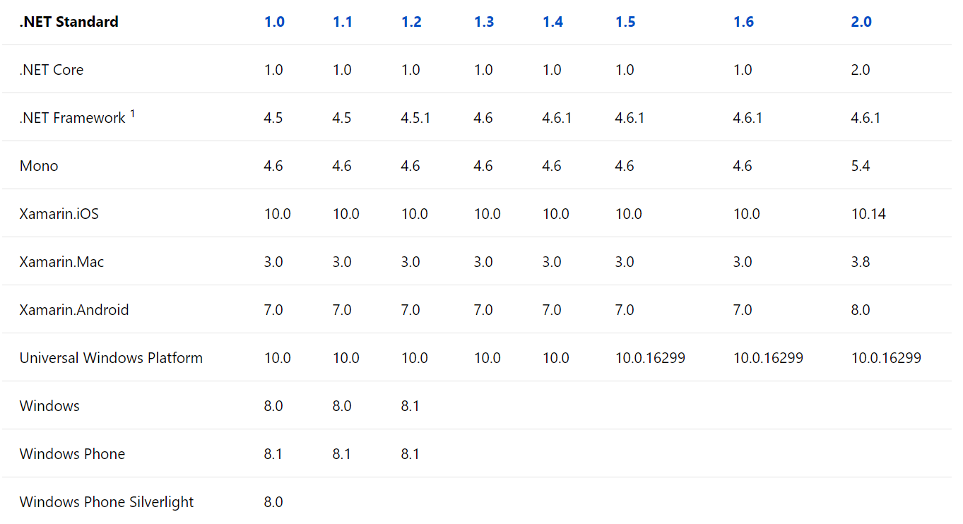
Versions of .NET Standard
Don’t worry about it.
Start with .NET Standard 2.0.

Slide 7
.NET Standard is also Open Source!
Anybody can propose API additions
The review board approves the API
Has representatives from the .NET Foundation, Microsoft, Xamarin/Mono, & Unity
Acceptance requires
A stable implementation that is shipped in at least one .NET implementation
Sponsorship from a board member
Next version is planned here:
https://github.com/dotnet/standard/tree/master/docs/planning/netstandard-2.1
Notes:
The review board is not about a design review (no new APIs), but more an acceptance review. For new APIs, first go to Mono or .NET Core and implement it. Once it is released, then approach the review board.

Slide 8
.NET Standard & .NET Framework
We retroactively made .NET Framework 4.6.1 support .NET Standard 2.0
Turns out this was a mistake as it has a tail of issues.
Lesson learned for us: after a .NET platform has shipped, the version of .NET Standard it supports should be considered immutable.
.NET Framework 4.7.2 is the recommended version to consume .NET Standard 1.5+
Application authors: consider upgrading
Library authors: consider multi-targeting for .NET Framework 4.6.1

Slide 9
Using platform-specific APIs from .NET Standard

Slide 10
Windows Compatibility Pack
Microsoft.Windows.Compatibility (NuGet package)
Can be referenced from .NET Core as well as from .NET Standard
Has ~21k APIs (Windows-only as well as cross-platform)
Contents
ACLs
Code Pages
CodeDom
Configuration
Crypto
DirectoryServices
Drawing
EventLog
MEF v1
Odbc
Perf Counters
Permissions
Ports
Registry
Runtime Caching
WCF
Windows Services
…

Slide 11
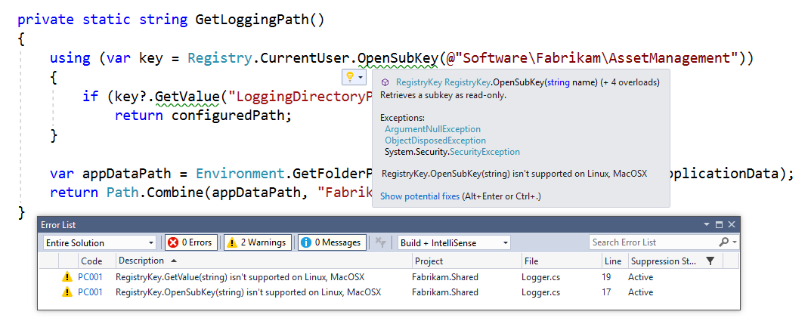
Detecting usage of unsupported APIs
Use API Analyzer!
https://aka.ms/apianalyzer
Roslyn analyzer that flags usages of APIs that don’t work across all platforms

Slide 12
Demo

Slide 13
Multi-Targeting Best Practices
DO start with .NET Standard 2.0
Most general purpose libraries will not need APIs outside this set.
CONSIDER targeting multiple frameworks
If you need to call platform-specific APIs outside of .NET Standard
DO NOT drop support for .NET Standard
Instead, throw from the implementation and offer capability APIs. This way, your library can used anywhere and supports runtime light-up.
DO share your component using a NuGet package
It shields consumers from having to pick the appropriate implementation.
CONSIDER using MSBuild.Sdk.Extras
Thanks Oren! ☺

Slide 14
.NET Standard & .NET Framework

Slide 15
Strong naming
Key signing to give assemblies an additional piece for the name
MyLibrary, Version=1.0.0.0, Culture=neutral, PublicKeyToken=70d3c3735d2363d4
Don’t confuse strong names with Authenticode signing, the industry standard based on certificates for indicating who authored a specific binary
Disambiguates assemblies with the same simple name (such as “Calculator”)
Required for GAC or for loading assemblies side-by-side

Slide 16
Strong naming
Strong naming is generally viral
Strong named assemblies can only reference strong named assemblies
Adding or removing a strong name is a binary breaking change
We recommend that you:
Strong name your libraries from the get-go
Check in the public and private key into your OSS repos
Do not make security decisions based on the strong name

Slide 17
apisof.net source.dot.net sourceof.net fuget.org

Slide 18
Best Practices
DO follow the API Design Guidelines
DO target .NET Standard 2.0
CONSIDER using multi-targeting to allow for platform-specific code
CONSIDER dual-targeting for .NET Framework 4.6.1
DO use NuGet for packaging multi-targeted libraries
DO throw PlatformNotSupportedException for unsupported APIs
CONSIDER offering capability APIs so that consumers can check upfront
DO strong name your libraries
AVOID if your library can’t be used on .NET Framework
DO check in the public & private key

Slide 19

Q & A
https://aka.ms/netstandardFaq
https://aka.ms/netstandardDocs
Matthew Leibowitz
@mattleibow
maleib@microsoft.com

