Slide 1
Modernizing Projects
Matthew Leibowitz
@mattleibow
maleib@microsoft.com

Slide 2
Terrible Things
Large project files
Weird elements
Many, many projects
Shared Projects
File Linking
Old Tools
Dependency Tracking / Coordinating

Slide 3
This can all go away! Today!

Slide 4
Modernization 1 - <PackageReference> Switch from packages.config and project.json to <PackageReference>
The Old
packages.config has a local copy of all packages
project.json is really bad, trust me!
<Reference> and <HintPath> is just clutter
The New
Packages are stored in a single location
No Visual Studio restarts

Slide 5
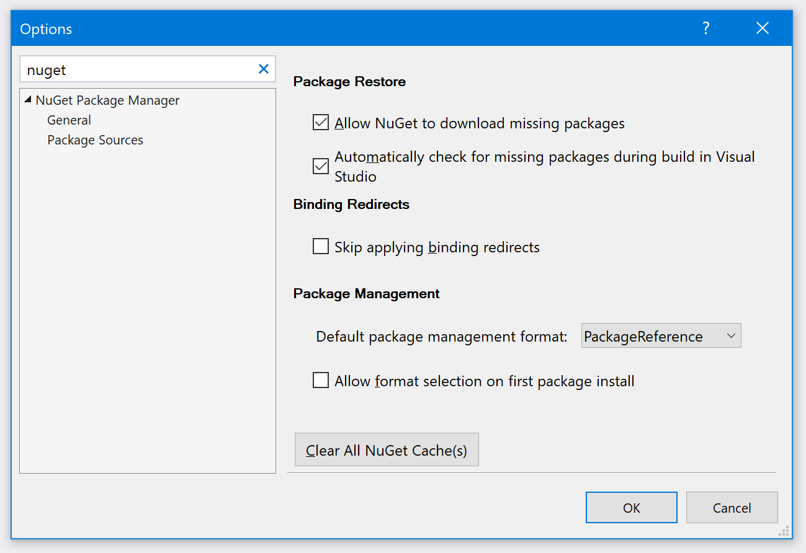
Setting the new defaults
Notes:
Make a note of:
* options dialog has search
* simple as a dropdown selection

Slide 6
The <PackageReference> Code
<Project>
<ItemGroup>
<PackageReference Include="Package.Id" Version="1.0.0" />
</ItemGroup>
</Project>

Slide 7
Demo
Making the switch…
Notes:
Show:
* the options dialog
* the migration path
* the .csproj differences
* the .props and .targets
* the references and hint paths

Slide 8
Modernization 2 – SDK Style Switch from the old project format to the SDK style project format
Removes boilerplate elements
Smaller project files
Automatic file inclusion
Visual Studio 2017 can open obsolete platforms
Makes use of MSBuild.Sdk.Extras package

Slide 9
The SDK Style Project
<Project Sdk="Microsoft.NET.Sdk">
<PropertyGroup>
<TargetFramework>net45</TargetFramework>
</PropertyGroup>
</Project>

Slide 10
Demo
Humongous, numongous, and annoymongous, projects…
Notes:
There are multiple things wrong with this solution:
* There are multiple projects (1 per platform)
* Some platforms have multiple configurations
* Desktop (net462) and OldDesktop (net20)
* There are shared projects and/or file linking
* The project files will have duplicate properties
* Managing dependencies is hard
* not all works in VS2017

Slide 11
Modernization 3 – Multitargeting Switch from multiple projects to a single project
Far, far fewer projects
Centralized configuration
Conventions can be used
Conditions can be used to customize builds

Slide 12
The <TargetFrameworks> Code
<Project>
<PropertyGroup>
<TargetFrameworks>
monoandroid8.1;
xamarinios1.0;
uap10.0.16299;
netstandard2.0
</TargetFrameworks>
</PropertyGroup>
</Project>

Slide 13
Demo
Mergalicious…
Notes:
Show:
* single file
* wildcards
* <TargetFrameworks> (plural) instead <TargetFramework> (singular)
* Conditions are easy

Slide 14
Modernization 4 – /t:Pack Switch from .nuspec files to .csproj files to create NuGets
No need for .nuspec files
Automatic dependencies and references
Package properties can be set with MSBuild properties

Slide 15
Demo
Packing, packing, packing…
Notes:
Show:
* /t:Pack
* /t:Pack with properties
* The properties in the .csproj

Slide 16
Silverlight is back!

Slide 17
Demo
Silverlight is back!

Slide 18
Links
Portable Class Library Profile Viewer https://portablelibraryprofiles.stephencleary.com
Windows SDKs https://developer.microsoft.com/en-us/windows/downloads/sdk-archive
NuGet Migration https://docs.microsoft.com/nuget/reference/migrate-packages-config-to-package-reference
MSBuild.Sdk.Extras https://github.com/onovotny/MSBuildSdkExtras
Multitargeting in Visual Studio Bug https://github.com/dotnet/project-system/issues/935
Example Library – Xamarin.Essentials https://github.com/xamarin/Essentials

Slide 19
Thank You!

