Slide 1
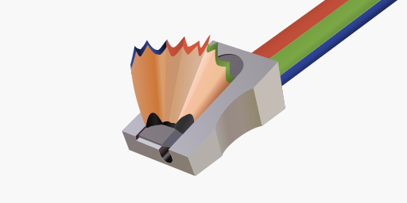
SkiaSharp

Slide 2
Updating the skia in SkiaSharp

