Slide 1
Jumping into Powerful 2D Graphics using SkiaSharp with Uno Platform

Slide 2

Matthew Leibowitz
Software Engineer at Microsoft

Slide 3
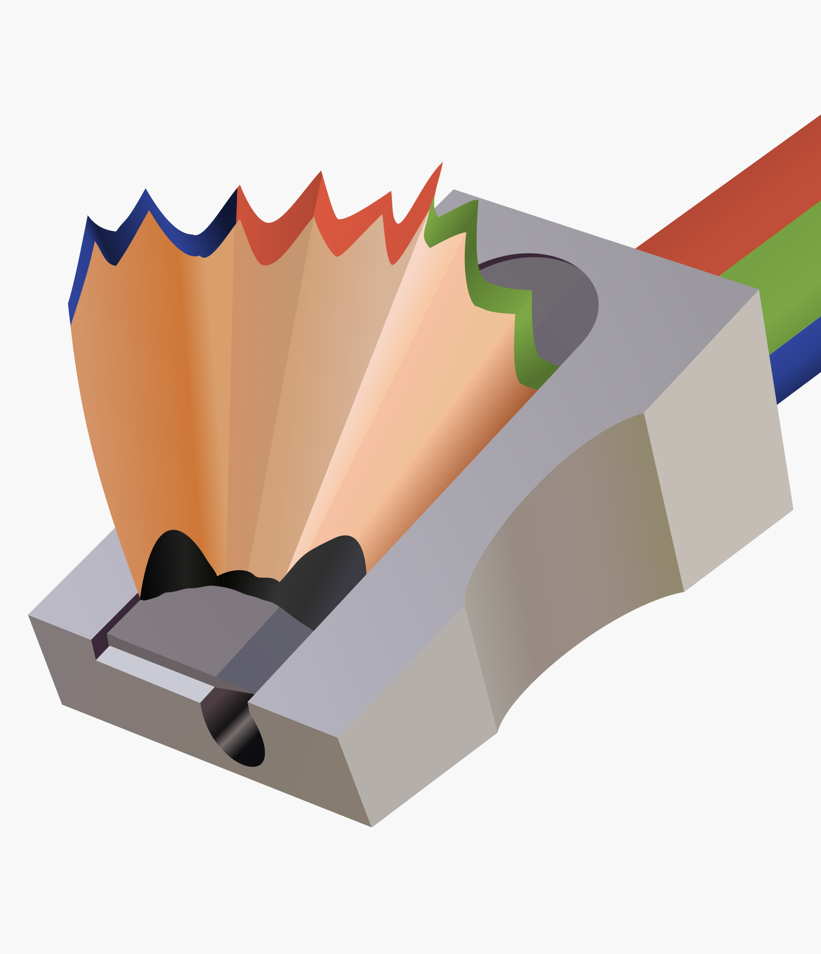
Skia & SkiaSharp
So just what is it? What can it do?

Slide 4
What is Skia?
Cross-platform 2D graphics library
Hardware rendering for OpenGL, DirectX, Metal and more
Software rendering for bitmaps and PDF documents
Powers Chrome, Android, Firefox, Chrome OS and Flutter
Written in C++, C, Assembly and other languages
Maintained by Google

Slide 5
What is SkiaSharp?
.NET wrapper around Skia
Supports all the features of Skia
Runs on basically everything straight from NuGet
Written in C#
Maintained by Microsoft
Found on NuGet: “SkiaSharp”

Slide 6
How does it all work?
The surface wraps the underlying/platform surface
eg: GPU texture, memory block
The canvas translates drawing commands into operations that the surface understands
eg: DrawRect, DrawImage, DrawPath, Translate, Rotate
The paint describes what the drawn object will look like
eg: color, style, smoothing, effects, filters

Slide 7
How does it all work?
// create a raster surface [256x256]
using var surface = SKSurface.Create(new SKImageInfo(256, 256));
// get the canvas so we can draw on the surface
var canvas = surface.Canvas;
// make sure the canvas is blank
canvas.Clear(SKColors.White);
// create the solid red paint
using var paint = new SKPaint { Color = SKColors.Red, Style = SKPaintStyle.Fill };
// draw a red rectangle
canvas.DrawRect(SKRect.Create(10, 10, 20, 30), paint);

Slide 8
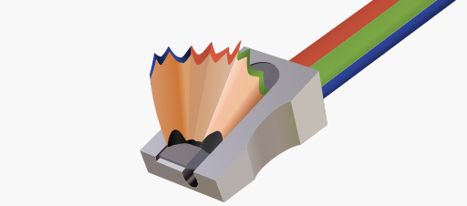

SkiaSharp & Uno Platform
+
How can SkiaSharp work with your Uno Platform app?

Slide 9
How can I draw on a view?
Install the “SkiaSharp.Views.Uno” NuGet
Add one of the pre-built SkiaSharp views for Uno Platform:
CPU: SKXamlCanvas
GPU: SKSwapChainPanel
Subscribe to the PaintSurface event
Draw!

Slide 10
How can I draw on a view?
<Page ... xmlns:skia="using:SkiaSharp.Views.UWP">
<skia:SKXamlCanvas PaintSurface="OnPaintSurface" />
</Page>

Slide 11
How can I draw on a view?
private void OnPaintSurface(object sender, SKPaintSurfaceEventArgs e)
{
// get the canvas so we can draw on the surface
var canvas = e.Surface.Canvas;
// make sure the canvas is blank
canvas.Clear(SKColors.White);
// create the solid red paint
using var paint = new SKPaint { Color = SKColors.Red, Style = SKPaintStyle.Fill };
// draw a red rectangle
canvas.DrawRect(SKRect.Create(10, 10, 20, 30), paint);
}

Slide 12
The Spinning Drawing
Add some animation to see what happens…

Slide 13
Where are those links?
https://github.com/mono/SkiaSharp
https://github.com/mattleibow/UnoConf2020

Slide 14


THANK YOU!
Follow me at
mattleibow

