Slide 1
Jumping into Powerful 2D Graphics using SkiaSharp with Uno Platform

Slide 2

Matthew Leibowitz
Software Engineer at Microsoft

Slide 3
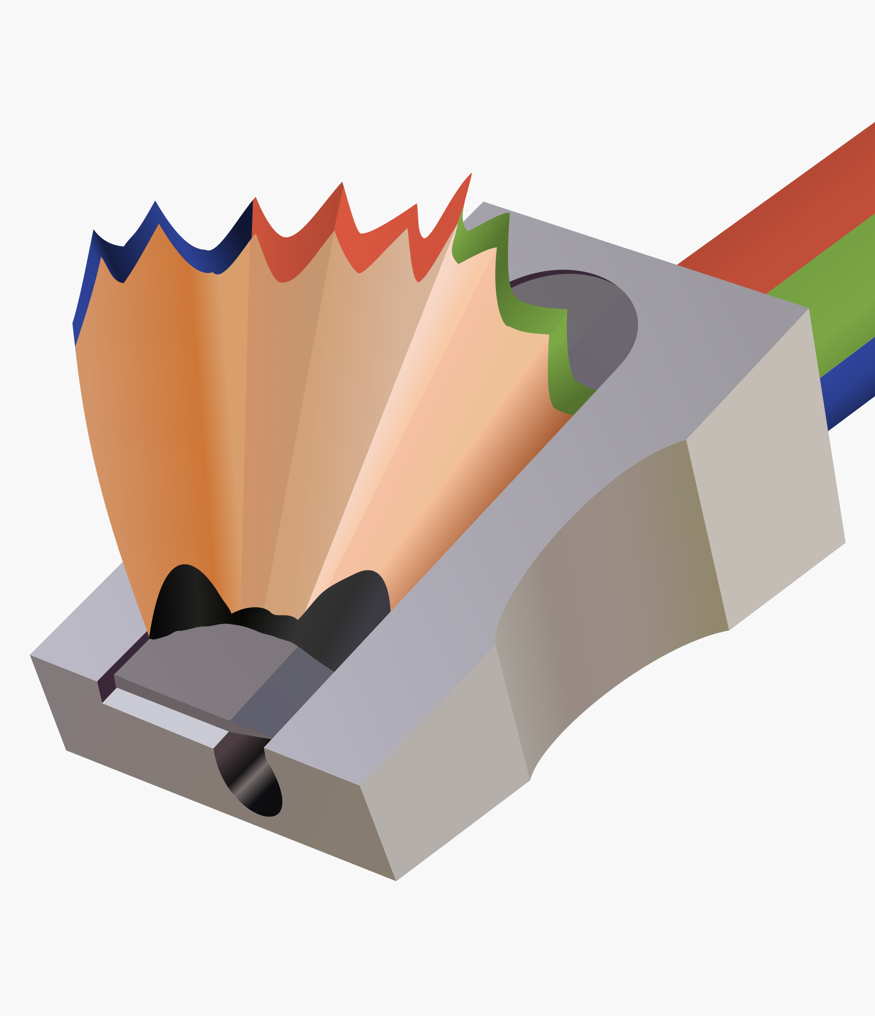
Skia & SkiaSharp
So just what is it? What can it do?

Slide 4
What is Skia?
Cross-platform 2D graphics library
Immediate mode rendering
Hardware rendering for OpenGL, DirectX, Metal and more
Software rendering for bitmaps and PDF documents
Powers Chrome, Android, Firefox, Chrome OS and Flutter
Written in C++, C, Assembly and other languages
Maintained by Google

Slide 5
What is SkiaSharp?
.NET wrapper around Skia
Supports all the features of Skia
Runs on basically everything straight from NuGet
Written in C#
Maintained by Microsoft

Slide 6
How does it all work?
The surface wraps the underlying/platform surface
eg: GPU texture, memory block
The canvas translates drawing commands into operations that the surface understands
eg: DrawRect, DrawImage, DrawPath, Translate, Rotate
The paint describes what the drawn object will look like
eg: color, style, smoothing, effects, filters

Slide 7
How does it all work?
// create a raster surface [256x256]
using var surface = SKSurface.Create(new SKImageInfo(256, 256));
// get the canvas so we can draw on the surface
var canvas = surface.Canvas;
// make sure the canvas is blank
canvas.Clear(SKColors.White);
// create the solid red paint
using var paint = new SKPaint { Color = SKColors.Red, Style = SKPaintStyle.Fill };
// draw a red rectangle
canvas.DrawRect(SKRect.Create(10, 10, 20, 30), paint);

Slide 8
How does it all work?

Slide 9
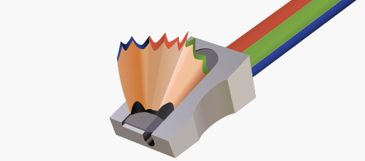

SkiaSharp & Uno Platform
+
How can SkiaSharp work with your Uno Platform app?

Slide 10
How can I draw on a view?
Install the “SkiaSharp.Views.Uno” NuGet
Add one of the pre-built SkiaSharp views for Uno Platform:
CPU: SKXamlCanvas
GPU: SKSwapChainPanel
Subscribe to the PaintSurface event
Draw!

Slide 11
How can I draw on a view?
<Page ... xmlns:skia="using:SkiaSharp.Views.UWP">
<skia:SKXamlCanvas PaintSurface="OnPaintSurface" />
</Page>

Slide 12
How can I draw on a view?
private void OnPaintSurface(object sender, SKPaintSurfaceEventArgs e)
{
// get the canvas so we can draw on the surface
var canvas = e.Surface.Canvas;
// make sure the canvas is blank
canvas.Clear(SKColors.White);
// create the solid red paint
using var paint = new SKPaint { Color = SKColors.Red, Style = SKPaintStyle.Fill };
// draw a red rectangle
canvas.DrawRect(SKRect.Create(10, 10, 20, 30), paint);
}

Slide 13
The Spinning Drawing
Add some animation to see what happens…

Slide 14
Where are those links?
https://github.com/mono/SkiaSharp
https://github.com/mattleibow/UnoConf2020

Slide 15


THANK YOU!
Follow me at
mattleibow

