Slide 1
Jumping into Powerful 2D Graphics using SkiaSharp with Uno Platform
Notes:
Good afternoon, good evening, good morning, good night! Wherever you are!
I would just like to thank Jen for that awesome introduction and all the rest of the Uno Team for a great UnoConf! A special thanks to the team for inviting me to speak.
I hope everyone is doing well and enjoying UnoConf? I know I am, and I am pretty sure you are too! I have just seen some of the really cool things that has been going on at Uno and I am pretty excited to try some things out. And I know you will too!
Well, we better get started on some SkiaSharp goodness. I know you already have seen some of the things that Uno is doing with SkiaSharp, so I am just wanting to take a few minutes to just chat about it.

Slide 2

Matthew Leibowitz
Software Engineer at Microsoft
Notes:
I am Matthew Leibowitz, a Senior Software Engineer at Microsoft with a great passion for software development, software development with .NET and cross-platform software development with .NET.
I work on a team that focuses on making developer lives easier by creating tooling, libraries and frameworks that enable you as developers to not only create great apps, but also create your own libraries and frameworks.

Slide 3
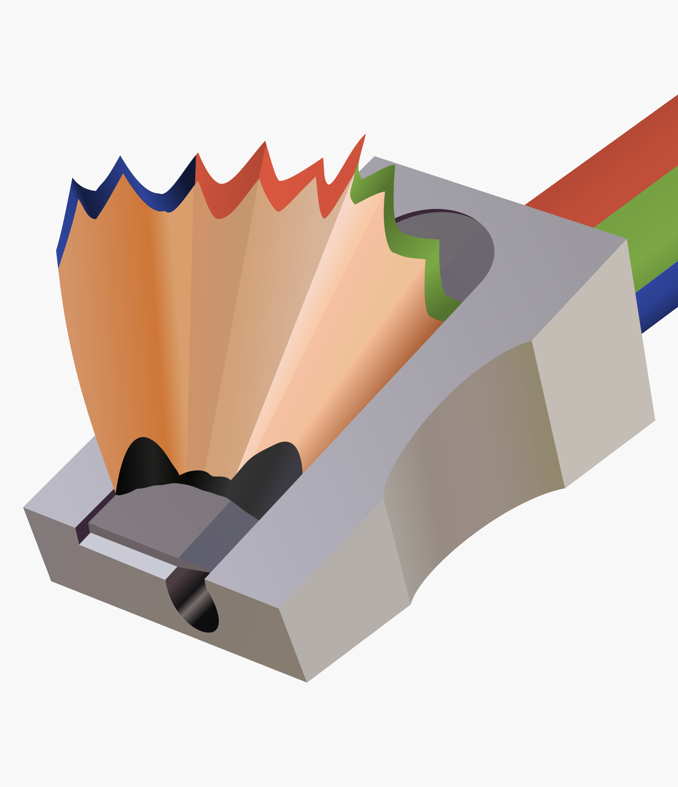
SkiaSharp
So just what is it? What can it do? How does it all work?

Slide 4
What is Skia?
Cross-platform 2D graphics library
Hardware rendering for OpenGL, DirectX, Metal and more
Software rendering for bitmaps and PDF documents
Written in C++, C, Assembly and other languages
Powers Chrome, Android, Firefox, Chrome OS and Flutter
Maintained by Google
Notes:
Before we talk about SkiaSharp, we must talk about Skia – the engine behind library.
It is an awesome cross-platform 2D graphics library that enables you to draw whatever you want, however you want, without sacrificing performance.
It supports hardware accelerated rendering on the GPU through OpenGL, DX, Metal and Vk.
If the GPU is not your thing, then the CPU is also capable of all the same drawings, again without sacrificing performance.
It achieves this but making sure the code is optimized, often utilizing low-level features such as assembly and intrinsics.
If you doubt the power, then just take a moment to think about all the things that were just announced for Linux and Windows 7. And then take a look at that the very browser you are streaming through now. If you are using Chrome, Edge of FF, then it is probably using skia right now!

Slide 5
What is SkiaSharp?
.NET wrapper around Skia
Supports all the features of Skia
Runs on basically everything straight from NuGet
Written in C#
Maintained by Microsoft

Slide 6
How does it all work?
The surface wraps the underlying/platform surface
eg: GPU texture, memory block
The canvas translates drawing commands into operations that the surface understands
eg: DrawRect, DrawImage, DrawPath, Translate, Rotate
The paint describes what the drawn object will look like
eg: color, style, smoothing, effects, filters

Slide 7
How does it all work?
// create a raster surface [256x256]
using var surface = SKSurface.Create(new SKImageInfo(256, 256));
// get the canvas so we can draw on the surface
var canvas = surface.Canvas;
// make sure the canvas is blank
canvas.Clear(SKColors.White);
// create the solid red paint
using var paint = new SKPaint { Color = SKColors.Red, Style = SKPaintStyle.Fill };
// draw a red rectangle
canvas.DrawRect(SKRect.Create(10, 10, 20, 30), paint);

Slide 8
How does it all work?

Slide 9
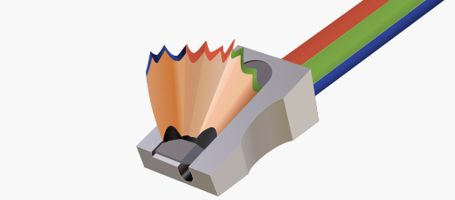

SkiaSharp & Uno Platform
+
How can SkiaSharp work with your Uno Platform app?

Slide 10
How can I draw on a view?
Install the “SkiaSharp.Views.Uno” NuGet
Add one of the pre-built SkiaSharp views for Uno Platform:
CPU: SKXamlCanvas
GPU: SKSwapChainPanel
Subscribe to the PaintSurface event
Draw!

Slide 11
How can I draw on a view?
<Page ... xmlns:skia="using:SkiaSharp.Views.UWP">
<skia:SKXamlCanvas PaintSurface="OnPaintSurface" />
</Page>

Slide 12
How can I draw on a view?
private void OnPaintSurface(object sender, SKPaintSurfaceEventArgs e)
{
// get the canvas so we can draw on the surface
var canvas = e.Surface.Canvas;
// make sure the canvas is blank
canvas.Clear(SKColors.White);
// create the solid red paint
using var paint = new SKPaint { Color = SKColors.Red, Style = SKPaintStyle.Fill };
// draw a red rectangle
canvas.DrawRect(SKRect.Create(10, 10, 20, 30), paint);
}

Slide 13
The Spinning Drawing
Add some animation to see what happens…

Slide 14
Where are those links?
https://github.com/mono/SkiaSharp
https://github.com/mattleibow/UnoConf2020

Slide 15


THANK YOU!
Follow me at
mattleibow

