Slide 1


Xamarin & GitHub Actions
That’s right, doing cool things with cool things… While the “virus” infects the flat earth… As if! #DinosaurEarth
Matthew Leibowitz Software Engineer @mattleibow

Slide 2
Xamarin
Because I just wanted to have Xamarin in the title…

Slide 3
What is Xamarin?
Cross-platform app development!
Using .NET!
Write once, run anywhere! (almost)
We got slides with graphics to prove this!
But, you know all about this already…
https://dotnet.microsoft.com/apps/xamarin
Notes:
Xamarin is dead! .NET for iOS/Android/macOS/watchOS/tvOS is the new hotness! Don’t worry, that is just a name change. Marketing loves to change names.

Slide 4
What is .NET for Android/iOS/etc?
Cross-platform app development!
Using .NET!
Write once, run anywhere! (almost)
We got slides with graphics to prove this!
But, you know all about this already…
https://dotnet.microsoft.com/apps/xamarin
Notes:
.NET runs everywhere and that means that our .NET code also runs everywhere. Even on mobile. And, we can share code with a full-on web server!

Slide 5



Desktop
Web
Cloud
Mobile
Gaming
IoT
AI
.NET
Notes:
.NET runs in many different places.

Slide 6





Desktop
Web
Cloud
Mobile
Gaming
IoT
AI
.NET
Notes:
We are going to spend a little more time in the really cool place, mobile.

Slide 7
GitHub Actions
This is more the main topic…

Slide 8
What are GitHub Actions?
Automating the process of building those awesome apps!
Workflows! (basically more yaml describing how to do something)
Building, testing, deploying apps – right from GitHub
https://github.com/features/actions
https://help.github.com/actions
Notes:
GitHub Actions is more a set of tools and features that allow you to automate arbitrary steps in a workflow/pipeline. We just use it to build our .NET and mobile apps. We can do FAR more!
The workflows are written in yaml and allow us to do literally anything. Anything!
We can also use it to build, test and then deploy/distribute a mobile app or cross-platform library.

Slide 9
Why Automate?
Every commit and every PR is compiled! (literally the simplest check you can possibly do)
Not only is this the basic code check, but also any analyzers and linting
Tests can run…
If the tests run, then you can actually see if that compiling code is working
Both unit tests and integration tests can run
Releases are more frequent
Releases can be made to nightly feeds or TestFlight, Play beta or even AppCenter
Feedback sooner and more frequent
Continuous releases means that you know when you can go stable
Notes:
Do not underestimate the power of a simple step to ensure the code is good. Basic tests go a long way. Releases are very helpful for your community/users.

Slide 10
Any Cool Features?
Any type of run for any type of event (push, PR, release, tag)
Any operating system (Windows, macOS, Linux, Docker!)
Any language, any toolchain, any runtime, anything
Build matrix for simultaneous executing with different variables
Variables, secrets, conditions, expressions
Not JUST building, but any automation (issues, PRs, labels)

Slide 11
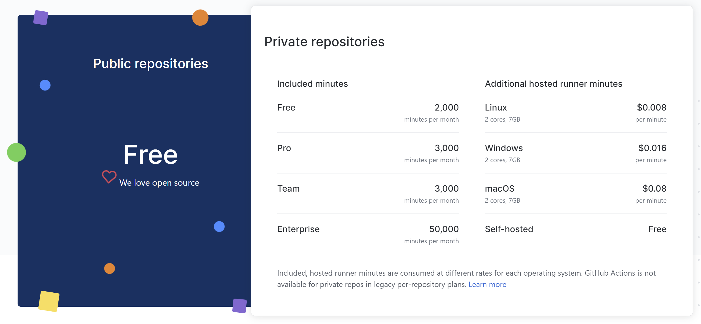
What is the damage?

Slide 12
Show me the YAML!
name: Build .NET Core
on:
push:
branches: [ master ]
pull_request:
branches: [ master ]
jobs:
build:
runs-on: ubuntu-latest
steps:
- uses: actions/checkout@v2
- uses: actions/setup-dotnet@v1
with:
dotnet-version: 3.1.101
- run: dotnet build --configuration Release
# a nice name for the checks and status
# when to build... (triggers)
# on a branch push
# just the “master” branch for now
# on the pull requests
# pull requests to the master branch
# the actual work now...
# the ID of this particular job
# what is the OS for the build
# the actual steps to run
# - a basic checkout the code step
# - a step that takes parameters
# the parameters
# some nice values
# - the raw power of the command line
https://help.github.com/actions/reference/workflow-syntax-for-github-actions

Slide 13
I came to see the code and other clicky things
Let me just switch to my editor…

Slide 14
Links
Overview: https://github.com/features/actions
Docs: https://help.github.com/actions
YAML: https://help.github.com/en/actions/reference/workflow-syntax-for-github-actions
Xamarin: https://dotnet.microsoft.com/apps/xamarin
App Center: https://appcenter.ms
This: https://github.com/mattleibow/XamarinGitHubActions

