Slide 1
An Intro to Web Development ASP.NET Core Razor Pages Edition
Matthew Leibowitz
Software Engineer @ Microsoft
@mattleibow
maleib@microsoft.com

Slide 2
What is ASP.NET?
.NET is a developer platform made up of tools, programming languages, and libraries for building many different types of applications.
ASP.NET extends the .NET developer platform with tools and libraries specifically for building web apps.

Slide 3
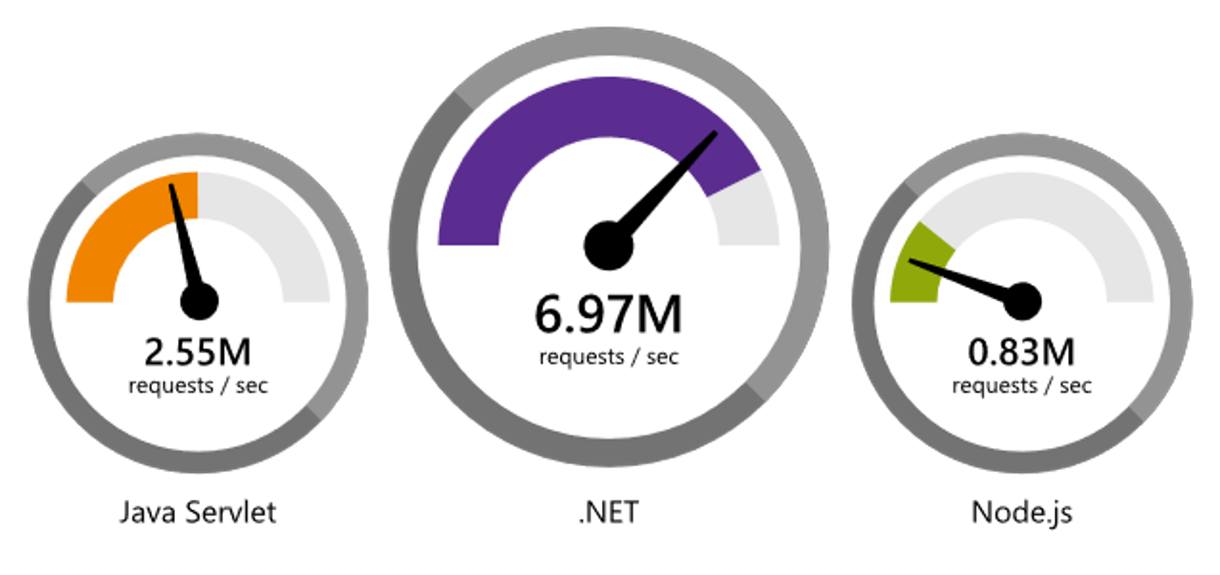
ASP.NET Core Performance
https://www.techempower.com/benchmarks/#section=data-r17&hw=ph&test=plaintext

Slide 4
Evolution of the Active Server Page
[Classic] ASP
ASP.NET Web Forms
ASP.NET MVC v1 (with ASPX)
ASP.NET MVC v3 & Web Pages (with Razor)
ASP.NET MVC v4 & Web API
ASP.NET Core v1 (grew from ASP.NET MVC v6)
ASP.NET Core MVC
ASP.NET Core Web API
ASP.NET Core v2 & Razor Pages

Slide 5
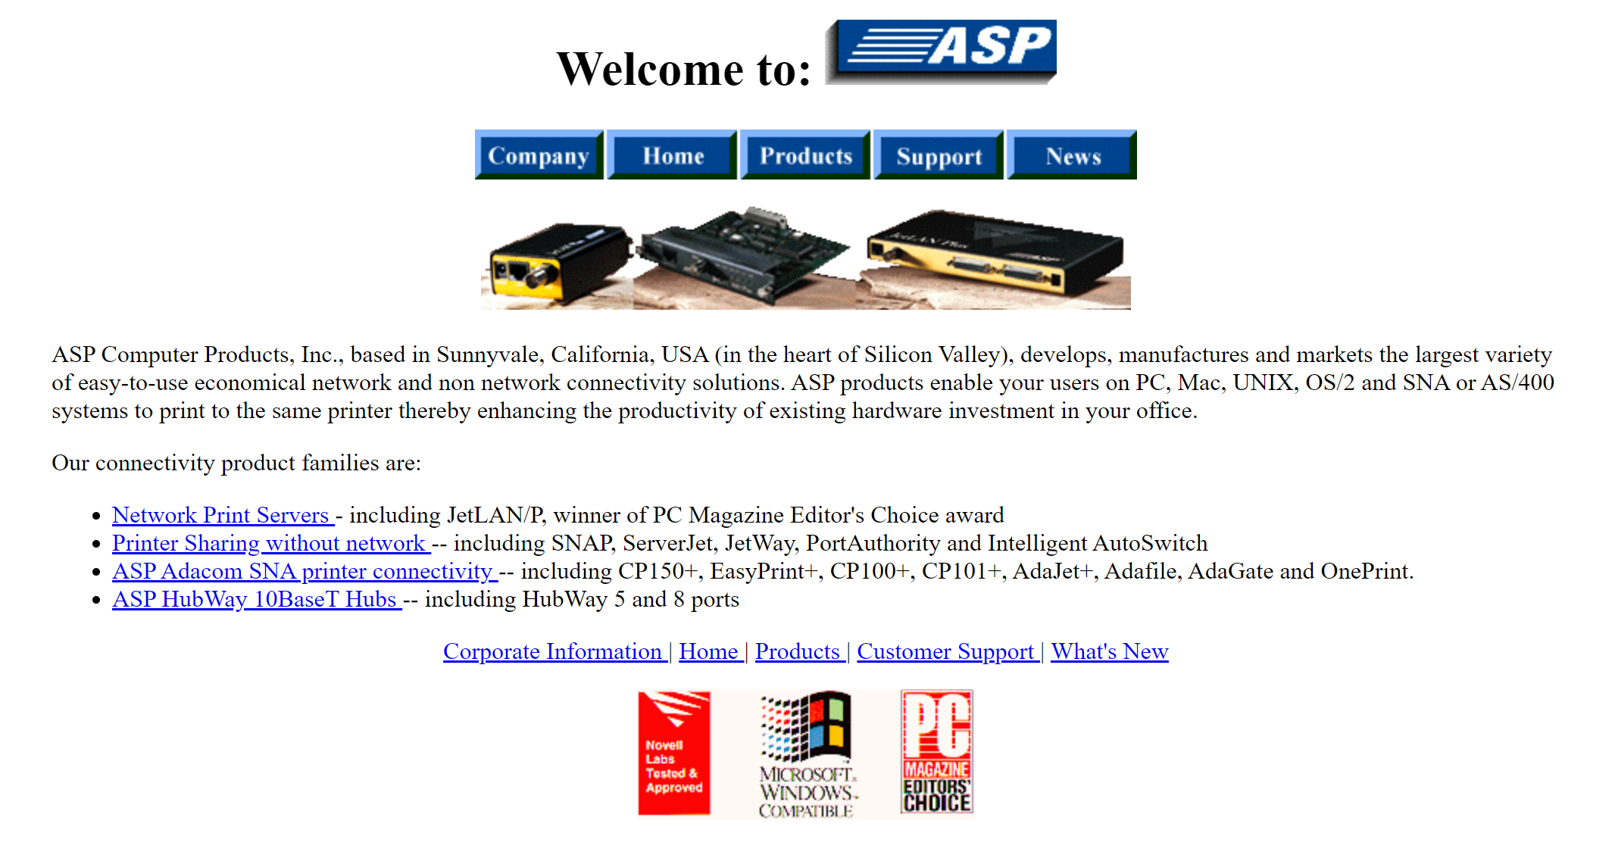
(1996)
http://web.archive.org/web/19961029090559/http://asp.net/

Slide 6
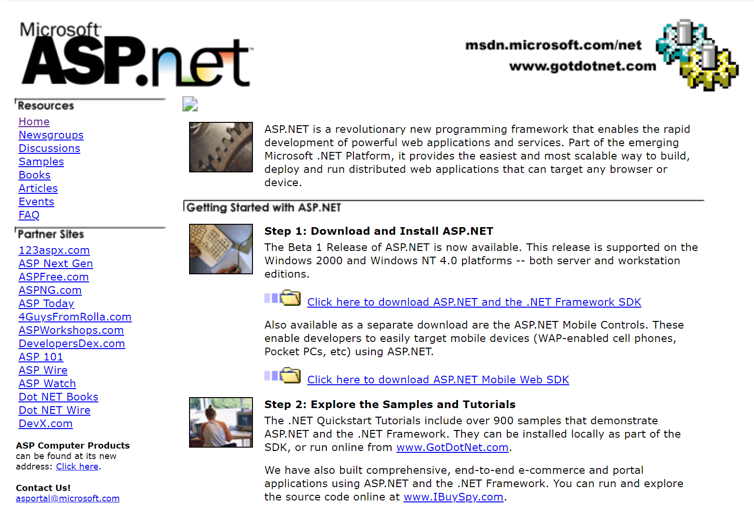
(2001)
http://web.archive.org/web/20010202155000/http://asp.net/default.aspx

Slide 7
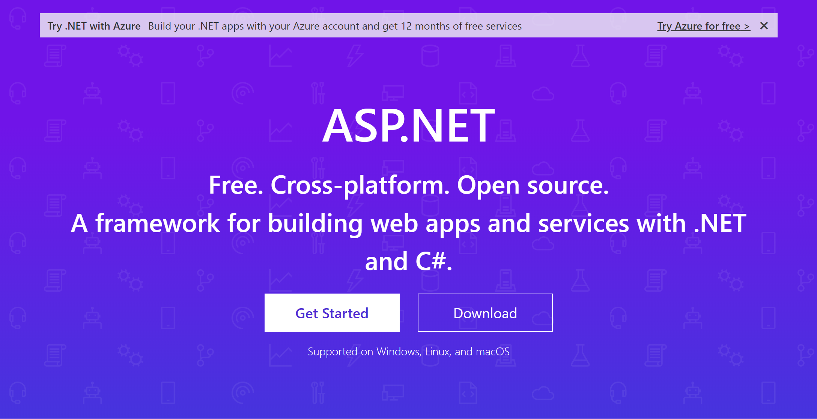
(2019)
http://web.archive.org/web/20190604124157/https://dotnet.microsoft.com/apps/aspnet

Slide 8
[Classic] ASP

Slide 9
[Classic] ASP
Similar to PHP
Files contain server scripts and HTML
Scripts in an ASP file are executed on the server
Server code in VBScript or JavaScript

Slide 10
ASP.NET

Slide 11
ASP.NET
Successor to [Classic] ASP
Built on top of the .NET Framework
Server code in any .NET Language (eg: C# or VB)
https://dotnet.microsoft.com/apps/aspnet

Slide 12
ASP.NET Web Forms
Windows Forms… for the web
Each page had an HTML file and a controller file
The HTML file supported server scripts, but was avoided
Server controls and events
https://dotnet.microsoft.com/apps/aspnet/web-forms

Slide 13
ASP.NET MVC
A design pattern for achieving a clean separation of concerns
Requests go through a controller
Controllers populate a model and select a view
Views render a page based on the data in the model
Originally ASPX view syntax, then Razor
https://dotnet.microsoft.com/apps/aspnet/mvc

Slide 14
ASP.NET Web Pages
A mix of [Classic] ASP and MVC
Like the [Classic] ASP’s page-based app
Using the new MVC Razor syntax
https://docs.microsoft.com/aspnet/web-pages

Slide 15
ASP.NET Web API
Based on MVC, but the views are JSON/XML/anything
Building REST APIs for any client
Automatic object serialization
https://dotnet.microsoft.com/apps/aspnet/apis

Slide 16
ASP.NET Core

Slide 17
ASP.NET Core
Redesign of ASP.NET
Cross-platform, open-source, high-performance
Improved ASP.NET MVC and Web API
Upgraded ASP.NET Web Pages to Razor Pages
Space for new technologies such as Blazor
Supports mixing MVC and Web API controllers
https://docs.microsoft.com/aspnet/core

Slide 18
ASP.NET Core Razor Pages

Slide 19
ASP.NET Core Razor Pages
More powerful version of ASP.NET Web Pages
Optionally supports page layouts like Web Forms
Optionally supports controllers like MVC and Web API
https://docs.microsoft.com/aspnet/core/razor-pages

Slide 20
Demos!!!

Slide 21
Links
ASP.NET Website: dotnet.microsoft.com/apps/aspnet
ASP.NET Docs: docs.microsoft.com/aspnet
Razor Pages: docs.microsoft.com/aspnet/core/razor-pages
Tutorials: docs.microsoft.com/aspnet/core/tutorials/razor-pages
W3 Schools: w3schools.com/asp
Learn Razor Pages: learnrazorpages.com
The History of ASP.NET
dotnetcurry.com/aspnet/1492/aspnet-history-part-1
dotnetcurry.com/aspnet/1493/aspnet-history-part-2-mvc
dotnetcurry.com/aspnet/1494/aspnet-history-part-3-core

Slide 22
Thank You!

