Slide 1
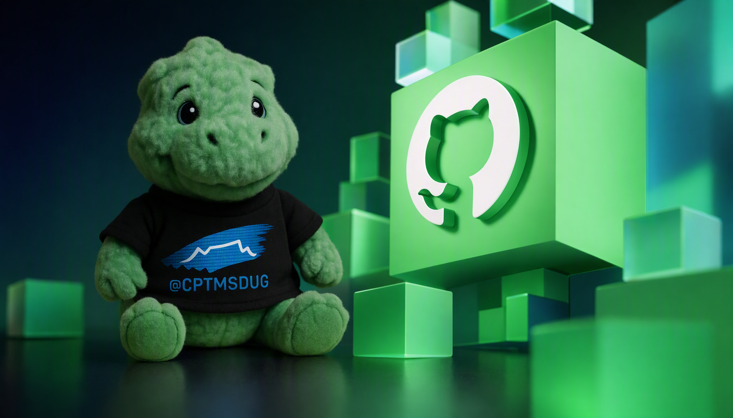
DEV
DAYS
CAPE TOWN
2026
3 OCTOBER / BBD CAPE TOWN
A day for builders.
Notes:
CONCEPT 1: Community opener. Preserve the event hero, mascot, shirt mark and GitHub cube. Title arrives with the slide; location follows. This is a visual direction sample, not the final keynote.

Slide 2

GITHUB COPILOT
From writing
code.
To directing
the work.
Notes:
CONCEPT 2: Statement and reveal. Start with "From writing code." Click once to reveal "To directing the work." The official 3D Copilot is retained. Narration: Copilot spans assistance and delegation; people remain accountable for scope, review and delivery.

Slide 3
One Copilot.
Different ways to work.
01
02
03
IDE + CLI
CLOUD AGENT
COPILOT APP
Stay in your flow.
Delegate a task.
Bring it together.
Work interactively in your
editor or terminal.
Hand off scoped work.
Review the pull request.
Direct sessions. Review work.
Share live canvases.
Notes:
CONCEPT 3: High-key ecosystem beat. No miniature screenshot grid, decorative rails, or boxed cards. The three surfaces are an illustrative selection, not the full ecosystem. IDE and CLI permissions/workspace capabilities differ; the App supports both local and cloud workflows. Do not imply universal feature parity.

Slide 4
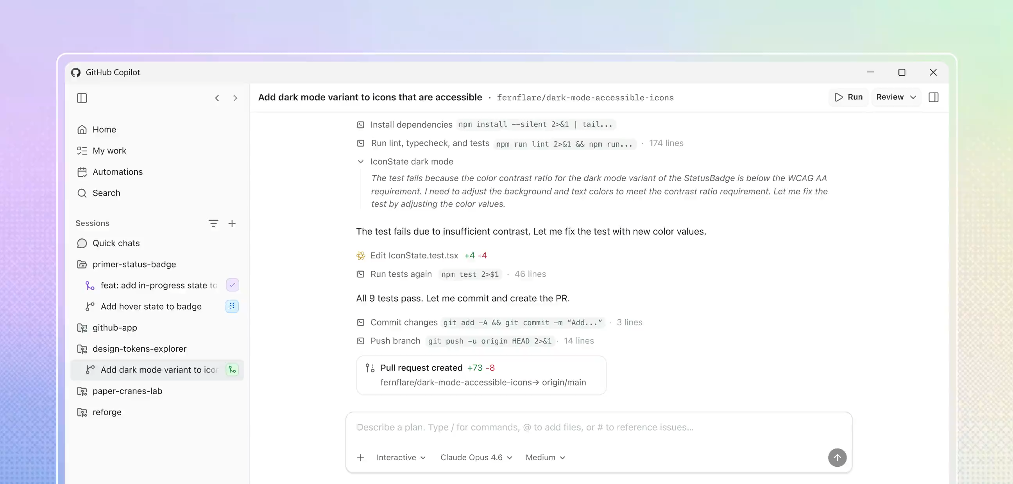
YOU + YOUR AGENT. ONE SHARED SURFACE.
Work on the same thing.
Notes:
CONCEPT 4: Native product footage. Imported from official source slide 11, preserving the embedded video and its animation/playback tree. Headline and caption are retargeted in place. This concept demonstrates reuse, not a promise that playback has been rehearsed. Rehearse in Slide Show on the event machine.

