Slide 1
Ethical implications of the internet of things
Matthew S. Levan
CSC 500 – Research Methods
California State University, Dominguez Hills
Carson, CA

Slide 2
Introduction
Computer Ethics
What is it and why is it important?
Differences between absolute and relative morality
What does it mean to be ethical as a technology business?
The Internet of Things
What is it and what can it do?
Potential security issues: safety and privacy
Security as an Ethical Imperative
Increased security expectations from IoT consumers
Fierce competition in today’s technology markets

Slide 3


Computer Ethics
What is it?
Why is it important?
Absolute vs. relative morality
Power of ethics in technology business

Slide 4
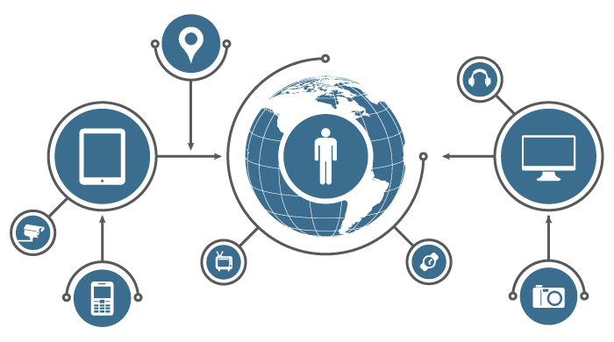
The Internet of Things
A network of objects or “things” with embedded electronics, software, and connectivity
Convenience, data awareness, automation of actions and events (simple or complex)
Potential security threats
Cyber attacks become increasingly physical instead of just virtual
Cars, cooking and household appliances, pacemakers, etc.

Slide 5
Security as an Ethical Imperative
Don’t consumers only care about features, not security?
Business Insider Intelligence Survey, 2014, 39% care
Snowden leaks about NSA and US government spying
Yes, consumers do care
Consumers are loyal to companies that care about their safety
Competition in today’s tech market is fierce
Insecure and unsafe products will not be received lightly

Slide 6
References
http://www.businessinsider.in/We-Asked-Executives-About-The-Internet-Of-Things-And-Their-Answers-Reveal-That-Security-Remains-A-Huge-Concern/articleshow/45959921.cms
Thank you!

