Slide 1
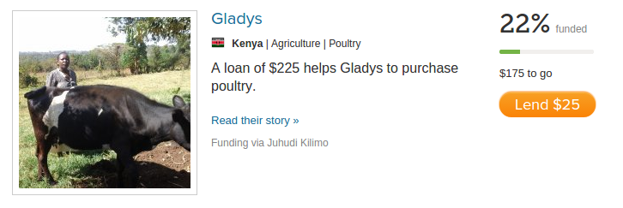
How to get loans funded on Kiva

Slide 2
Problem
Half of the world lacks access to financial services making it hard to start and expand small businesses and fund higher education
Microfinance platforms like kiva.org provide an additional source of funding for microfinance loans
Hard to determine the preferences of small time lenders on platforms like Kiva

Slide 3
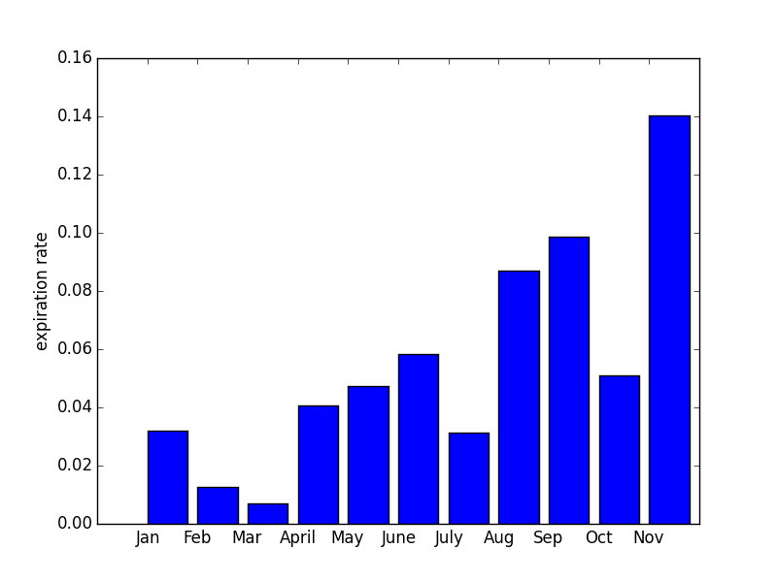
Expiration rate by month

Slide 4
Model
Random forest with weighted samples
Features
Loan amount, Payment term in months
Gender, group size, currency loss,
Payment interval (monthly, irregular, all at end)
Country (77)
Sector (15) ex. agriculture, retail, education
Activity (149) ex. rickshaw, cafe, cattle
Themes (22) ex. green, conflict zones, startup
Description of use: term frequencies of 250 most common words, ex. 'buy new fishing nets'

Slide 5
Results
October 2014
5.1% of loans expired, 28.2% flagged high risk:
High-risk group: 17.1% of loans expired
Low-risk group: 0.4% of loans expired
94.3% of expired loans in high-risk group
November 2014
14.1% of loans expired, 33.2% flagged high risk
38.8% of loans in high risk group and 1.5% of low-risk group expired
Identified 91.8% of expired loans

Slide 6
Challenges
Large data set, 5 GB of json files for 840k loans
Huge seasonal variations in expiration rates
Kiva made many policy changes to expiration policies over time
Many features are highly correlated
Unbalanced classes: only 5.5% expired
Avoid overfitting models

Slide 7
Keys to getting funded
Monthly repayment schedule
Smaller loans and shorter repayment terms
Sector - Agriculture and education best, housing and personal expenses did poorly
Group loans over individual loans
Women more likely to get funded
Country very important
Shorter text is better – important text keywords
Make plots of exp rate based on various features

