Slide 1
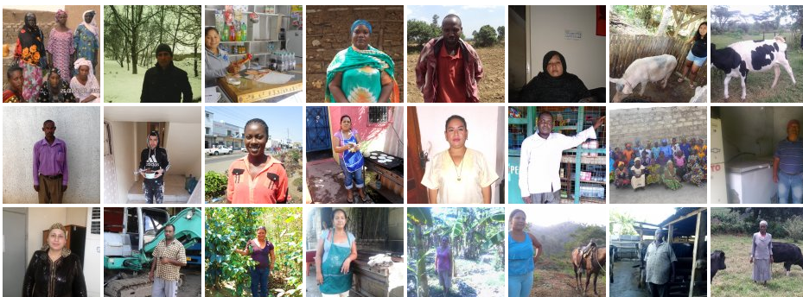

How to get loans funded on Kiva
Matthew Lichti
Data Science Fellow
Zipfian Academy

Slide 2

Problem
850,000 loans ($682 million) funded by 2 million lenders around the world on Kiva
Kiva loans expire if not funded in 30 days
Microfinance organizations need to determine which features make loans more likely to get funded

Slide 3
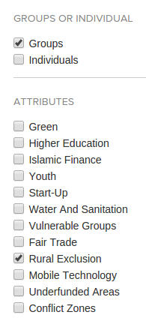
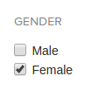
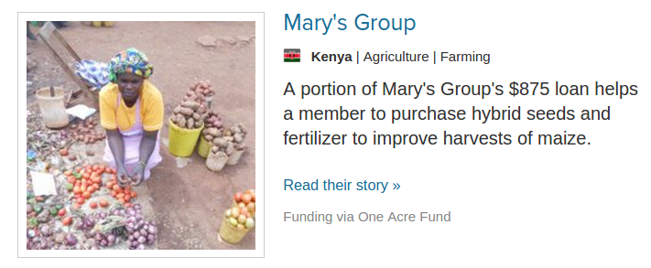


Feature Engineering
Country
Sector
Activity
Loan amount
Loan Use: Vector of Terms

Slide 4
Model
Random Forest
Unbalanced classes: weighted samples of expired loans
Tuned model to avoid overfitting
Trained model on April – Sep. 2014 loans
Tested model on Nov 2014 loans

Slide 5
Results
 | Predicted High Risk | Predicted Low Risk
Expired | 38.8% expired | 1.5% expired
Funded | 61.2% funded | 98.5% funded

Slide 6
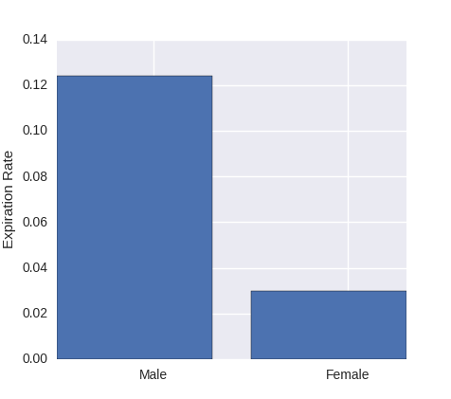
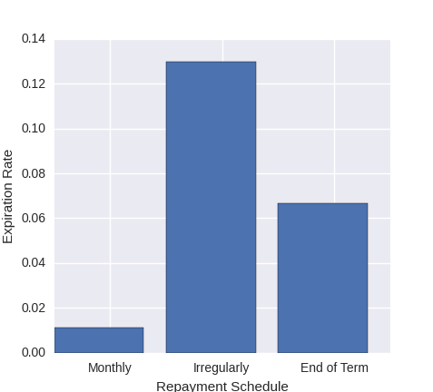
Keys to getting funded
Loans to women
Loans with monthly payments

Slide 7
Keys to getting funded
Smaller loans and shorter repayment terms
Agriculture and education best, housing and personal expenses did poorly
Group loans over individual loans
Shorter text is better

