Slide 1
DSD FINAL PRESENTATION
RICV G2
電機三 蔡易霖 趙彥安 劉凡

Slide 2

Branch prediction

Slide 3
Two level adaptive predictor
Branch history table
Branch history
00 | Strongly taken
01 | Stongly not taken
10 | Weakly taken
11 | Weakly not taken
Bn-2 | Bn-1
0 | 0

Slide 4
Accuracy of each predictors
2 level adaptive predictor outperforms its counterparts!
Interleave in BrPred: 10..10..10-> history register cannot store 1 when IF stage need to predict 0

Slide 5
Disadvantage
Much more area!
N bits history -> Need 2^{N} saturating counter

Slide 6
Local branch predictor
00 | Strongly taken
01 | Weakly taken
10 | Weakly not taken
11 | Stongly not taken
Respective branch history
bne 11
beq 01
bne
00 | Weakly taken
01 | Stongly taken
10 | Stongly not taken
11 | Weakly taken

Slide 7
Accuracy

Slide 8
Disadvantage
Area: i branch instructions, j bits history for each instruction
Need i*2^{j} saturating counters!

Slide 9
Compression
I_mem_rdata
[9:8]!=2’b11&&
I_mem_rdata
[25:24]!=2’b11
16+16
BOTTOM
16
PC+2
I_mem_rdata
[25:24]=2’b11
(32 bit)
PC+4
TOP
I_mem_rdata
[9:8]=2’b11
32+32
I_mem_rdata
[9:8]!=2’b11
32+16
I_mem_rdata
[9:8]=2’b11
32+32
TOP 32
PC+2

Slide 10
Advantage of compression
Reduce miss rate
Require less cache size
Consume less energy

Slide 11
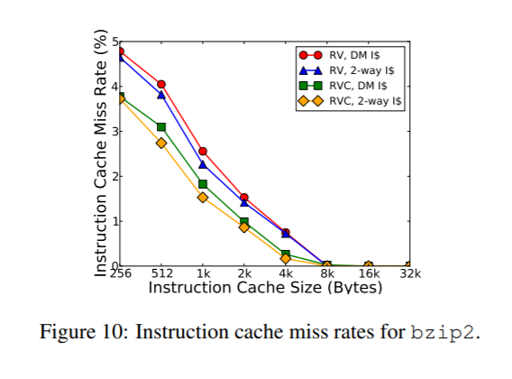
Miss rate and cache size
Ref:https://people.eecs.berkeley.edu/~krste/papers/waterman-ms.pdf

Slide 12
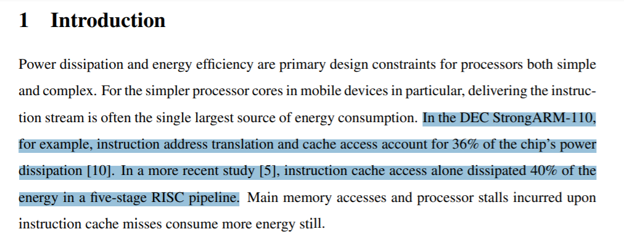
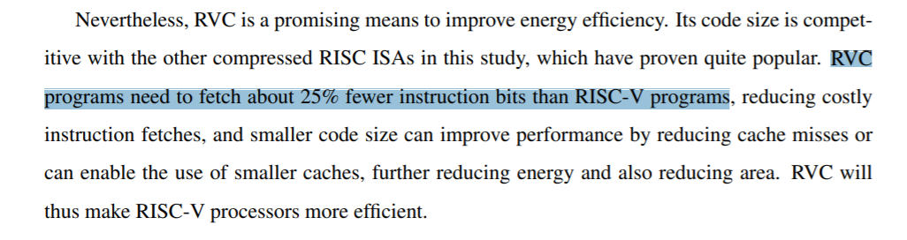
Improve energy efficiency

Slide 13
L2 Cache
Best Format:
L1 cache: write through
L2 cache: write back
Our Format:
L1 cache: write back
L2 cache: write through

Slide 14
Our Comparison
Separate Cache:
Direct map memory 64/128 words
Unified Cache:
Direct map memory 128/256 words
An extra bit to classify I or D

Slide 15
Area & execution time under same cycle time

Slide 16
A*T Value

Slide 17
L2 Cache Miss Rate
L2 Cache | Miss Rate
256_unified | 5.8%
128_unified | 7.6%
128_dm | 6.6%
64_dm | 8.9%
Better Miss Rate in our design:
Unified > Direct map memory !

