Slide 1
STICKER

Slide 2
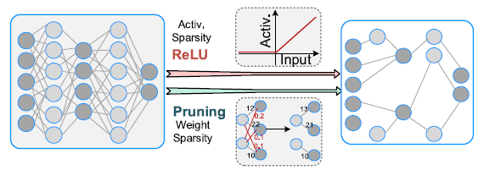
Introduction
Multi-sparsity compatible accelerator for CNN
A multi-sparsity control and data flow with an online sparsity adaptor
Reconfigurable multi-mode memory architecture
A multi-sparsity compatible set-associative PE array

Slide 3
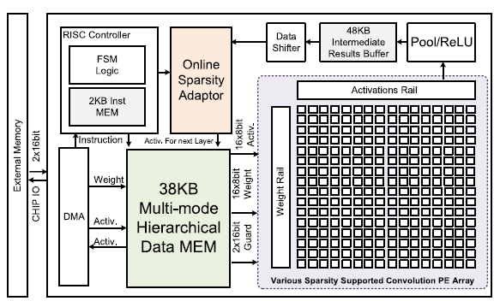
Architecture overview
8-bit data
24-bit temporary result
Data shifter cut 24-bit to 8-bit

Slide 4
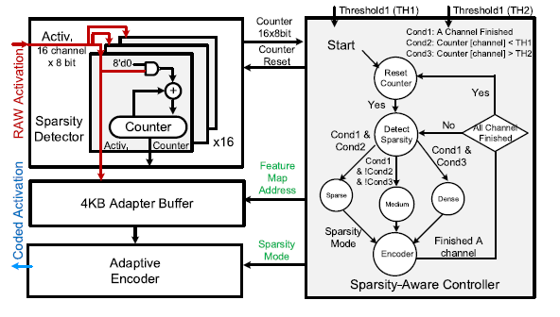
Multi-sparsity control and data flow
Three modes: sparse(S), medium(M), dense(D)
Threshold: TH1, TH2
Sparsity adaptor

Slide 5
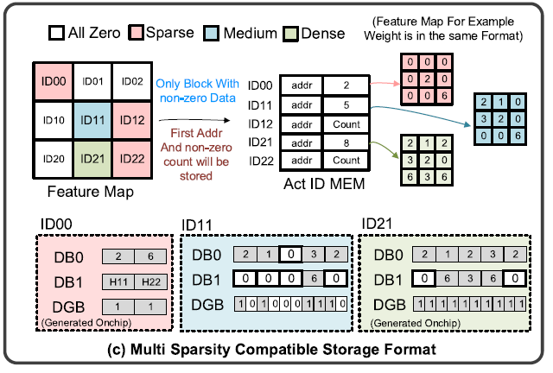
Multi-sparsity compatible memory
Activation ID MEM
Block ID, begin address, nonzero data count
3-mode MEM
Data zero guard, data bank0, data/index bank1

Slide 6
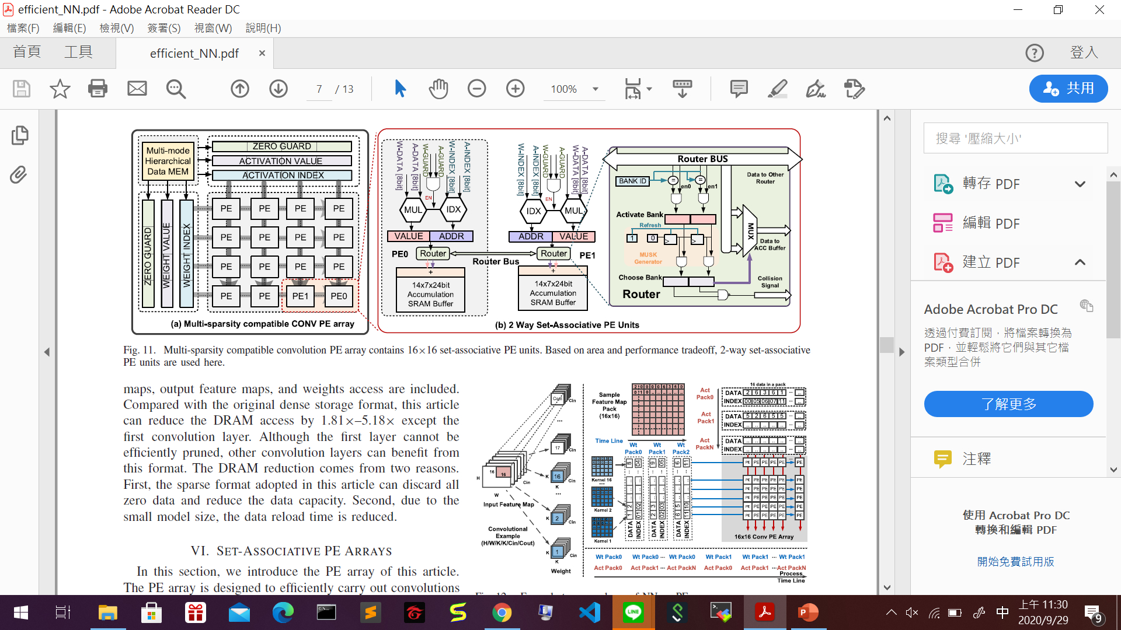
PE array
16 X 16 PE array
16 weights in different output channels and 16 input activations in a feature map
Weight stationery

Slide 7
2-Way set-associative PEs
To handle irregular data while processing sparse networks
Two PEs share two ACC buffer
Router is used to dispatch data and control congestion

Slide 8
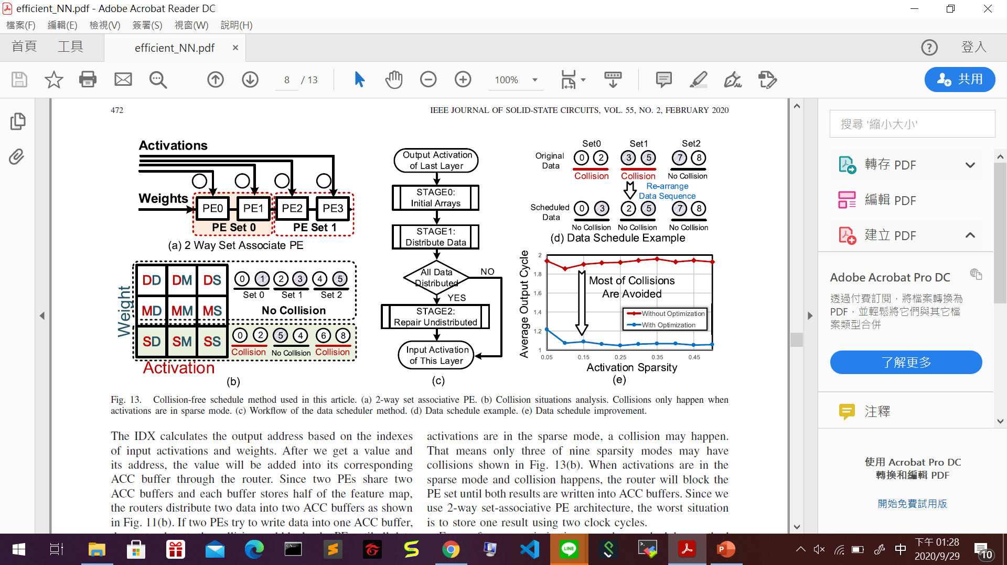
Collision-Free schedule method
Hardware optimization
Odd and Even columns are stored in different ACC buffers

Slide 9
Collision-free schedule method
Software optimization
Use CPU to re-arrange the activations data order to reduce collision

