Slide 1
Head Position Identifier
PRESENTED Far East Heads
Wei WEN & Zhengyuan LIU

Slide 2
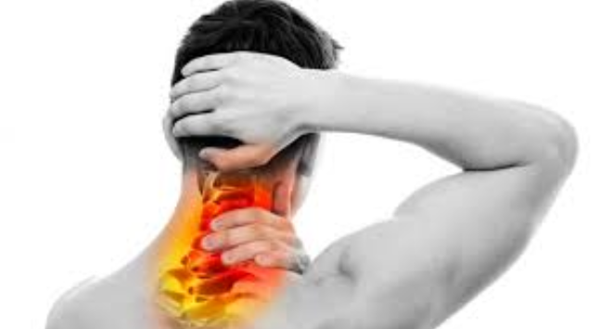
Introduction
System Mission
One of the modern-day issues with white collar workers and at a growing proportion of occurrence is neck pain and neck spasm.
Neck pain has an annual prevalence rate exceeding 30% among adults in the US; nearly 50% of individuals will continue to experience some degree of chronic neck pain or frequent occurrences.
Among adults, 20% to 70% will experience neck pain that interferes with their daily activities during their lifetime.
We try to accomplish the first part of the rehabilitation machine, which is identifying neck and head position first. Logically when the device knows where our head is, it can determine the motion next and achieve the rehabilitation purpose.

Slide 3
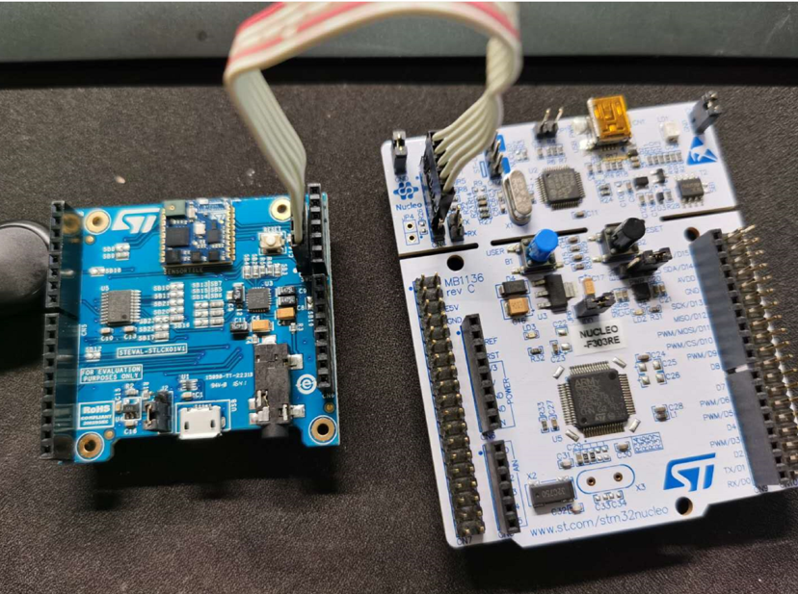
Introduction
System Requirements
List of Required Equipment and Materials
1) 1x STMicroelectronics SensorTile kit.
2) 1x STMicroelectronics Nucleo Board.
3) 1x Personal Computer
4) 1x USB 2.0 A-Male to Micro-B Cable (micro USB cable).
5) 1x USB 2.0 A-Male to Mini-B Cable (mini USB cable).
6) Network access to the Internet.

Slide 4
Introduction
Background
Zhengyuan and Wei Wen took 2 introductory Java course and CS50 here in Harvard Extension School prior to taking this class. We know some coding but does not have systematic training in Python as well as data analysis. Machine learning is a completely new concept that we often heard but never learned how to implement. Diving into the class it is our understanding that the class will walk you through how to implement a hardware system that has embedded machine learning functionality.

Slide 5
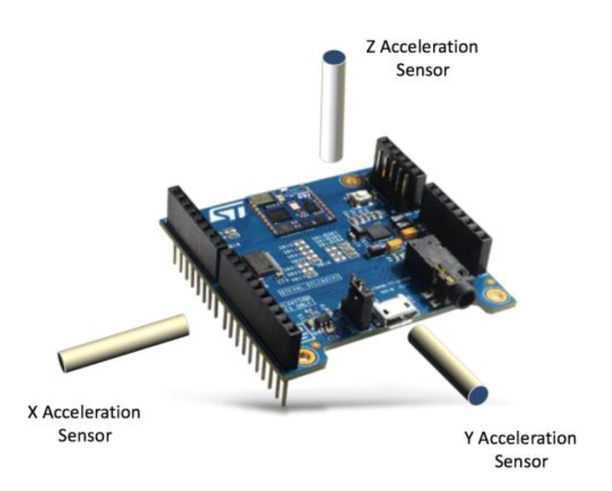
System Design
The project is primarily based on STMicroelectronics SensorTile Tutorial: IoT Machine Learning Motion Classification. Project initial source code is downloaded from:
https://drive.google.com/open?id=1IWkwmeVwvyZyM03Y37d-2B6hD2ejfpgM
We are designing the system to recognize the orientation of SensorTile when the SensorTile is attached to our head, and recognize turning action. The four actions that we hope to recognize are:
Turn Left – Orientation 1
Turn Right – Orientation 2
Turn Up – Orientation 3
Turn Down – Orientation 4

Slide 6
System Design
 | Pros | Cons
State machine | Easy to implement | Different users have different threshold
Machine learning | Difficult to implement | Program adapts to different users
Our original design was to implement the motion recognition by a state machine with 4 states and different threshold values. However, the disadvantage is also apparent: threshold value on different axis might be different for users.
It is best to implement Machine Learning Algorithms here to train the system to implement motion detection to allow some degree of customization

Slide 7
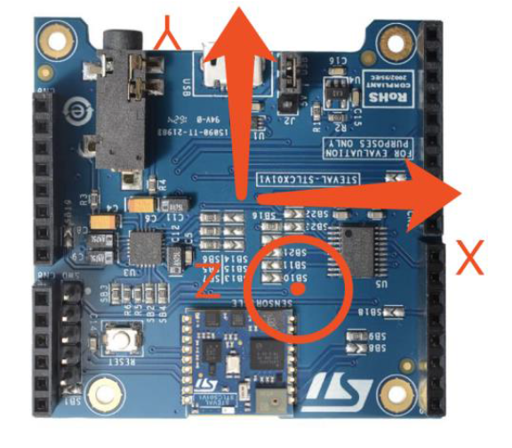
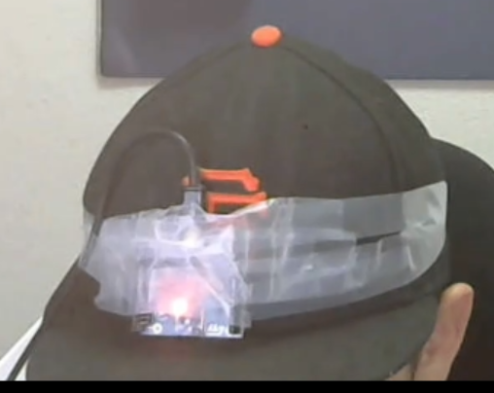
System Design
Y
The default position of the system will be SensorTile facing outward with the “ST” sign positions at lower right corner.
We expect each position to follow the following metrics
Position | X | Y | Z
Left | Negative | Negative | positive
Right | Positive | positive | Negative
Up | Positive | Negative | Positive
Down | Positive | Negative | Negative

Slide 8
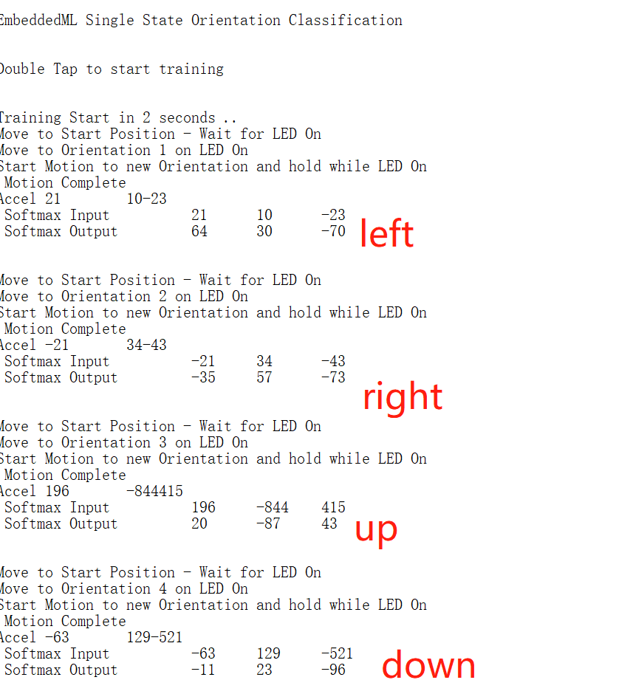
Implementation
Collecting Data
System is activated when double tapped. After activation, user is prompted to go through training session and acquire necessary training data (“ground truth”). Please note that during the data acquisition we have to come back to the default state after logging each movement data.

Slide 9
Implementation
Training Data
Training Epochs: 300
State 0 Max 104 Mean 32 Z-score 136 Outputs 104 0 -12 38
State 1 Max 85 Mean 31 Z-score 132 Outputs 15 85 -11 35
State 2 Max 84 Mean 25 Z-score 148 Outputs 12 -1 84 6
State 3 Max 76 Mean 14 Z-score 143 Outputs 4 0 -25 76
Error State: 0
After the inputs are recorded, the system will train each input for 2000 epochs.
We have reach the optimal state in 300 trainings
Softmax output is the actual value times 100 to avoid confusion and show normalization.
Maximum output represents the “correct” motion, in this case, left, right, up, down.

Slide 10
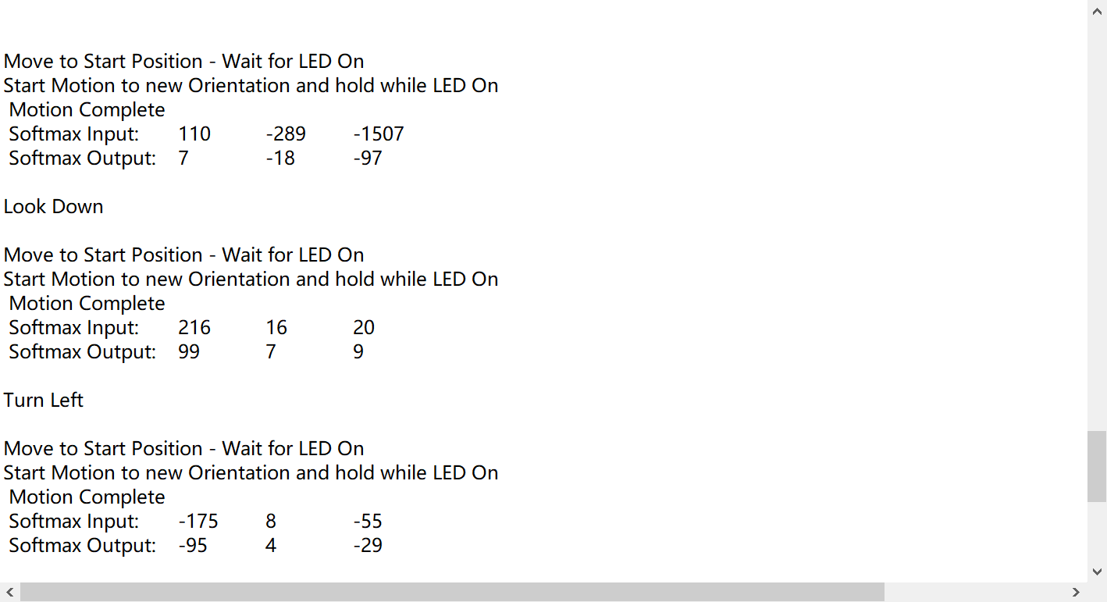
Implementation
Testing Data
Users will be prompt to test different head position and check the accuracy of the program.

Slide 11
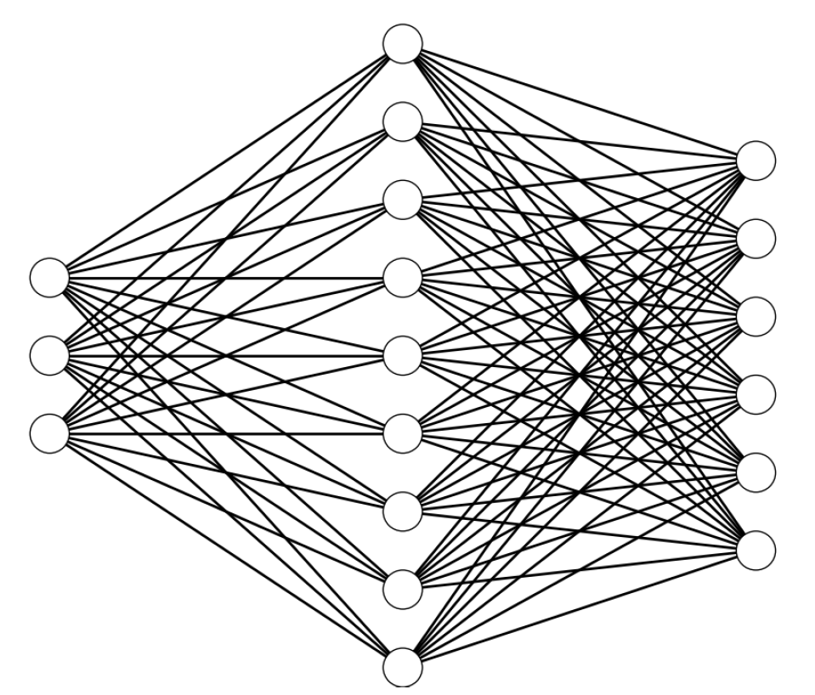
Implementation
Code Implementation
There are 81 present weights but we did not used the entirety of 81 weights. 81 weights correspond to 3 input, 9 neurons, and 6 output. However, we only have 4 outputs in our case, so the correct weight should be 63 (27 + 36). In order to preserve the integrity of the model, and because the weight not used is not effecting the accuracy of the ANN model, we didn’t change the metric.
We set outputs to 4 outputs and network topology to { 3, 9, 4 }.
Neural Network model is ready to use for testing purposes. Weights are balance towards classifying the correct motion based on training data collected. Note that the training epochs are set to maximum of 2000 instances. If the model is ready before 2000, the training will stop.

Slide 12
Final Comment
Please refer https://youtu.be/AfoU-YRGdCs for demonstration of the system.
The system is successful in recognizing the correct head position. However, we still need additional system level development. Our foreseeable next step if time is allowed would be to test more corner cases when head position is not turning but tilting slightly or if the head is limited in motion range because that would be more realistic in nature with neck spasm.
In addition, it would be reasonable to see in the future that we add audio output to the system and give out voice comment to consist of a complete neck and head exercise. The system can give out command and identify if the action is performed by the user.
One final comment is that we are impressed by the SensorTile system and its capability of performing machine learning algorithm and training on a small equipment. Prior to this course my understanding was that you need a powerful GPU to perform any machine learning. However, this course taught us that machine learning is not that complicated. We will definitely continue to explore machine learning and edge computing in the future.

Slide 13

THANK YOU

