Slide 1
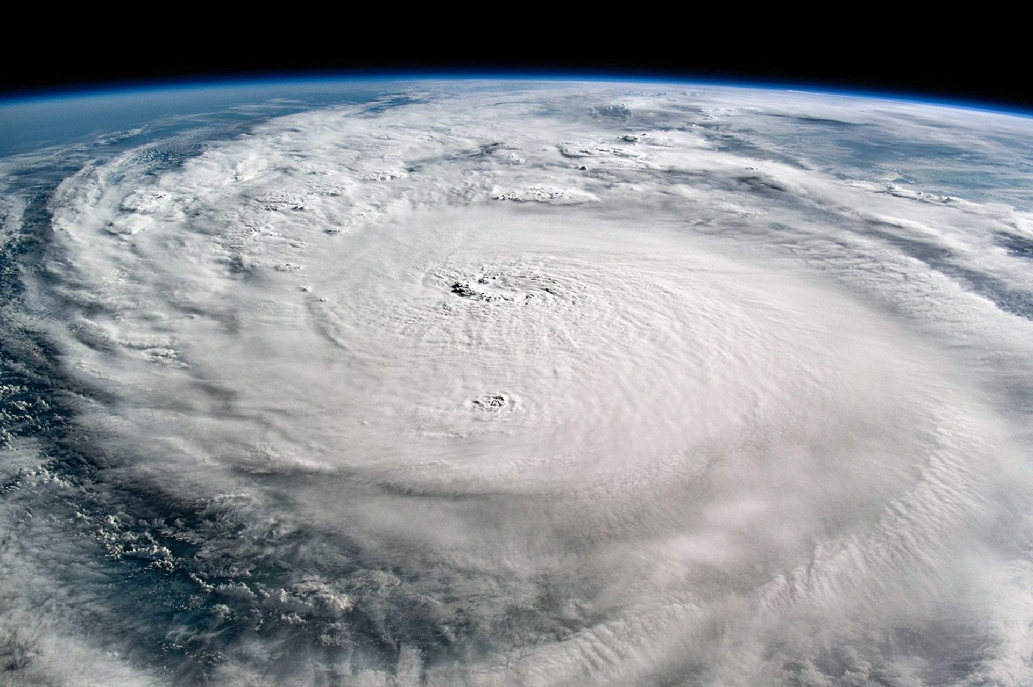

harbor
Evacuation cash, ready before landfall.
Technica 2026
Notes:
Harbor reads hurricane forecasts for your ZIP code and gets your evacuation money ready days before the storm arrives.

Slide 2
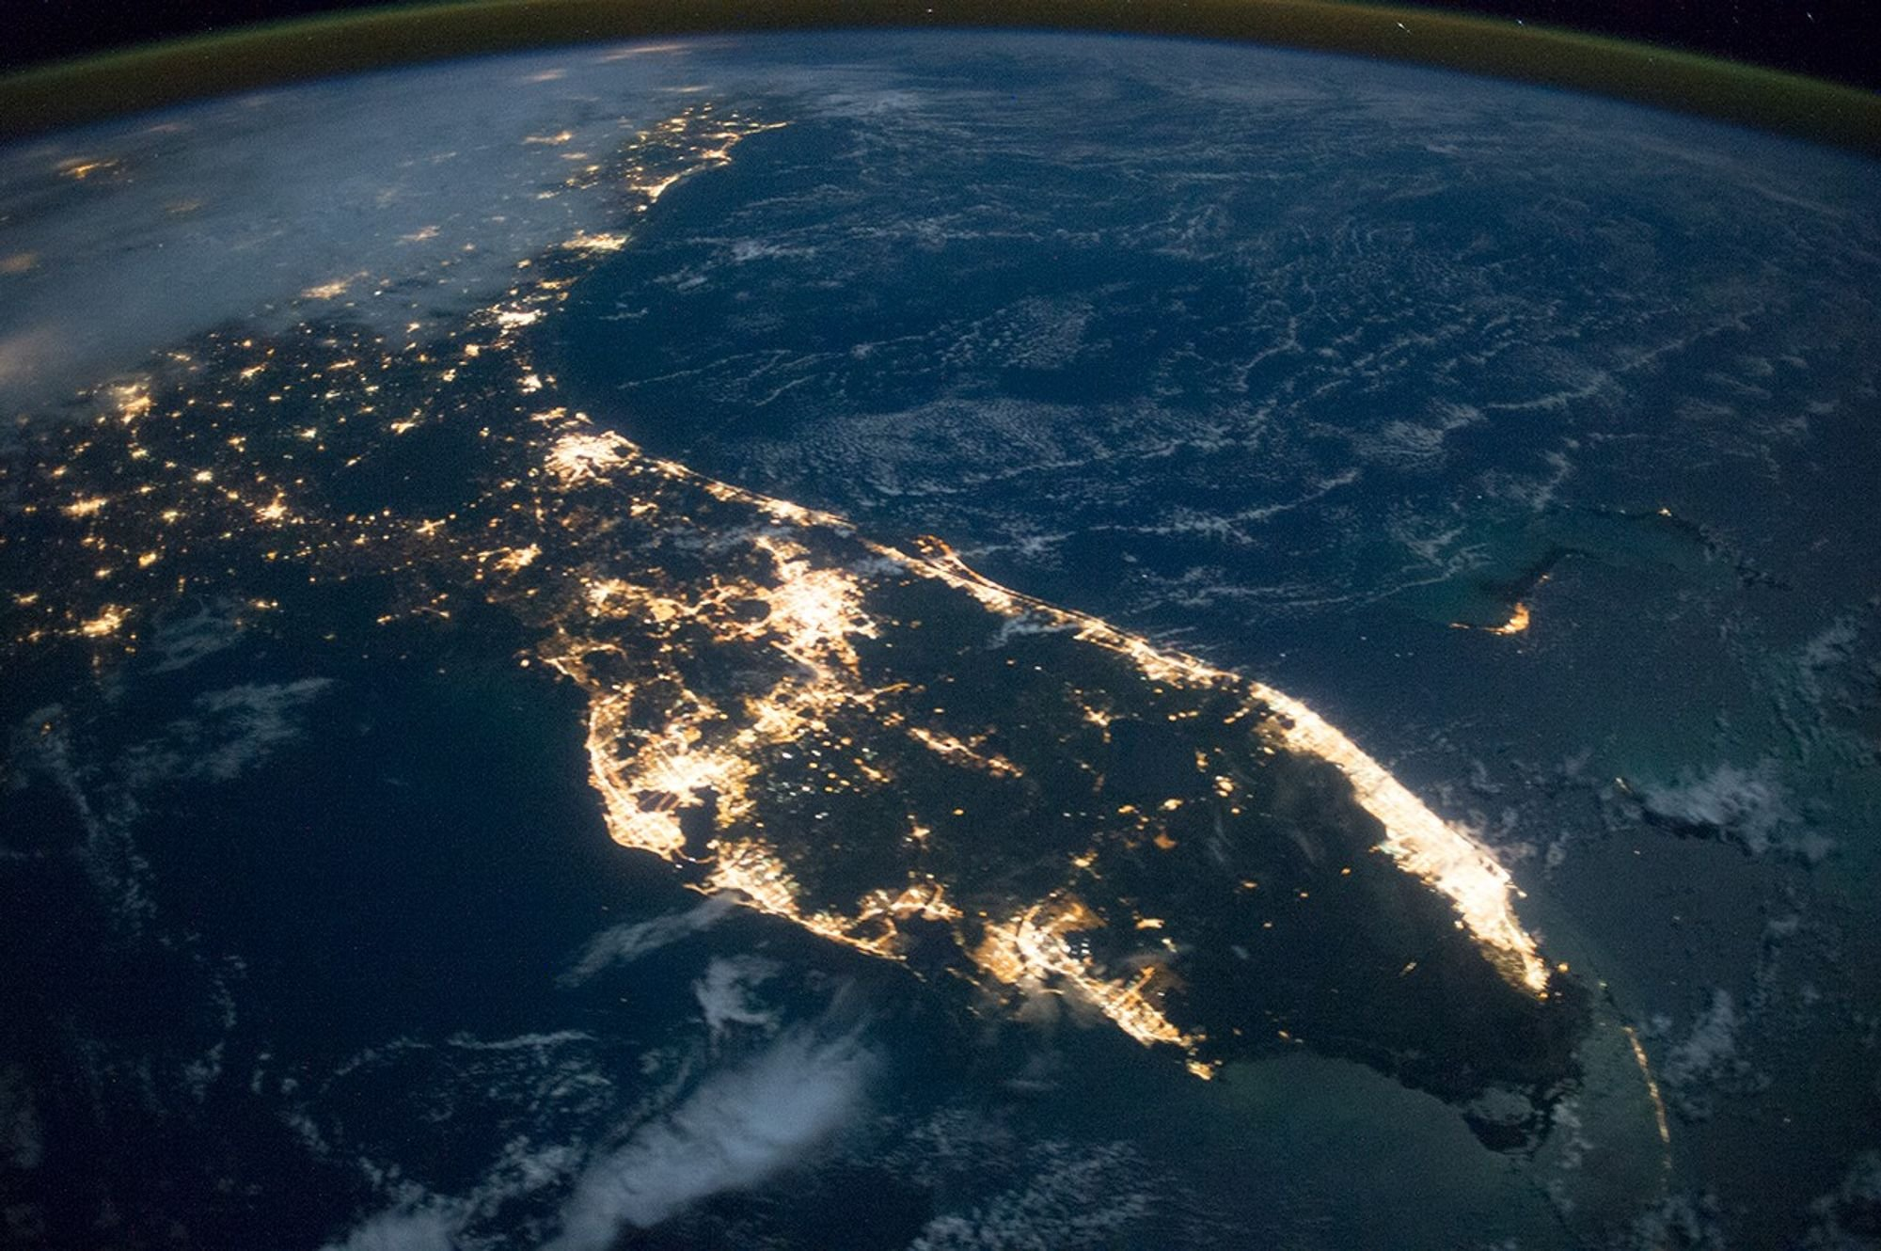
How many people we can help.
60M
live in Atlantic and Gulf coastal counties
22M
can't cover a $400 emergency with cash
14M
say they can't afford to evacuate
3.3M
adults displaced in one year, over half by hurricanes
22M and 14M apply national rates to coastal residents.
Sources: US Census 2017, Household Pulse 2022 · Federal Reserve SHED 2025 · YouGov, Oct 2024
Notes:
Start with scale. 60 million people live in Atlantic and Gulf coastal counties, the areas most exposed to hurricanes. Apply national numbers to that population: about 37 percent can't cover a 400 dollar emergency with cash, roughly 22 million people, and 24 percent say they couldn't afford to leave home for a few days, roughly 14 million people. In 2022 alone, 3.3 million adults were displaced by disasters, more than half by hurricanes, and nearly 1 million of them in Florida after Ian and Nicole. Make it human: during Milton, one couple found hotel rooms outside the storm's path at close to 1,000 dollars a night, ended up in a tent outside Pensacola, and still spent nearly 2,500 dollars. Sources: US Census 2019 and Household Pulse Survey 2022, Federal Reserve SHED 2025, YouGov October 2024, Grist 2024.

Slide 3
Built for every household.
63%
37%
24%
Ready
Stretched
Can't leave
can cover a $400 emergency with cash. Harbor makes it reachable in time.
can't cover it. Harbor builds a Storm Fund from round ups and moves bill dates.
can't afford to evacuate. Harbor finds them a free way out.
Groups overlap. Sources: Federal Reserve SHED 2025 · YouGov, Oct 2024
Notes:
Three segments with three different jobs. Ready: 63 percent can cover a 400 dollar emergency with cash; Harbor makes sure it's reachable in time. Stretched: 37 percent can't, so Harbor builds a Storm Fund from round ups during hurricane season and moves bill dates out of the evacuation window. Can't leave: 24 percent say they couldn't afford to evacuate at all, which is the next slide. Sources: Federal Reserve SHED 2025, YouGov poll of 2,379 US adults, October 8, 2024.

Slide 4



Money that moves with the forecast.
Watch
Prepare
Return
the forecast
the cash
after the storm
Tracks every hurricane advisory for your ZIP code.
Sizes your evacuation budget and puts it within reach. You approve with one tap.
Moves the money back when the all clear comes.
The customer never has to remember to open an app.
Notes:
Three steps. Harbor watches the hurricane forecast for your ZIP code, prepares the cash by sizing your evacuation budget and putting it in reach with one tap, and returns everything after the all clear. The customer never has to remember to open an app.

Slide 5
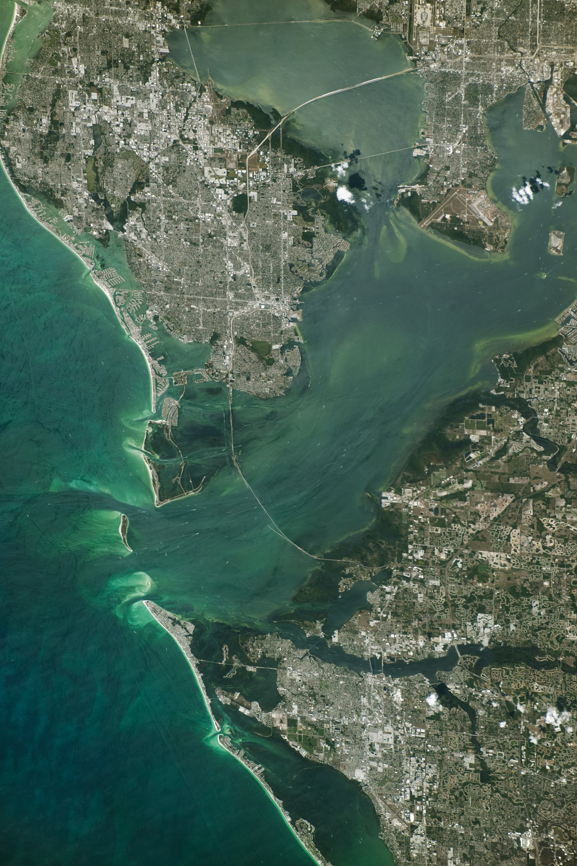




No money? A free way out.
Free buses
Registers you for county evacuation buses before signups close, 60 hours before landfall in Sarasota.
Pet friendly shelters
30% of Floridians who wouldn't evacuate cite their pets. Harbor routes to shelters that take them.
Family fund
Relatives send money instantly to one shared fund.
FEMA aid
Drafts the $790 Serious Needs Assistance claim after the storm.
Sources: Sarasota County via WGCU · AAA Florida survey, 2022 · FEMA, 2025
Notes:
For people with nothing to move, Harbor works on information and timing. It signs them up for free county evacuation buses before registration closes; Sarasota's buses take pets but registration closes 60 hours before landfall. Thirty percent of Floridians who wouldn't evacuate cite their pets, so Harbor routes to pet friendly and special needs shelters. Relatives can send money instantly to a family fund. After the storm, Harbor drafts FEMA's Serious Needs Assistance, a one time 790 dollar payment for disasters declared since October 2025. Sources: Sarasota County via WGCU, AAA Florida survey 2022, FEMA Federal Register notice 2025.

Slide 6
Everyone else shows up after.
Automatic
Parametric insurance
harbor
Automatic, but pays after the event
Before landfall, automatic once approved
Manual
FEMA aid, credit cards
Bank tips, savings apps
You apply, or you take on debt
Early, but the customer has to act
After the storm
Before landfall
Notes:
Name the real alternatives. FEMA aid and credit cards help after the storm, and you do the work: applications, or debt. Parametric insurance pays automatically, but only after the event. Bank storm tips and savings apps come before, but rely on the customer to act. Harbor is the only one in the top right: before landfall, and automatic once approved.

Slide 7
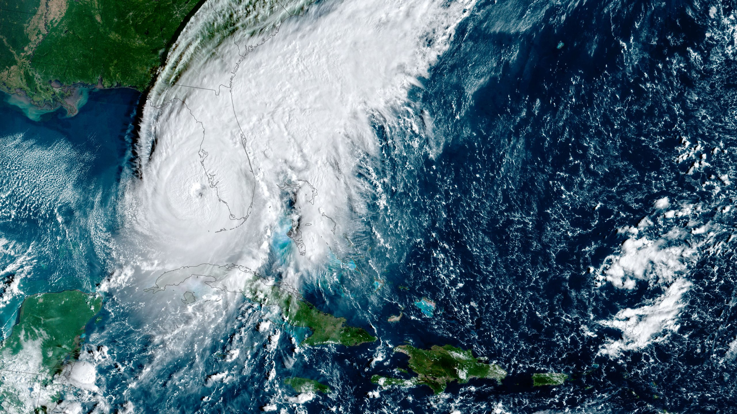
A $720M market. Paid by banks.
harbor
$720M
$40M
$12M
TAM
SAM
SOM
60M coastal residents
3.3M adults displaced each year
one bank partner, 1M coastal customers
Harbor estimates at $1 per customer per month, paid by banks · US Census 2017, Household Pulse 2022
Notes:
Revenue at one dollar per customer per month, paid by bank partners, never by customers. Total: 60 million residents of Atlantic and Gulf coastal counties, 720 million dollars a year. Serviceable: 3.3 million adults displaced by disasters in a year, about 40 million dollars. Obtainable: one bank partner with a million coastal customers, 12 million dollars. These dollar figures are our estimates.

