Slide 1

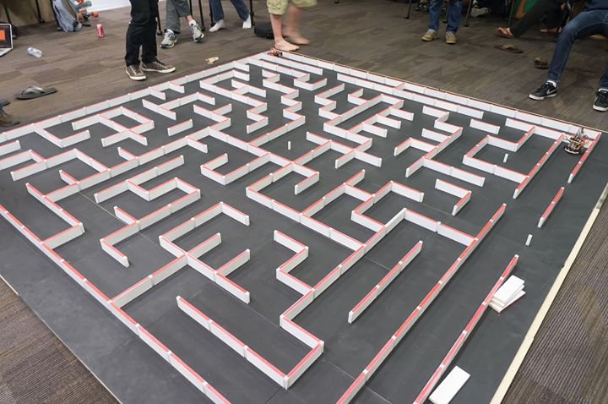
EE 190 Final Project – Micromouse Controller PCB
By Matthew Lumantas and
Sergio Morales

Slide 2
Motivation
Building a micromouse controller from the ground up
Create a practical PCB
Apply skills learned in the course throughout the quarter

Slide 3
Process
Figure out what parts would be compatible with motors, drivers, microcontroller, etc.
Draft schematic
Create board from schematic
Run DRC/ERC
Revise!

Slide 4
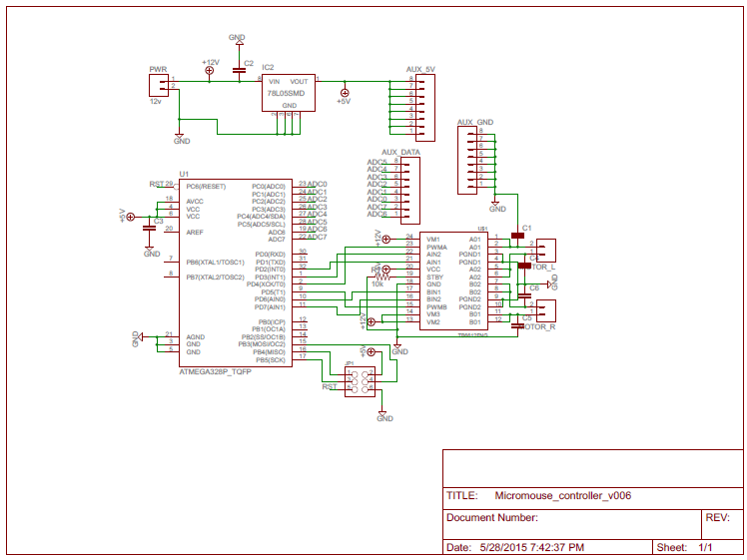
Design - Schematic
Got the following result for the schematic:

Slide 5
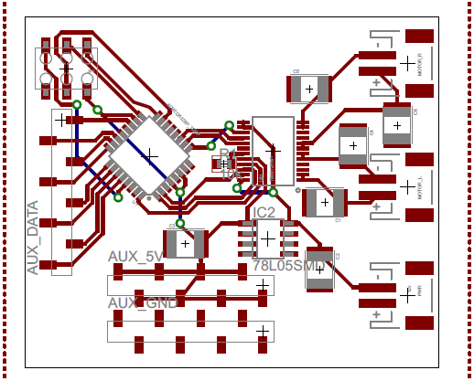
Design - Board
Got the following result for the board:

Slide 6
Conclusion

