Slide 1
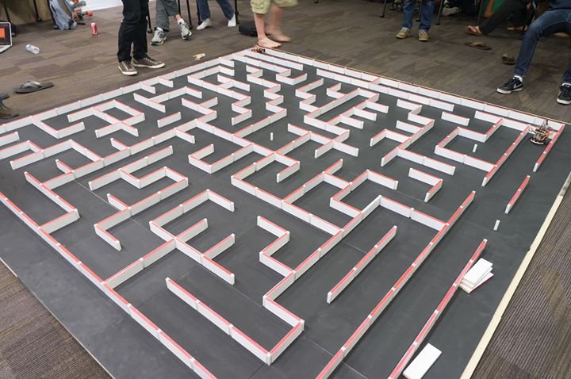
EE 190 Final Project – Micromouse Controller PCB
By Matthew Lumantas and
Sergio Morales

Slide 2
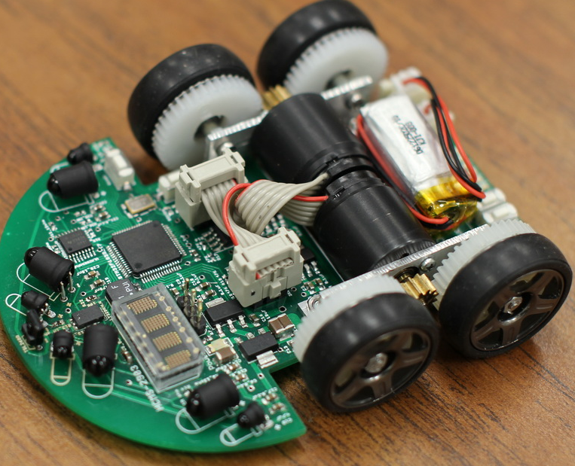
Motivation
Build a general-use micromouse controller from the ground up
Design allows for many different configurations
Create a practical PCB
Apply skills learned in the course throughout the quarter
Design schematic for particular requirements
Connect a large number of pins in an efficient manner
The first Micromouse... that showed up on Google

Slide 3
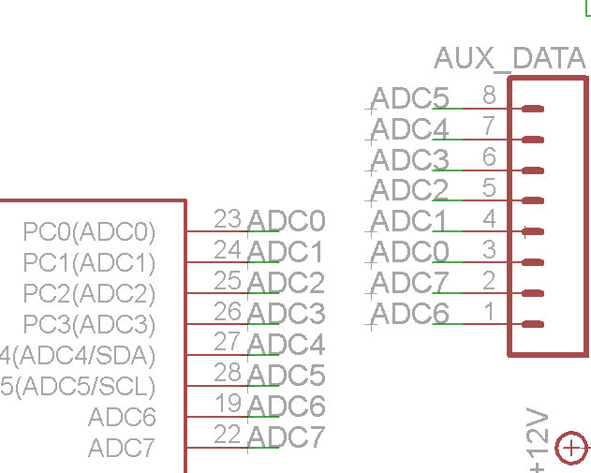
Schematic Design Process
Figure out what parts would be compatible with motors, drivers, microcontroller, etc.
Requirements consisted of:
2 motors
As many Analog or Digital
I/O ports as possible
Draft schematic
Follow manufacturer datasheets for pinouts, voltages, etc.
Run DRC
Revise!
Shortcuts

Slide 4
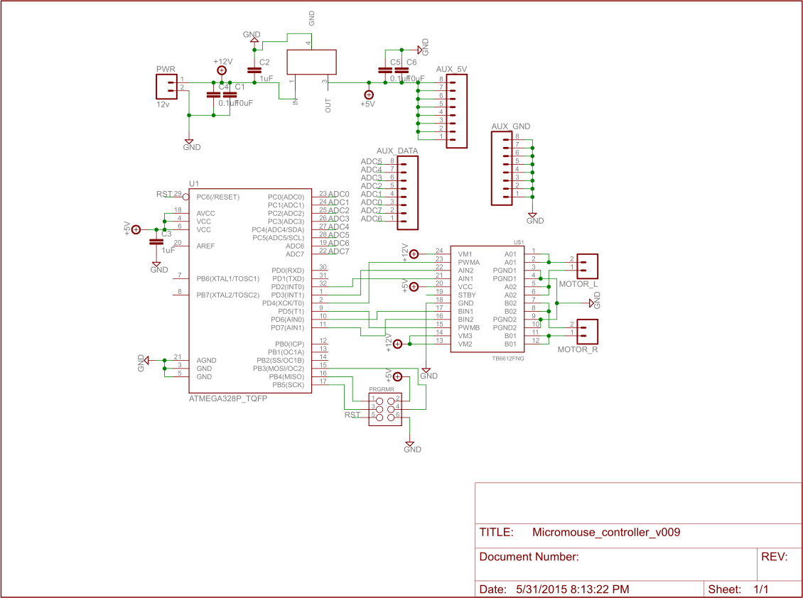
Schematic Design
3 Primary
Components:
Power System
Microcontroller
Motor Driver

Slide 5
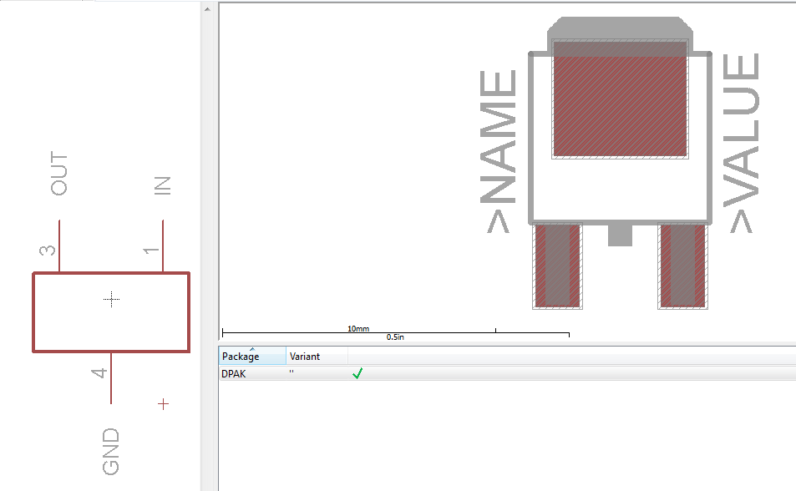
Schematic Design Difficulties
Learning how each component works
Constant referral to manufacturer datasheets
The selected voltage regulator did not have an EAGLE component
Used ref_package.lbr to find package for component and created own
Custom component using
DPAK package

Slide 6
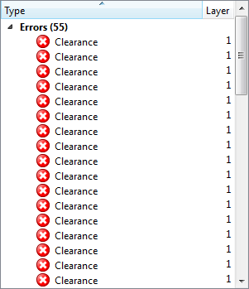
Board Design Process
Create board from schematic
Position components for various needs:
Ease of routing
Efficient use of board space
As few vias as possible
Run ERC
Revise!
ERC of an early version

Slide 7
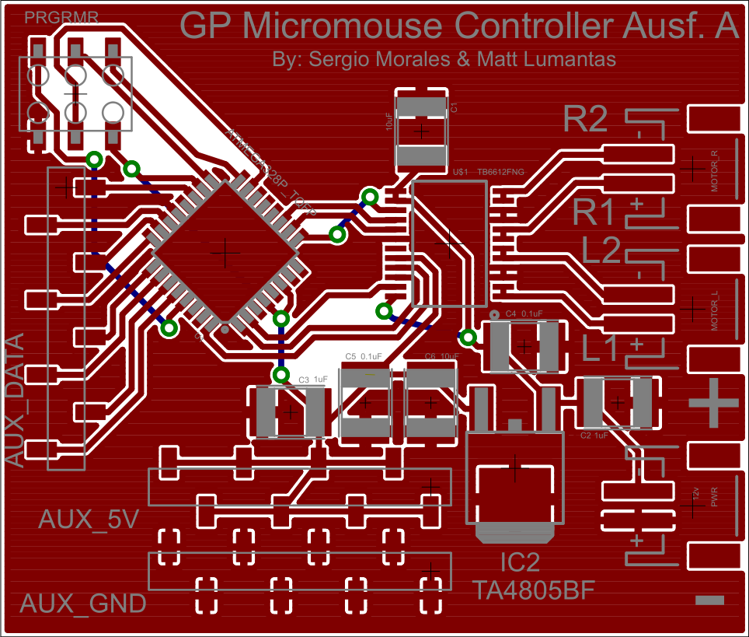
Board Design
2 Primary Areas:
Power I/O
Microcontroller & Data ports

Slide 8
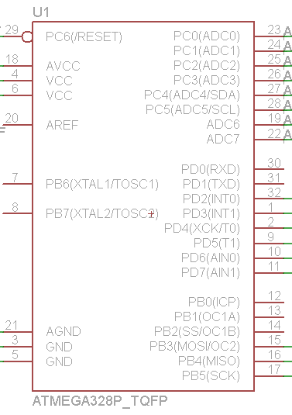
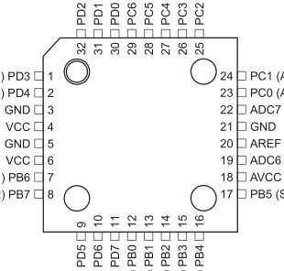
Board Design Difficulties
Confusing arrangement of pins in schematic vs. board for ICs
General routing and positioning problems
Physical pins
vs. Schematic pins

Slide 9

Bill of Materials
ATmega328p Microcontroller
TB6612FNG Motor Controller
TA4805BF Linear Voltage Regulator (5v)
Various headers for power I/O and data I/O
Various capacitors for noise filtering
Total Price: $ 24.64
Why the heck are 8-pin connectors so expensive?

